Slide 1
Stats for Engineers Lecture 7

Slide 2
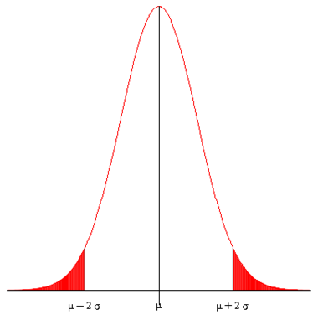
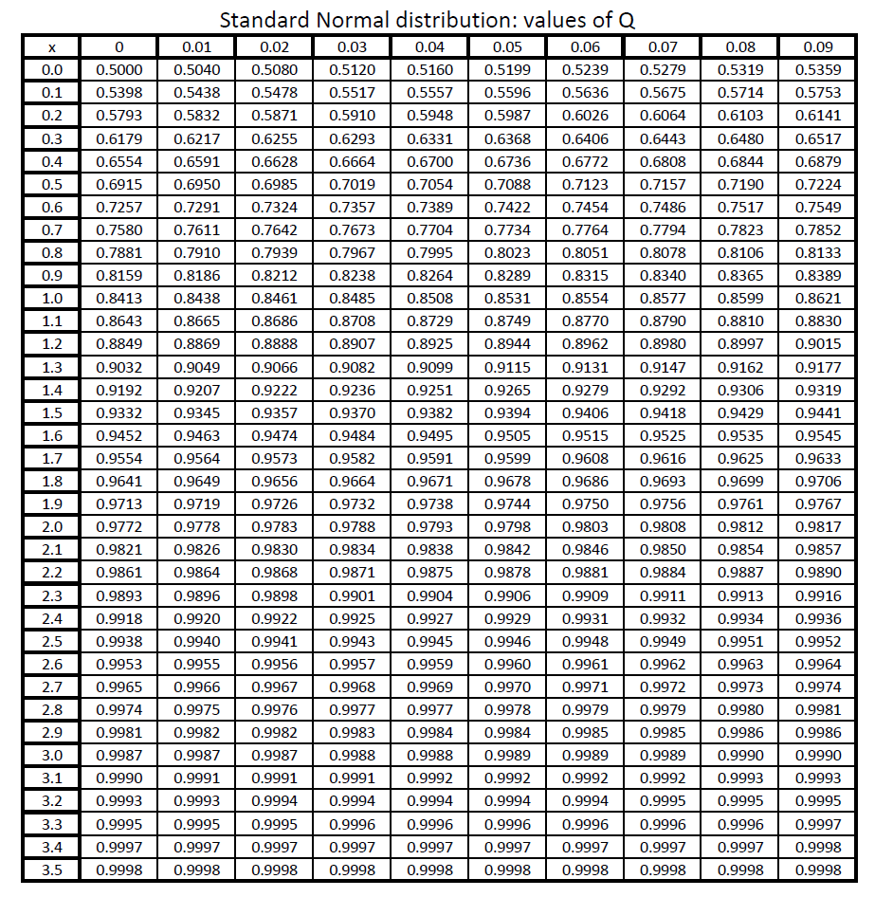
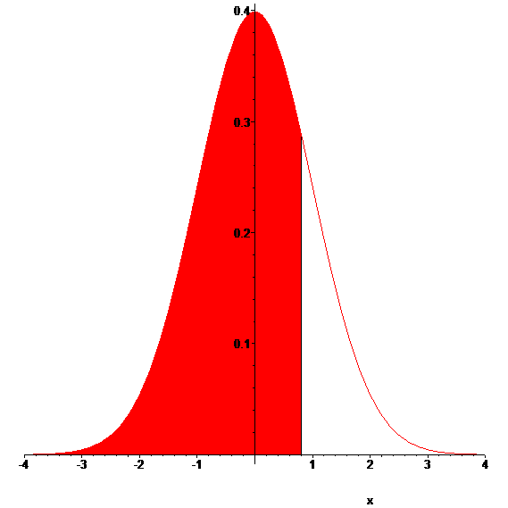
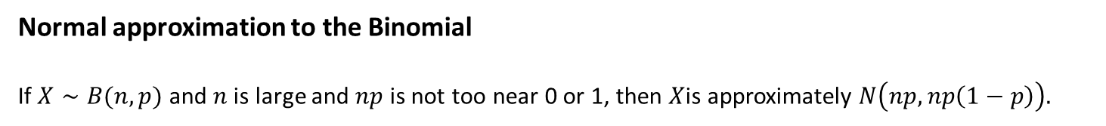

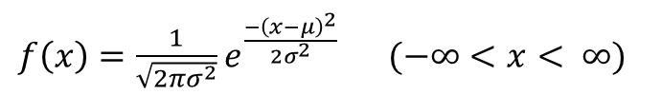


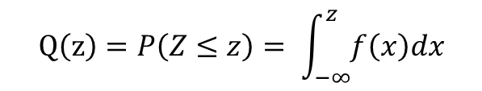

Summary From Last Time
Normal/Gaussian distribution
$f\left(x\right)=\frac{1}{\sqrt{2πσ^{2}}}e^{\frac{{−\left(x−μ\right)}^{2}}{2σ^{2}}} (−∞<x< ∞)$
$$σ$$
$μ:$ mean
$σ:$ standard deviation
$Z=\frac{X−μ}{σ}∼N(0,1)$
$$Q\left(z\right)=P\left(Z≤z\right)= \int_{−∞}^{z}{f\left(x\right)dx}$$
Q
Central Limit Theorem: Sums of independent random variables tends to normal distribution as you add many
Normal approximation to the Binomial
If $X∼B(n,p)$ and $n$ is large and $np$ is not too near 0 or 1, then $X$is approximately $N\left(np,np\left(1−p\right)\right).$

Slide 3
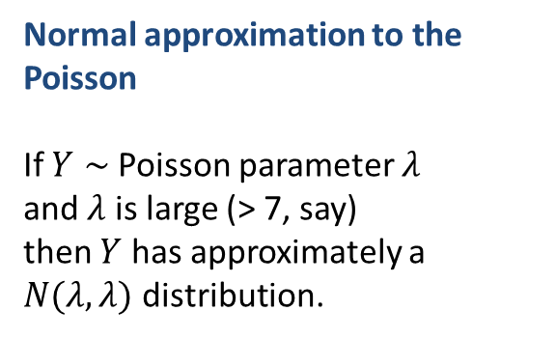
Normal approximation to the Poisson
If $Y∼$Poisson parameter $λ$
and $λ$ is large (> 7, say)
then $Y$ has approximately a $N(λ,λ)$ distribution.

Slide 4





Example: Stock Control
At a given hospital, patients with a particular virus arrive at an average rate of once every five days. Pills to treat the virus (one per patient) have to be ordered every 100 days. You are currently out of pills; how many should you order if the probability of running out is to be less than 0.005?
Solution
Assume the patients arrive independently, so this is a Poisson process, with rate 0.2/day.
Therefore, Y, number of pills needed in 100 days, ~ Poisson, $λ$= 100 x 0.2 = 20.
We want
$P\left(Y>n\right)< 0.005$ $⇒P\left(Y≤n\right)>0.995$
Normal approximation, find $X$ so that $P\left(X≤n+\frac{1}{2}\right)>0.995$
Using table:
$$Q\left(z\right)=0.995⇒z=2.575$$
$$z=\frac{x−μ}{σ}$$
$$μ=σ=λ$$
$$⇒ n+\frac{1}{2}=x=20+2.575\sqrt{20}=31.5$$
Need to order $n≥32$pills to be safe.

Slide 5
Variation
Let’s say the virus is deadly, so we want to make sure the probability is less than 1 in a million, 10⁻⁶. How many pills do we need to order?
A normal approximation would give 4.7$σ$ above the mean, so $n≥42$ pills
But surely getting just a bit above twice the average number of cases is not that unlikely?? (42 pills can treat 0.42 people a day on average)
Yes indeed, the assumption of independence is extremely unlikely to be valid.
(viruses often infectious!)
i.e. the normal approximation result is wrong because we made an inaccurate assumption
Don’t use approximations that are too simple if their failure might be important!
Rare events in particular are often a lot more likely than predicted by (too-) simple approximations for the probability distribution.

Slide 6

Normal distribution summary
Central limit theorem means Normal distribution is ubiquitous
- Sums and averages of random variables tend to a normal distribution for large $n$
- Sums of Normal variates also have Normal distributions
- Normal is useful approximation to Binomial and Poisson for large $n$
$$Z=\frac{X−μ}{σ}$$
- Calculate integrals using tables of Q standard normal variable

Slide 7
Descriptive Statistics
Types of data
A variate or random variable is a quantity or attribute whose value may vary
There are various types of variate:
Qualitative or nominal; described by a word or phrase (e.g. blood group, colour)
Quantitative; described by a number
(e.g. time till cure, number of calls arriving at a telephone exchange in 5 seconds)
Ordinal; this is an "in-between" case. Observations are not numbers but they can be ordered (e.g. much improved, improved, same, worse, much worse)

Slide 8
Quantitative data can be:
Discrete: the variate can only take one of a finite or countable number of values (e.g. a count)
Continuous: the variate is a measurement which can take any value in an interval of the real line (e.g. a weight).

Slide 9
Discrete data: frequency table and bar chart
The frequency of a value is the number of observations taking that value.
A frequency table is a list of possible values and their frequencies.
A bar chart consists of bars corresponding to each of the possible values, whose heights are equal to the frequencies.

Slide 10
e.g. Discrete data: frequency table and bar chart
Number of accidents | Tallies | Frequency
0 | |||| |||| |||| |||| |||| |||| |||| |||| |||| |||| |||| | 55
1 | |||| |||| |||| | 14
2 | |||| | 5
3 | || | 2
4 |  | 0
5 | || | 2
6 | | | 1
7 |  | 0
8 | | | 1

Slide 11
Continuous data: histograms
When the variate is continuous, we do not look at the frequency of each value, but group the values into intervals. The plot of frequency against interval is called a histogram. Be careful to define the interval boundaries unambiguously.
Example
The following data are the left ventricular ejection fractions (LVEF) for a group of 99 heart transplant patients.
Construct a frequency table and histogram.
62 64 63 70 63 69 65 74 67 77 65 72 65
77 71 79 75 78 64 78 72 32 78 78 80 69
69 65 76 53 74 78 59 79 77 76 72 76 70
76 76 74 67 65 79 63 71 70 84 65 78 66
72 55 74 79 75 64 73 71 80 66 50 48 57
70 68 71 81 74 74 79 79 73 77 80 69 78
73 78 78 66 70 36 79 75 73 72 57 69 82
70 62 64 69 74 78 70 76
Frequency table
LVEF | Tallies | Frequency
24.5 - 34.5 | | | 1
34.5 - 44.5 | | | 1
44.5 - 54.5 | ||| | 3
54.5 - 64.5 | |||| |||| ||| | 13
64.5 - 74.5 | |||| |||| |||| |||| |||| |||| |||| |||| |||| | 45
74.5 - 84.5 | |||| |||| |||| |||| |||| |||| |||| | | 36

Slide 12
Histogram

Slide 13
Things to look out for
Normally distributed data
Bimodality

Slide 14
Skewness
Outliers

Slide 15

Summary Statistics
Mean and variance, as for the distributions
BUT – now sample estimates, rather than population estimates
Sample mean
The sample mean of the values $x_{1},x_{2},…, x_{n}$is
$$\overline{x}=\frac{x_{1}+x_{2}+..x_{n}}{n}=\frac{1}{n}\sum_{i=1}^{n}{x_{i}}$$
This is just the average or arithmetic mean of the values. Sometimes the prefix "sample" is dropped, but then there is a possibility of confusion with the population mean which is defined later.

Slide 16


Frequency data: suppose that the frequency of the class with midpoint $x_{i}$ is $f_{i}$, for i = 1, 2, ..., m). Then
$$\overline{x}=\frac{f_{1}x_{1}+f_{2}x_{2}+…+f_{m}x_{m}}{n}=\frac{1}{n}\sum_{i=1}^{m}{f_{i}x_{i}}$$
Where $n=\sum_{i=1}^{m}{f_{i}}$ = total number of observations.
Example:
Number of accidents, | Frequency
0 | 55 | 0
1 | 14 | 14
2 | 5 | 10
3 | 2 | 6
4 | 0 | 0
5 | 2 | 10
6 | 1 | 6
7 | 0 | 0
8 | 1 | 8
TOTAL | 80 | 54
$$⇒\overline{x}=\frac{54}{80}=0.675$$

Slide 17
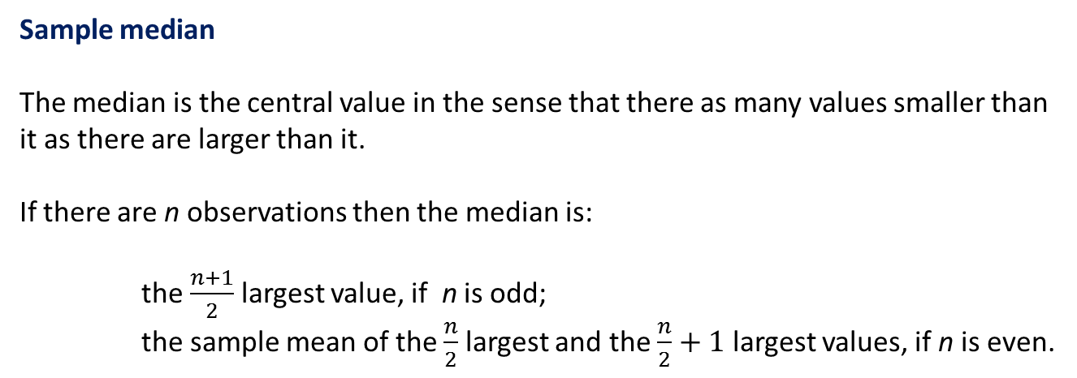
Sample median
The median is the central value in the sense that there as many values smaller than it as there are larger than it.
If there are n observations then the median is:
the $\frac{n+1}{2}$ largest value, if n is odd;
the sample mean of the $\frac{n}{2}$ largest and the $\frac{n}{2}+1$ largest values, if n is even.
Mode
The mode, or modal value, is the most frequently occurring value. For continuous data, the simplest definition of the mode is the midpoint of the interval with the highest rectangle in the histogram. (There is a more complicated definition involving the frequencies of neighbouring intervals.) It is only useful if there are a large number of observations.

Slide 18
Comparing mean, median and mode
Symmetric data: the mean median and mode will be approximately equal.
Skew data:
Tail of high values: positive skew
Tail of low values: negative skew
IFS Briefing Note No 73
Mode
The median is less sensitive than the mean to extreme observations. The mode ignores them.

Slide 19
Comparing mean, median and mode
Symmetric data: the mean median and mode will be approximately equal.
Skew data:
Tail of high values: positive skew
Tail of low values: negative skew
IFS Briefing Note No 73
Mode
The median is less sensitive than the mean to extreme observations. The mode ignores them.

Slide 20

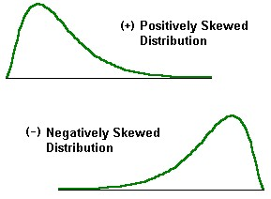

Location of the mean
A distribution has many more events above the mean than below the mean. What can be said about this distribution?
Question from Murphy et al.
The distribution is positively skewed.
The distribution is negatively skewed.
The distribution is symmetric.
30
Countdown

Slide 21
Statistical Inference
Probability theory: the probability distribution of the population is known; we want to derive results about the probability of one or more values ("random sample") - deduction.
Statistics: the results of the random sample are known; we want to determine something about the probability distribution of the population - inference.
In order to carry out valid inference, the sample must be representative, and preferably a random sample.
Random sample: (i) no bias in the selection of the sample;
(ii) different members of the sample chosen independently.
Formal definition of a random sample: $X_{1},X_{2},…X_{n}$ are a random sample if each $X_{i}$ has the same distribution and the $X_{i}$'s are all independent.

Slide 22
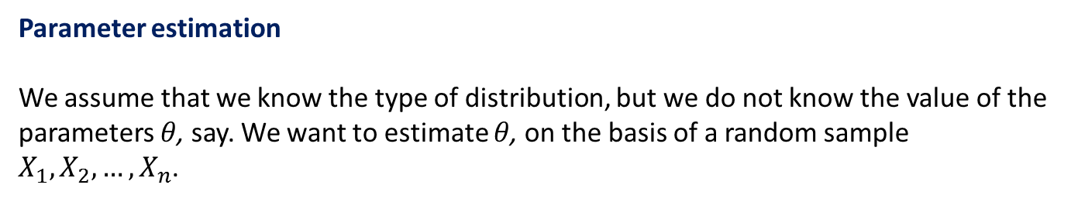




Parameter estimation
We assume that we know the type of distribution, but we do not know the value of the parameters $θ$, say. We want to estimate $θ$, on the basis of a random sample $X_{1},X_{2},…,X_{n}$.
For example we may want to estimate the population mean, $θ=μ.$
Let’s call the random sample $X_{1},X_{2},…,X_{n}$ our data D.
Given the data, what are the parameters?
Want to infer $P\left(θ | D\right):$
$$\text{P}\text{(}\text{θ}\text{|}\text{D}\text{) = }\frac{\text{P}\text{(}\text{D}\text{|}\text{θ}\text{)}\text{P}\text{(}\text{θ}\text{)}}{\text{P}\text{(}\text{D}\text{)}}$$
$P(D|θ)$: Likelihood
Bayes’ theorem
$P\left(θ\right):$ Prior
Normalization constant
How do we quickly get values of $θ$ that are probable given our data?

Slide 23
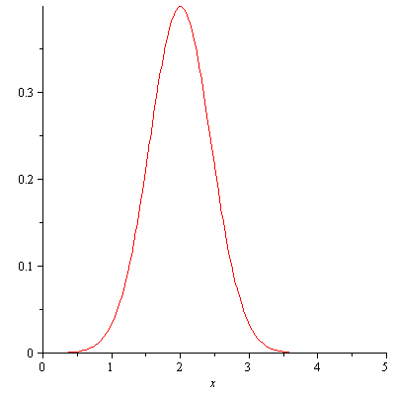
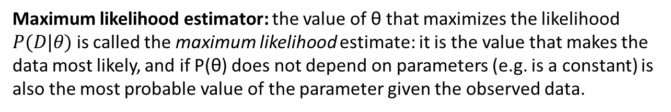
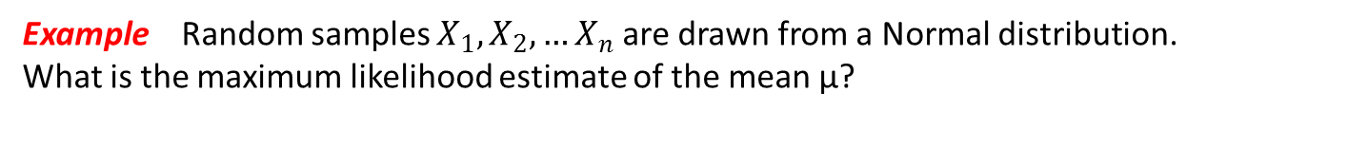
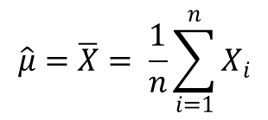



Maximum likelihood estimator: the value of θ that maximizes the likelihood $P(D|θ)$ is called the maximum likelihood estimate: it is the value that makes the data most likely, and if P(θ) does not depend on parameters (e.g. is a constant) is also the most probable value of the parameter given the observed data.
$$P(μ|D)$$
$$μ$$
$$\hat{μ}$$
Example Random samples $X_{1},X_{2},…X_{n}$ are drawn from a Normal distribution.
What is the maximum likelihood estimate of the mean μ?
$$\hat{μ}=\overline{X}= \frac{1}{n}\sum_{i=1}^{n}{X_{i}}$$
Answer: Sample mean:
[see notes]

Slide 24
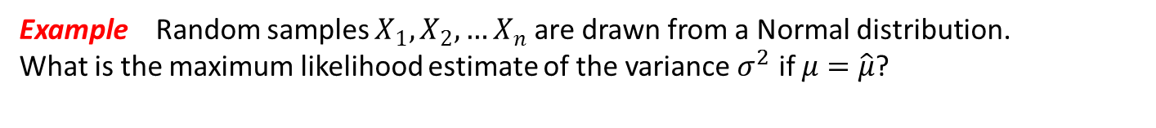
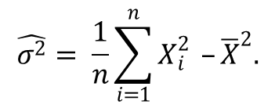
Example Random samples $X_{1},X_{2},…X_{n}$ are drawn from a Normal distribution.
What is the maximum likelihood estimate of the variance $σ^{2}$ if $μ=\hat{μ}$?
Answer:
$$\hat{σ^{2}}= \frac{1}{n}\sum_{i=1}^{n}{X_{i}^{2} }–{\overline{X}}^{2}.$$
But is this a good way to estimate the variance from a random sample?

Slide 25
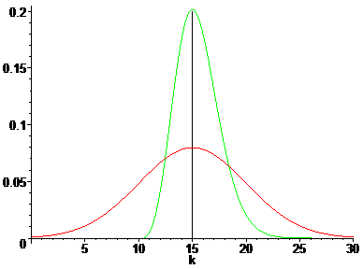

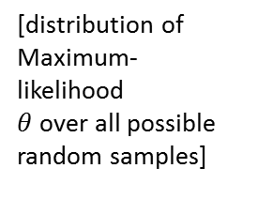
Comparing estimators
What are good properties of an estimator?
Efficient: estimate close to true value with most sets of data random data samples
Unbiased: on average (over possible data samples) it gives the true value
The estimator $\hat{θ}$ is unbiased for $θ$ if $E\left(\hat{θ}\right)=θ$ for all values of$θ$.
True mean
A good but biased estimator
$$P(\hat{θ})$$
[distribution of
Maximum-likelihood
$θ$ over all possible random samples]
A poor but unbiased estimator

Slide 26
Estimators
I want to estimate the mean IQ (measured by a standard test) of all adults in Britain, by averaging the test results of a sample of people.
Which of the following samples is likely to give closest to an unbiased estimator?
100 randomly selected University of Sussex students
The first two adults that answer the phone when I start dialling random numbers
The people who respond to a national newspaper advert asking for volunteers
30
Countdown

Slide 27



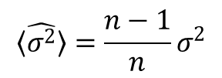
Result: $\hat{μ}=\overline{X}$ is an unbiased estimator of $μ$.
$$〈\overline{X}〉=〈\frac{1}{n}\left(X_{1}+…+X_{n}\right)〉=μ$$
Result:$\hat{σ^{2}}$ is a biased estimator of σ²
$$〈\hat{σ^{2}}〉=\frac{n−1}{n}σ^{2}$$
[proof in notes]

Slide 28
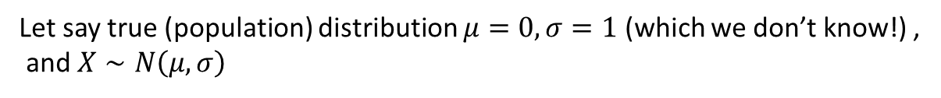

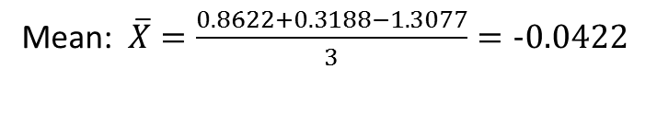
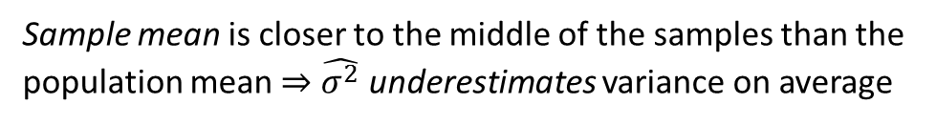
Example
Let say true (population) distribution $μ=0,σ=1$ (which we don’t know!) ,
and $X∼N\left(μ,σ\right)$
We collect three samples giving
0.8622 0.3188 -1.3077
Given this data we want to estimate $σ$ and $μ$
Mean: $\overline{X}=\frac{0.8622+0.3188−1.3077}{3}=−0.0422$
Variance: $\hat{σ^{2}}= \frac{1}{n}\sum_{i=1}^{n}{{\left(X_{i}^{}−\overline{X}\right)}^{2}=}\frac{{0.9044}^{2}+{0.3610}^{2} −{1.2655}^{2}}{3}=$0.8499
But if we knew the true mean we would have got
$\frac{1}{n}\sum_{i=1}^{n}{{\left(X_{i}^{}−0\right)}^{2}=}\frac{{0.7434}^{2}+{0.1016}^{2} −{1.7101}^{2}}{3}=$ 0.8517
Sample mean is closer to the middle of the samples than the
population mean $⇒$ $\hat{σ^{2}}$ underestimates variance on average
i.e. if we collected lots of sets of three samples, $\hat{σ^{2}}$ would not average to the right answer: it is biased

Slide 29
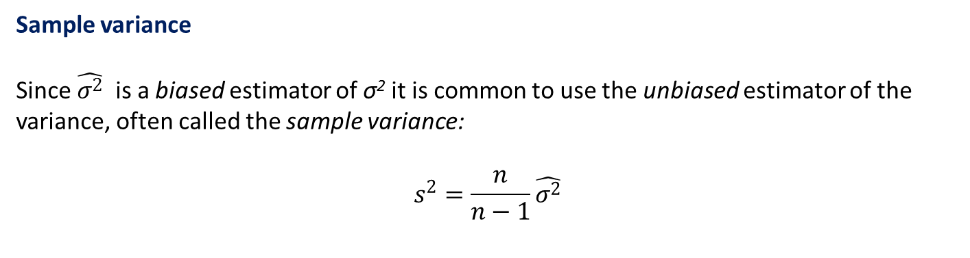

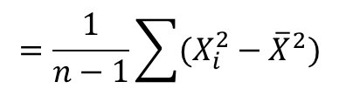
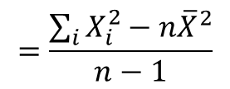
Sample variance
Since $\hat{σ^{2}}$ is a biased estimator of σ² it is common to use the unbiased estimator of the variance, often called the sample variance:
$$s^{2}=\frac{n}{n−1}\hat{σ^{2}}$$
$$=\frac{n}{n−1}\frac{1}{n}\sum{{\left(X_{i}− \overline{X}\right)}^{2} }$$
$$=\frac{1}{n−1}\sum{(X_{i}^{2}}−{\overline{X}}^{2})$$
$$=\frac{\sum_{i}{X_{i}^{2}}−n{\overline{X}}^{2}}{n−1}$$

Slide 30

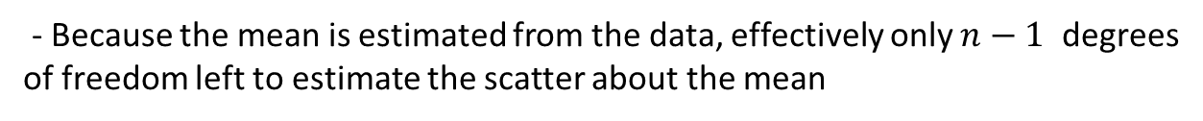
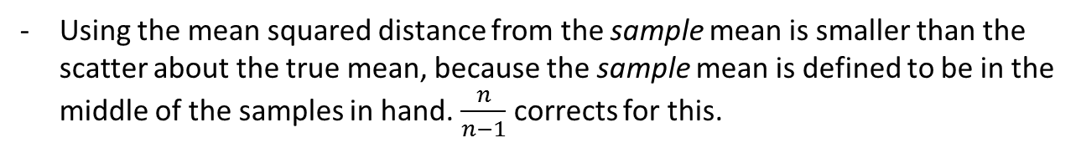
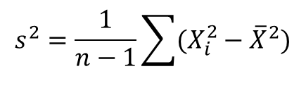
$$s^{2}=\frac{1}{n−1}\sum{(X_{i}^{2}}−{\overline{X}}^{2})$$
Why the $n−1$?
- Because the mean is estimated from the data, effectively only $n−1$ degrees
of freedom left to estimate the scatter about the mean
Using the mean squared distance from the sample mean is smaller than the scatter about the true mean, because the sample mean is defined to be in the middle of the samples in hand. $\frac{n}{n−1}$ corrects for this.

Slide 31
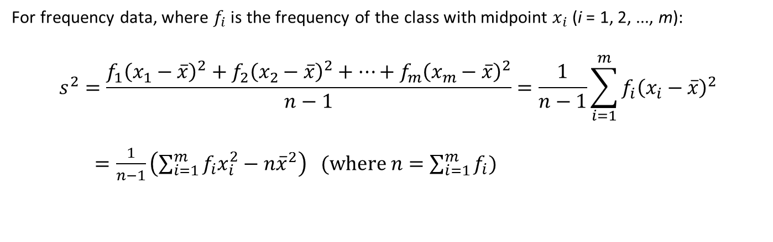
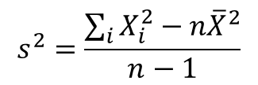
Sample variance is
$$s^{2}=\frac{\sum_{i}{X_{i}^{2}}−n{\overline{X}}^{2}}{n−1}$$
For frequency data, where $f_{i}$ is the frequency of the class with midpoint $x_{i}$ (i = 1, 2, ..., m):
$$s^{2}=\frac{f_{1}{\left(x_{1}−\overline{x}\right)}^{2}+f_{2}{\left(x_{2}−\overline{x}\right)}^{2}+…+f_{m}{\left(x_{m}−\overline{x}\right)}^{2}}{n−1}=\frac{1}{n−1}\sum_{i=1}^{m}{f_{i}{\left(x_{i}−\overline{x}\right)}^{2}}$$
$=\frac{1}{n−1}\left(\sum_{i=1}^{m}{f_{i}x_{i}^{2}}−n{\overline{x}}^{2}\right) (where n=\sum_{i=1}^{m}{f_{i}})$
Standard Deviation: square root of the sample variance $s=\sqrt{sample variance}$.

Slide 32

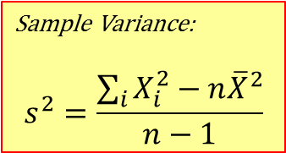
Sample variance
A sample of three random batteries had lifetimes of 2, 6 and 4 hours.
What is the sample variance of the lifetime?
4
8/3
2
22
3
Sample Variance:
$$s^{2}=\frac{\sum_{i}{X_{i}^{2}}−n{\overline{X}}^{2}}{n−1}$$
60
Countdown

Slide 33


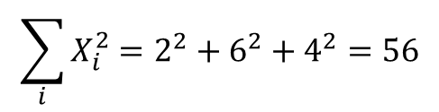
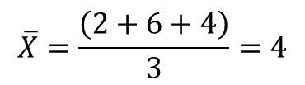
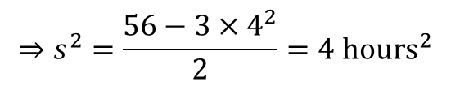
Sample variance
A sample of three random batteries had lifetimes of 2, 6 and 4 hours.
What is the sample variance of the lifetime?
Want $s^{2}=\frac{\sum_{i}{X_{i}^{2}}−n{\overline{X}}^{2}}{n−1}$ with $n=3$
$$\sum_{i}{X_{i}^{2}}=2^{2}+6^{2}+4^{2}=56$$
$$\overline{X}=\frac{\left(2+6+4\right)}{3}=4$$
$$⇒s^{2}=\frac{56−3×4^{2}}{2}=4 {hours}^{2}$$

Slide 34
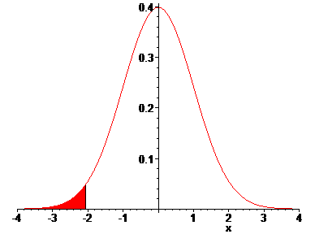
Percentiles and the interquartile range
The kth percentile is the value corresponding
to cumulative frequency of k/100
0.02 percentile

Slide 35
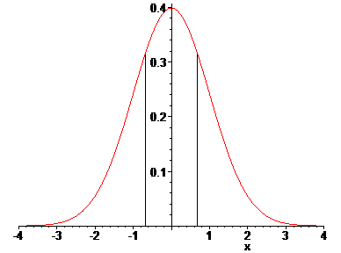
A quartile corresponds to 25% of the cumulative frequency
-2nd quartile corresponds 50%, 3rd quartile corresponds to 75%
2nd quartile
3rd quartile
1st quartile
The interquartile range of a set of data is the difference between the third quartile and the first quartile
It is the range within which the "middle half" of the data lie, and so is a measure of spread which is not too sensitive to one or two outliers.
Interquartile range

Slide 36
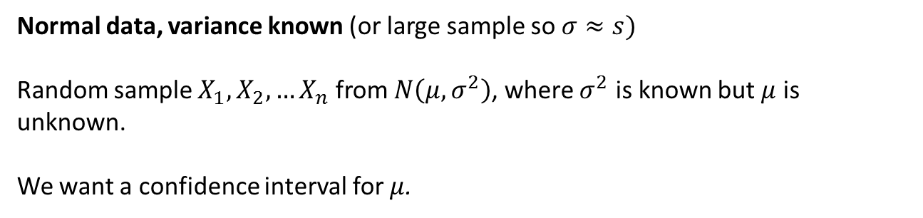

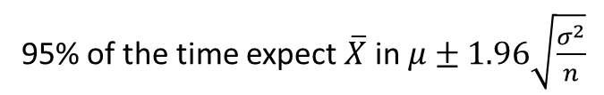
Confidence Intervals
Some interval we are “pretty sure” a parameter lies.
Confidence Interval for the mean
Normal data, variance known (or large sample so $σ≈s)$
Random sample $X_{1},X_{2},…X_{n}$ from $N\left(μ, σ^{2}\right)$, where $σ^{2}$ is known but $μ$ is unknown.
We want a confidence interval for $μ$.
Reminder: $\overline{X}∼N(μ,\frac{σ^{2}}{n})$
With probability 0.95, a Normal random variables lies within 1.96 standard deviations of the mean.
P=0.025
P=0.025
95% of the time expect $\overline{X}$ in $μ±1.96\sqrt{\frac{σ^{2}}{n}}$

Slide 37
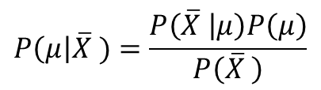
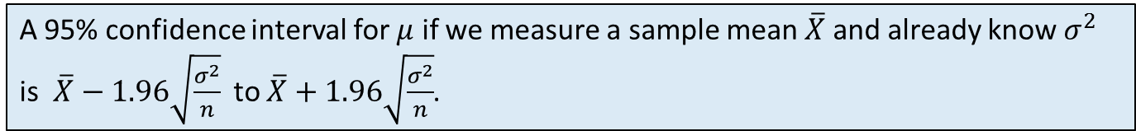
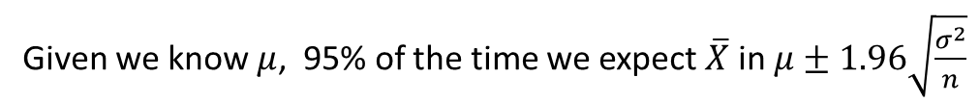

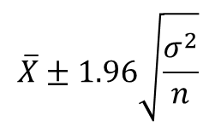
Given we know $μ$, 95% of the time we expect $\overline{X}$ in $μ±1.96\sqrt{\frac{σ^{2}}{n}}$
Now we measure $\overline{X}$ and want to infer a confidence interval for the unknown $μ$
What we want is a confidence interval for $μ$ given $\overline{X}.$
$$P\left(μ\right|\overline{X} )=\frac{P\left(\overline{X} | μ\right)P\left(μ\right)}{P\left(\overline{X} \right)}$$
Bayes’ theorem
If the prior on μ is constant, then $P\left(μ\right|\overline{X} )∝P\left(\overline{X}\right|μ )$
$⇒P\left(μ\right|\overline{X} )$ is also a Normal distribution with mean $\overline{X}$ and the same standard deviation
$$\overline{X}±1.96\sqrt{\frac{σ^{2}}{n}}$$
$⇒$ 95% confidence interval for $μ$ is
A 95% confidence interval for $μ$ if we measure a sample mean $\overline{X}$ and already know $σ^{2}$ is $\overline{X}−1.96\sqrt{\frac{σ^{2}}{n}}$ to $\overline{X}+1.96\sqrt{\frac{σ^{2}}{n}}$.
Frequency interpretation: If we were to measure a large number of different data samples, then on average 95% of the confidence intervals we computed would contain the true mean.

Slide 38
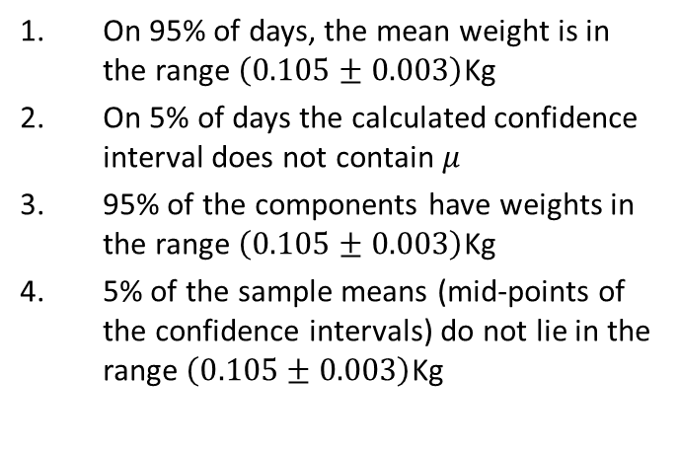
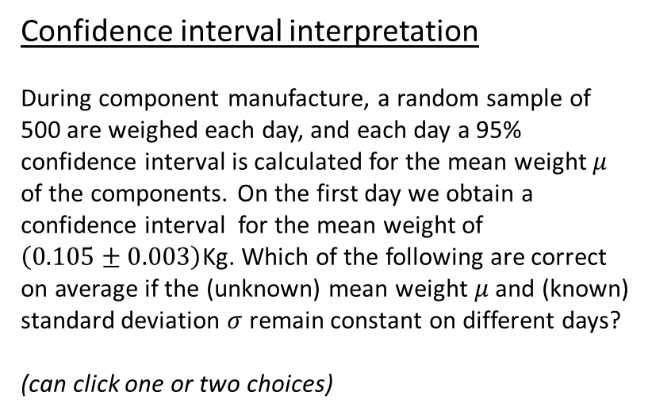
Confidence interval interpretation
During component manufacture, a random sample of 500 are weighed each day, and each day a 95% confidence interval is calculated for the mean weight $μ$ of the components. On the first day we obtain a confidence interval for the mean weight of $\left(0.105±0.003\right)$Kg. Which of the following are correct on average if the (unknown) mean weight $μ$ and (known) standard deviation $σ$ remain constant on different days?
(can click one or two choices)
On 95% of days, the mean weight is in the range $\left(0.105±0.003\right)$Kg
On 5% of days the calculated confidence interval does not contain $μ$
95% of the components have weights in the range $\left(0.105±0.003\right)$Kg
5% of the sample means (mid-points of the confidence intervals) do not lie in the range $\left(0.105±0.003\right)$Kg
60
Countdown

Slide 39


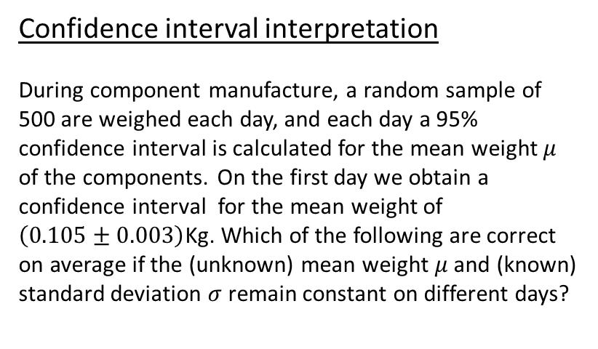
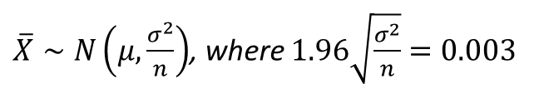
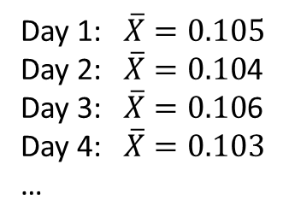
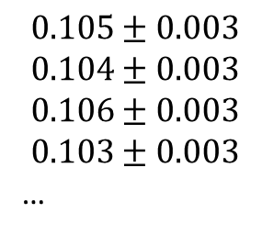


Confidence interval interpretation
During component manufacture, a random sample of 500 are weighed each day, and each day a 95% confidence interval is calculated for the mean weight $μ$ of the components. On the first day we obtain a confidence interval for the mean weight of $\left(0.105±0.003\right)$Kg. Which of the following are correct on average if the (unknown) mean weight $μ$ and (known) standard deviation $σ$ remain constant on different days?
$\overline{X}∼N\left(μ,\frac{σ^{2}}{n}\right)$, where $1.96\sqrt{\frac{σ^{2}}{n}}=0.003$
Every day we get a different sample, so different $\overline{X}$.
e.g.
Confidence interval
Day 1: $\overline{X}=0.105$
Day 2: $\overline{X}=0.10$4
Day 3: $\overline{X}=0.10$6
Day 4: $\overline{X}=0.103$
…
$$0.105±0.003$$
$$0.104±0.003$$
$$0.106±0.003$$
$$0.103±0.003$$
…
95% of the time, $\overline{X}$ is in $μ±0.003$
$⇒$5% of the time $\overline{X}$ is not in $μ±0.003$
95% of the time, $μ$ is in $\overline{X}±0.003$
$⇒$5% of the time $μ$ is not in $\overline{X}±0.003$
$⇒$On 5% of days the calculated confidence interval does not contain $μ$

Slide 40
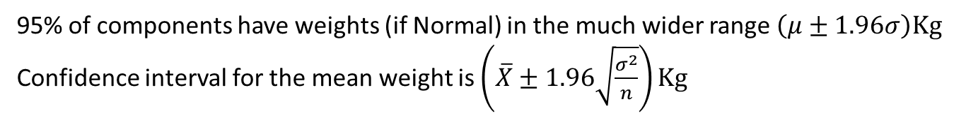
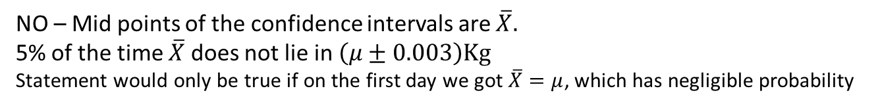
Other answers?
On 95% of days, the mean weight is in the range $\left(0.105±0.003\right)$Kg
NO - the mean weight $μ$ is assumed to be a constant.
It is either in the range or it isn’t – if true for one day it will be true for all days
95% of the components have weights in the range $\left(0.105±0.003\right)$Kg
NO – the confidence interval is for the mean weight, not individual weights
95% of components have weights (if Normal) in the much wider range $\left(μ±1.96σ\right)Kg$
Confidence interval for the mean weight is $\left(\overline{X}±1.96\sqrt{\frac{σ^{2}}{n}}\right)Kg$
5% of the sample means (mid-points of the confidence intervals) do not lie in the range $\left(0.105±0.003\right)$Kg
NO – Mid points of the confidence intervals are $\overline{X}.$
5% of the time $\overline{X}$ does not lie in $\left(μ±0.003\right)Kg$
Statement would only be true if on the first day we got $\overline{X}=μ$, which has negligible probability

Slide 41

In general can use any confidence level, not just 95%.
95% confidence level has 5% in the tails, i.e. p=0.05 in the tails.
In general to have probability $p$ in the tails; for two tail, $p/2$ in each tail:
A $100\left(1−p\right)\%$confidence interval for $μ$ if we measure a sample mean $\overline{X}$ and already know $σ^{2}$ is $\overline{X}±z\sqrt{\frac{σ^{2}}{n}} ,$ where $Q\left(z\right)=1−p/2$
p/2
p/2
Q
E.g. for a 99% confidence interval, we would want $Q\left(z\right)=0.995$.

Slide 42
Two tail versus one tail
Does the distribution have two small tails or one? Or are we only interested in upper or lower limits?
If the distribution is one sided, or we want upper or lower limits, a one tail interval may be more appropriate.
95% One tail
95% Two tail
P=0.05
P=0.025
P=0.025

Slide 43




Example
You are responsible for calculating average extra-urban fuel efficiency figures for new cars. You test a sample of 100 cars, and find a sample mean of $\overline{X}=55.40mpg.$ The standard deviation is $σ=1.2 mpg$. What is the 95% confidence interval for the average fuel efficiency?
Answer:
$\overline{X}±1.96\sqrt{\frac{σ^{2}}{n}}$.
Sample size if $n=100$ and 95% confidence interval is
$$⇒55.4±1.96\sqrt{\frac{{1.2}^{2}}{100}}=55.4±0.235$$
i.e. mean $μ$ in 55.165 to 55.63 mpg at 95% confidence

Slide 44

Confidence interval
Given the confidence interval just constructed, it is correct to say that approximately 95% of new cars will have efficiencies between 55.165 and 55.63 mpg?
Question from Derek Bruff
YES
NO
NO: $σ=1.2$mpg given in the question is the standard deviation of the individual car efficiencies (i.e. expect new cars in a range $±1.96σ)$. The confidence interval we calculated is the range we expect the mean efficiency to lie in (much smaller range).
30
Countdown

Slide 45




Example: Polling
A sample of 1000 random voters were polled, with 350 saying they will vote for the Conservatives and 650 saying another party. What is the 95% confidence interval for the Conservative share of the vote?
Answer: this is Binomial data, but large $n=1000$ so can approximate as Normal
Random variable $X$ is the number voting Conservative, $X∼N(μ,σ^{2})$
Take variance from the Binomial result with $p≈\frac{350}{1000}=0.35$
$$σ^{2}=np\left(1−p\right)≈1000×0.35×\left(1−0.35\right)=227.5$$
$$⇒σ=\sqrt{227.5}≈15.1$$
95% confidence interval for the total votes is
$$350± 1.96σ=350±1.96×15.1=350±29.6$$
$⇒$ 95% confidence interval for the fraction of the votes is
$$\frac{350±29.6}{1000}≈0.35±0.03$$
i.e. $±$3% confidence interval

Slide 46

Example – variance unknown
A large number of steel plates will be used to build a ship. A sample of ten are tested and found to have sample mean $\overline{X}=2.13kg$ and sample variance $s^{2}=$ ${\left(0.25 kg\right)}^{2}.$ What is the 95% confidence interval for the mean weight $μ$?
Reminder:
Sample Variance:$s^{2}=\frac{\sum_{i}{X_{i}^{2}}−n{\overline{X}}^{2}}{n−1}$

Slide 47
Normal data, variance unknown
Random sample $X_{1},X_{2},…X_{n}$ from $N\left(μ, σ^{2}\right)$, where $σ^{2}$a$nd μ$ are both unknown.
Want a confidence interval for $μ$, using observed sample mean and variance.
When we know the variance: use $z=$ $\frac{\overline{X}−μ}{σ/ \sqrt{n}}$ which is normally distributed
Remember: $\overline{X}∼N\left(μ,\frac{σ^{2}}{n}\right)$
But don’t know $σ^{2}$, so have to use sample estimate $s^{2}$
When we don’t know the variance: use $t=\frac{\overline{X}−μ}{s/ \sqrt{n}}$ which has a t-distribution
(with $n−1$ d.o.f)
Sometimes more fully as “Student’s t-distribution”
Wikipedia

Slide 48



$$ν=n−1=1$$
$$ν=n−1=5$$
$$ν=n−1=50$$
Normal
t-distribution
For large $n$ the t-distribution tends to the Normal
- in general broader tails

Slide 49


Confidence Intervals for the mean
If $σ^{2}$ is known, confidence interval for $μ$ is $\overline{X}−z\sqrt{\frac{σ^{2}}{n}}$ to $\overline{X}+z\sqrt{\frac{σ^{2}}{n}}$, where $z$ is obtained from Normal tables (z=1.96 for two-tailed 95% confidence limit).
If $σ^{2}$ is unknown, we need to make two changes:
(i) Estimate $σ^{2}$ by $s^{2}$, the sample variance;
(ii) replace z by $t_{n−1}$, the value obtained from t-tables,
The confidence interval for $μ$ if we measure a sample mean $\overline{X}$and sample variance $s^{2}$ is: $\overline{X}−t_{n−1}\sqrt{\frac{s^{2}}{n}}$ to $\overline{X}+t_{n−1}\sqrt{\frac{s^{2}}{n}}$.

Slide 50




t-tables
give $t_{ν}$ for different values Q of the cumulative Student's t-distributions, and for different values of $ν$
$$Q(t_{ν})= \int_{−∞}^{t_{ν}}{f_{ν}\left(t\right)dt}$$
The parameter $ν$ is called the number of degrees of freedom.
(when the mean and variance are unknown, there are $n−1$ degrees of freedom to estimate the variance)
Q
$t_{ν}$

Slide 51


Table on other side of Normal table handout
Q
$t_{ν}$
For a 95% confidence interval, we want the middle 95% region, so Q = 0.975
(0.05/2=0.025 in both tails).
Similarly, for a 99% confidence interval, we would want Q = 0.995.

Slide 52
t-distribution example:
A large number of steel plates will be used to build a ship. A sample of ten are tested and found to have sample mean $\overline{X}=2.13kg$ and sample variance $s^{2}=$ ${\left(0.25 kg\right)}^{2}.$ What is the 95% confidence interval for the mean weight $μ$?
Answer:
From t-tables, $ν=n−1=9$for Q = 0.975
$t_{9}$ = 2.2622.
95% confidence interval for $μ$ is:
$$μ=\overline{X}±t_{n−1}\sqrt{\frac{s^{2}}{n}}$$
$$⇒μ=2.13±2.2622\sqrt{\frac{{0.25}^{2}}{10}}=\left(2.13±0.18\right)kg$$
i.e. 1.95 to 2.31

Slide 53
Confidence interval width
We constructed a 95% confidence interval for the mean using a random sample of size n = 10 with sample mean $\overline{X}=2.13kg$ . Which of the following conditions would NOT probably lead to a narrower confidence interval?
Question adapted from
Derek Bruff
If you decreased your confidence level
If you increased your sample size
If the sample mean was smaller
If the population standard deviation was smaller
30
Countdown

Slide 54

Confidence interval width
We constructed a 95% confidence interval for the mean using a random sample of size n = 10 with sample mean $\overline{X}=2.13kg$ . Which of the following conditions would NOT probably lead to a narrower confidence interval?
95% confidence interval for $μ$ is:$μ=\overline{X}±t_{n−1}\sqrt{\frac{s^{2}}{n}}$; width is $2t_{n−1}\sqrt{\frac{s^{2}}{n}}$
Decrease your confidence level?
$⇒$ larger tail $⇒$ smaller $t_{ν}$ $⇒$ smaller confidence interval
Increase your sample size?
$⇒$ $n$ larger $⇒$ smaller confidence interval ($\frac{s^{2}}{n}$ and $t_{n−1}$ both likely to be smaller)
Smaller sample mean?
$⇒\overline{X}$ smaller $⇒$ just changes mid-point, not width
Smaller population standard deviation?
$⇒$ $s^{2}$ likely to be smaller $⇒$ smaller confidence interval

Slide 55




Sample size
How many random samples do you need to reach desired level of precision?
For example, for Normal data, confidence interval for $μ$ is $\overline{X}±t_{n−1}\sqrt{\frac{s^{2}}{n}}$.
Suppose we want to estimate $μ$ to within $±δ$, where $δ$ (and the degree of confidence) is given.
$$δ=t_{n−1}\sqrt{\frac{s^{2}}{n}}$$
Want
$$⇒n=\frac{t_{n−1}^{2}s^{2}}{δ^{2}}$$
Need:
- Estimate of $s^{2}$ (e.g. previous experiments)
- Estimate of $t_{n−1}$. This depends on n, but not very strongly.
e.g. take $t_{n−1}=2.1$ for 95% confidence.
Rule of thumb: for 95% confidence, choose $n=\frac{{2.1}^{2}×Estimate of variance}{δ^{2}}$

