Slide 1
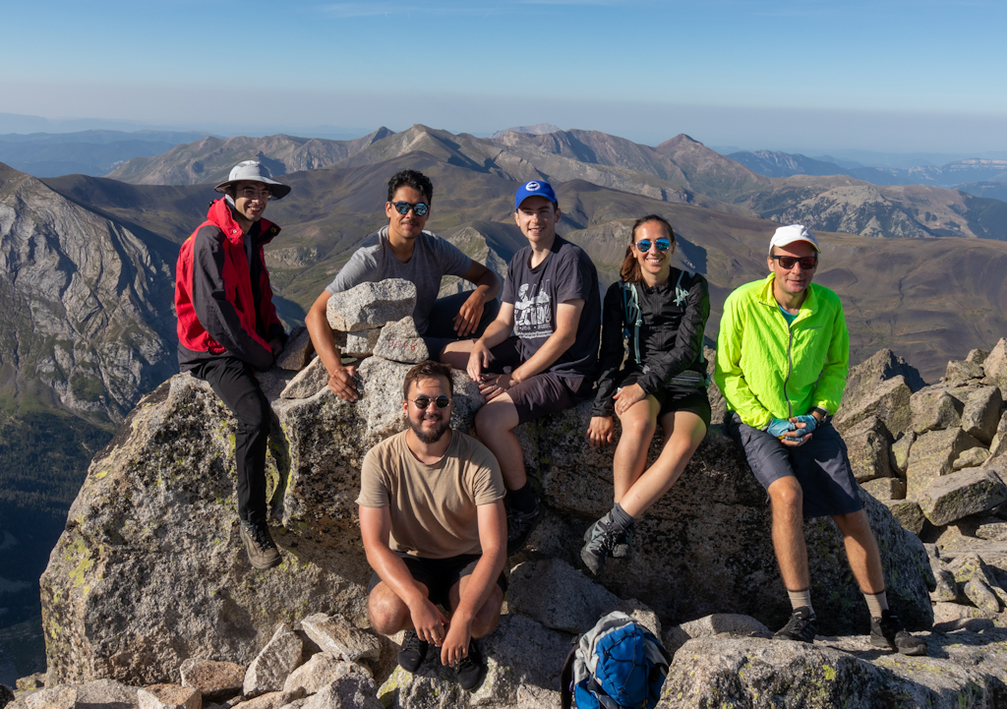


a.k.a. B-mode shear (not polarization rotation)
+ Robertson, Fabbian, Carron, Lewis 2024 in prep.

Slide 2

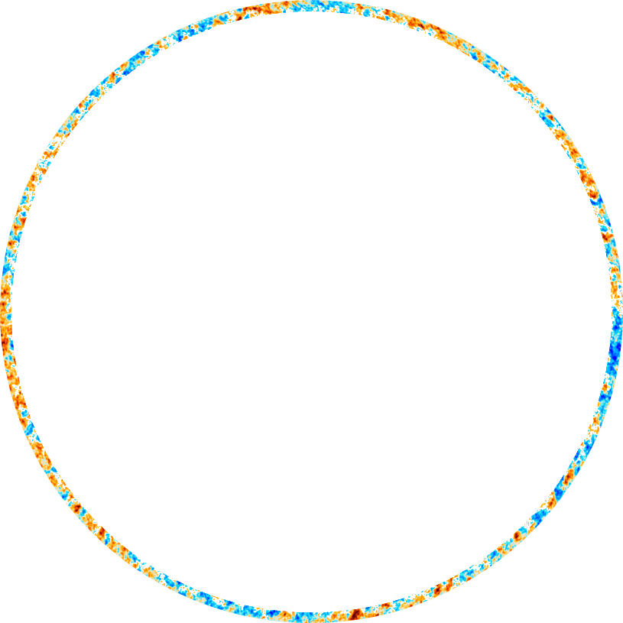
CMB Lensing: 1st order light propagation
Spatially varying gravitational potentials: high-$z$ kernel, mostly linear
(perturbations here not to scale)

Slide 3



Lens remapping approximation: deflection angle $α$
Deflection related to shear $γ_{i}$ , convergence $κ$, and rotation $ω$
$$κ$$
Convergence
$$γ$$
Shear
$$ω$$
Rotation
Rotation $ω=0$ from scalar perturbations in linear perturbation theory
$$ω=0⇒α=∇φ$$

Slide 4
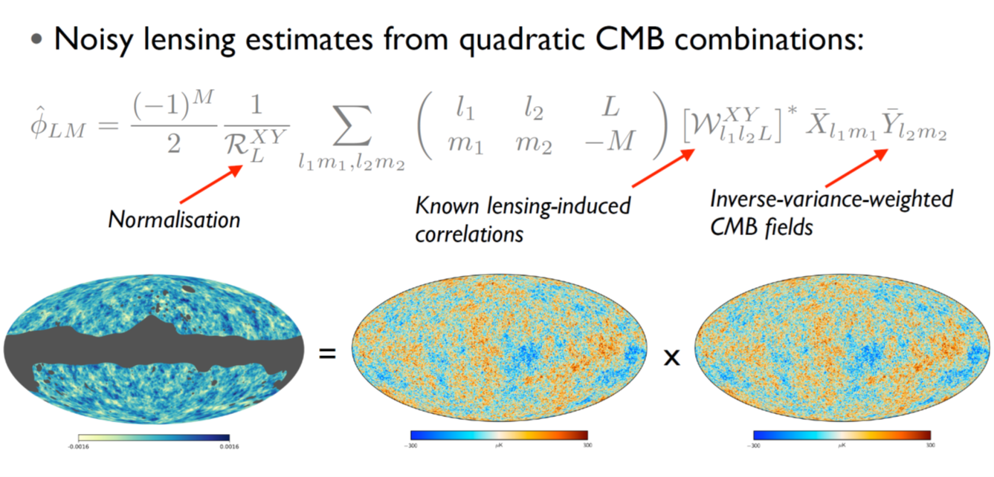
Lensing Reconstruction – Quadratic Estimators
Credit: Anthony Challinor

Slide 5
Planck PR4 lensing spectrum
Carron, Mirmelstein, Lewis 2022

Slide 6
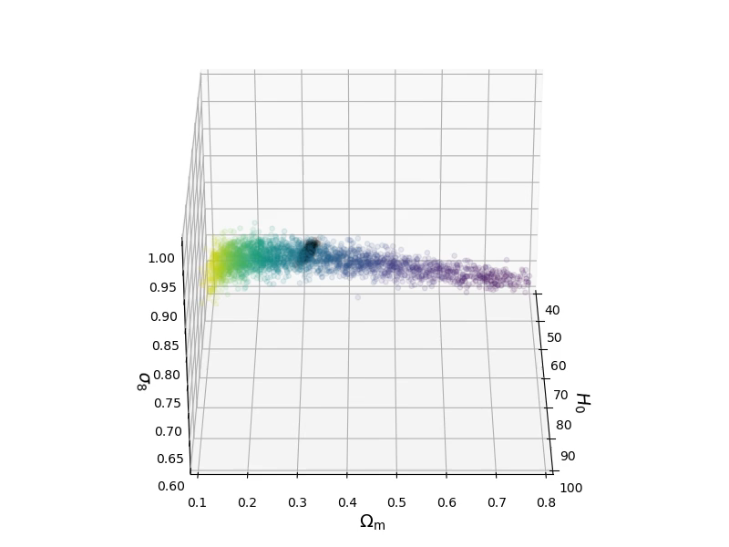
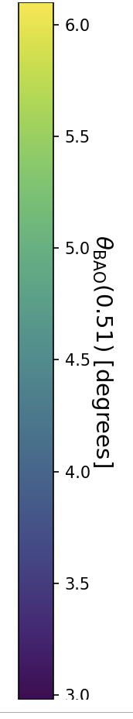


$ΛCDM$ (lensing priors)
lensing only
2018 TTTEEE+lowE
$$θ_{BAO}\left(0.51\right)≡r_{d}/D_{M}(z=0.51)$$

Slide 7
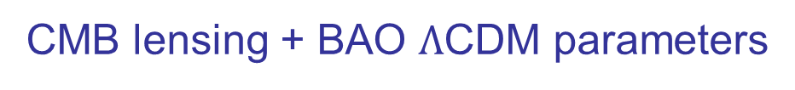
CMB lensing + BAO $Λ$CDM parameters
PR4 lensing + BAO (<2024) inverse distance ladder (with $Ω_{b}h^{2}$ prior from abundance measurements)
$σ_{8} =0.814±0.016$, $H_{0}={68.1}_{−1.1}^{+1.0} km s^{−1}{Mpc}^{−1}, Ω_{m}={0.313}_{−0.0186}^{+0.014}$
PR4 lensing +ACT DR6 + DESI (with PR4/DR6 $Ω_{b}h^{2}$ prior from abundance measurements)
$σ_{8} =0.821±0.013$, $H_{0}=69.0±0.7 km s^{−1}{Mpc}^{−1}, Ω_{m}=0.292±0.011$

Slide 8
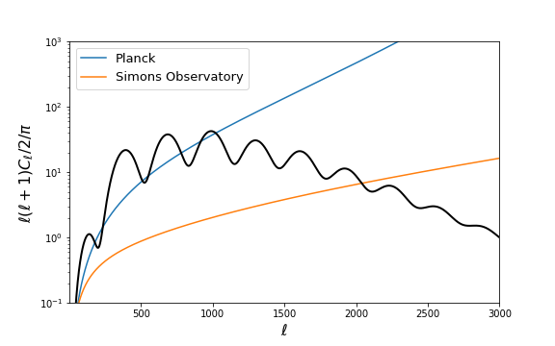
The Future
High resolution/sensitivity polarization:
precision small-scale T, E + much better B
EE polarization noise
+ ActPol, SPTpol (now)
+ CMB-S4, LiteBird (beyond)

Slide 9
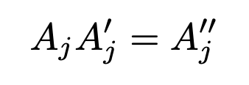
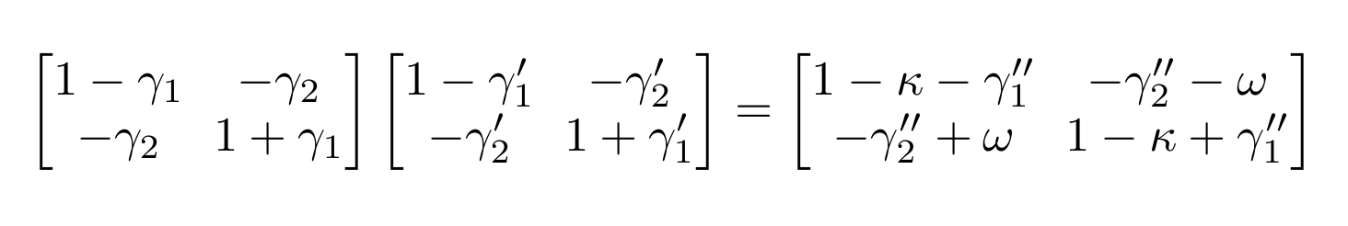
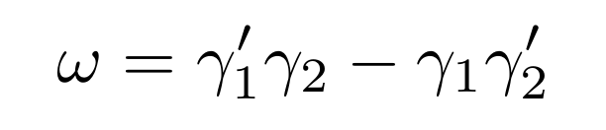

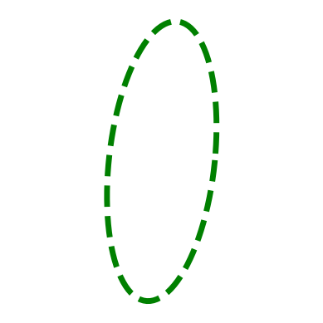
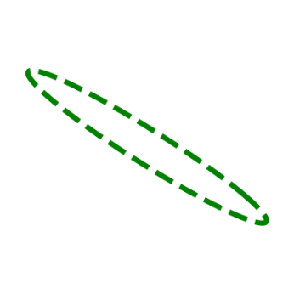
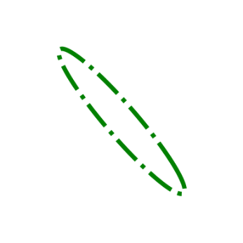
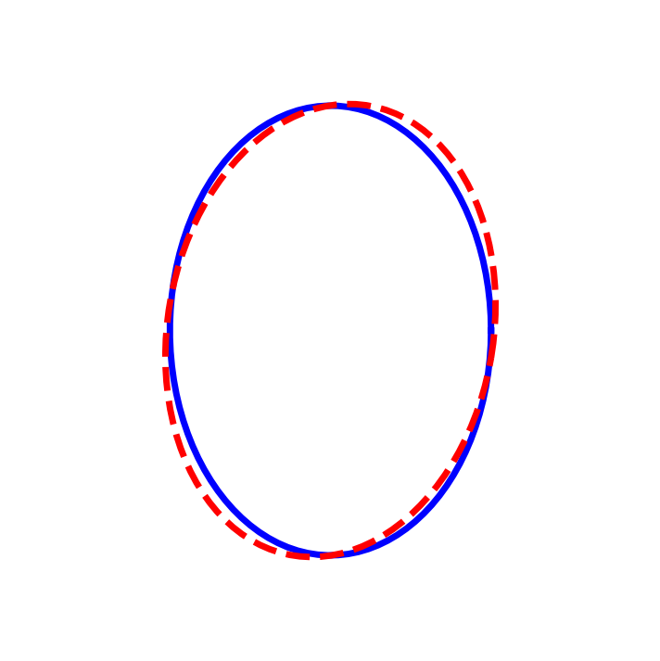

Lensing post-Born rotation
(lens-lens coupling)
+
=
$$∋$$
Source
Sheared
Sheared
Result
Rotation

Slide 10
CMB only reconstruction

Slide 11
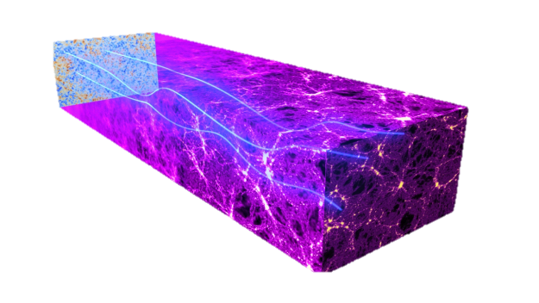
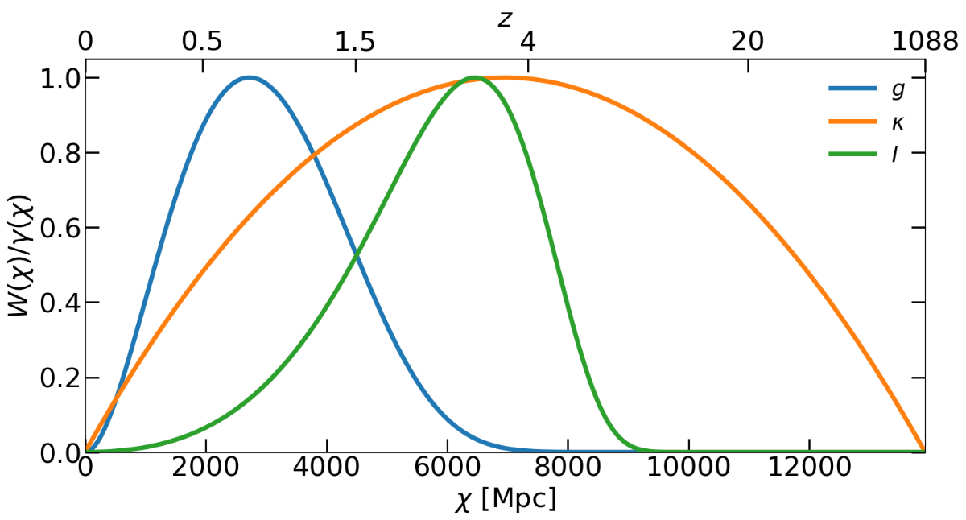
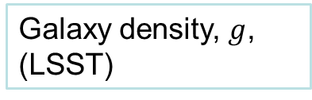
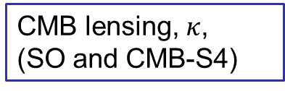
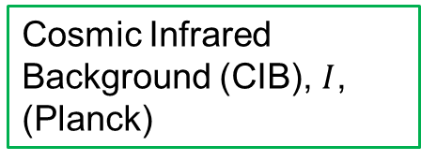
Large Scale Structure
CMB lensing, $κ$,
(SO and CMB-S4)
Galaxy density, $g$,
(LSST)
Cosmic Infrared Background (CIB), $I$,
(Planck)

Slide 12
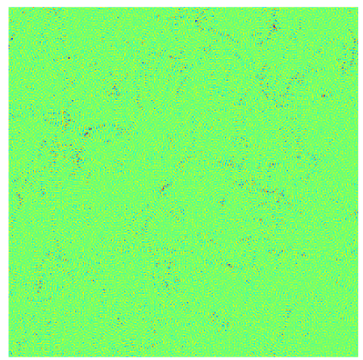
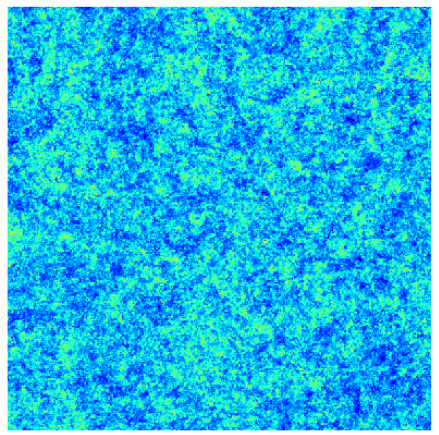
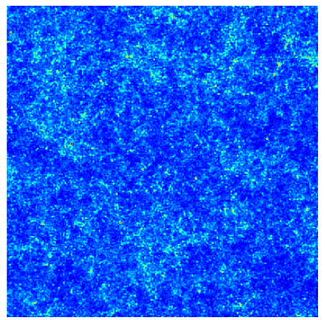
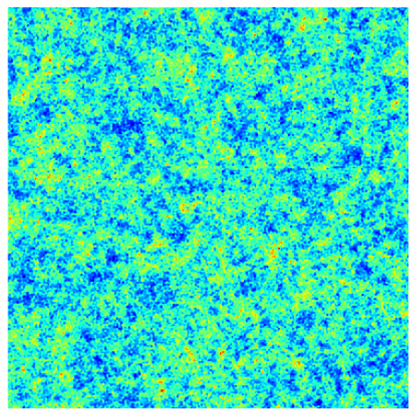






Optimal rotation template
$${\hat{ω}}^{tem}$$
$$\hat{κ}$$
$$\hat{g}$$
$$\hat{I}$$

Slide 13
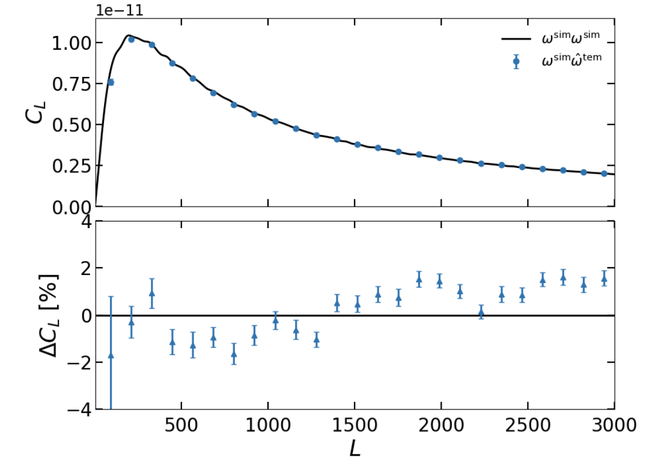
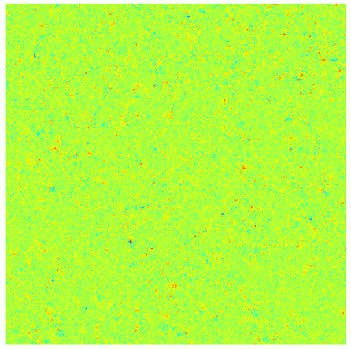



True x Template
$$ω^{sim}$$
$${\hat{ω}}^{tem}$$
$$=$$
Robertson, Fabbian, Carron & Lewis 2024 (in prep.)

Slide 14
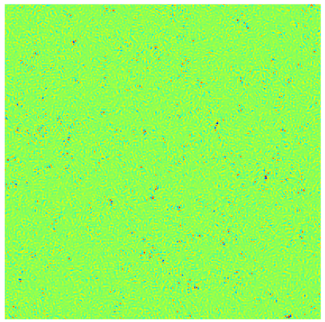
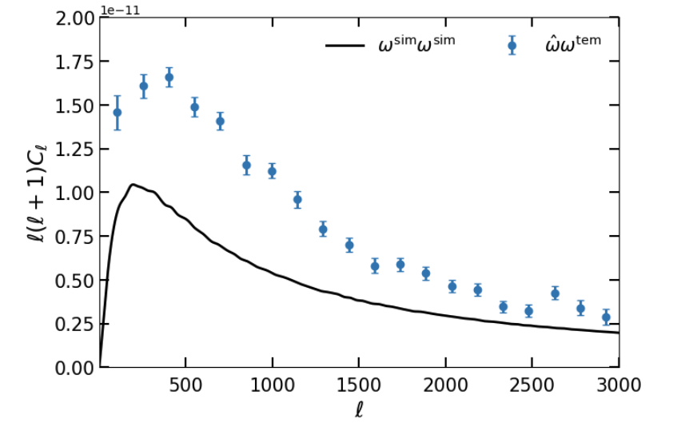

Reconstruction x Template
$$\hat{ω}$$
$${\hat{ω}}^{tem}$$
$$=$$
Robertson, Fabbian, Carron & Lewis 2024 (in prep.)

Slide 15
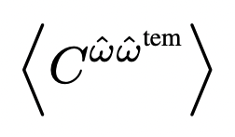
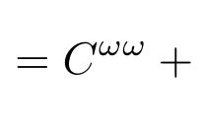
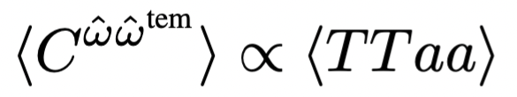
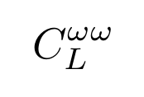

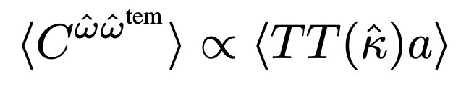
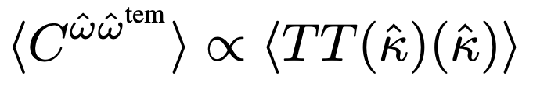









Bias (Gaussian)
bias
1
$$ω$$
$$ω$$
$$κκ$$
bias
2
3
$$TT$$
$$TTκ$$
$$a$$
bias
$$TT$$
$$TT$$
$$TT$$
bias
BUT:
- Gaussian biases can be predicted and subtracted
- Optimal iterative lensing reconstruction gives lower biases

Slide 16
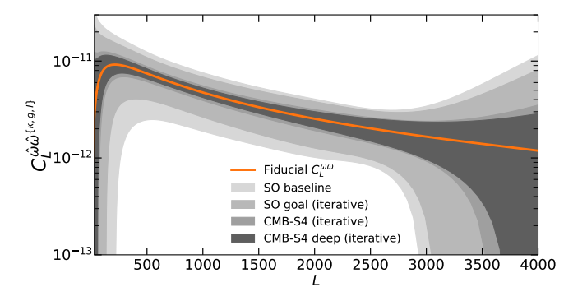
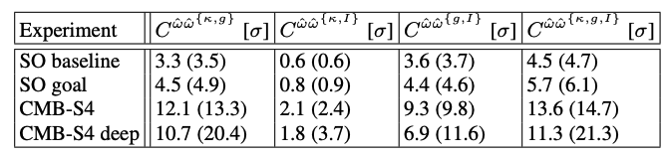

Cross spectra forecasts
$⇒$Should be detectable at high significance!

Slide 17
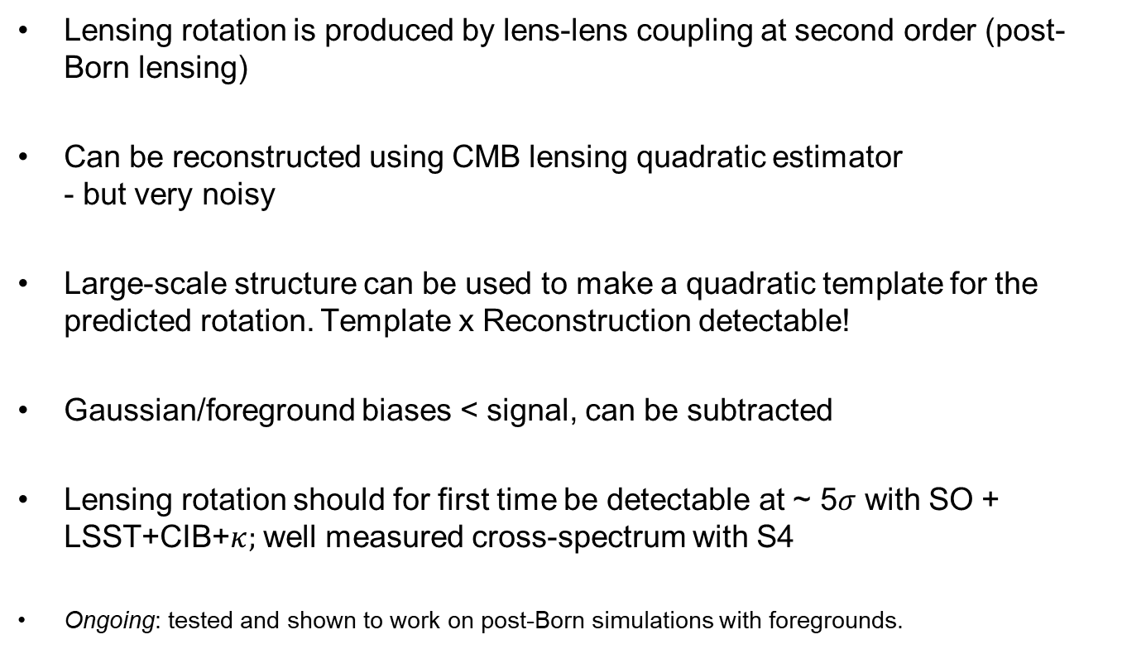
Conclusions
Lensing rotation is produced by lens-lens coupling at second order (post-Born lensing)
Can be reconstructed using CMB lensing quadratic estimator
- but very noisy
Large-scale structure can be used to make a quadratic template for the predicted rotation. Template x Reconstruction detectable!
Gaussian/foreground biases < signal, can be subtracted
Lensing rotation should for first time be detectable at ~ 5$σ$ with SO + LSST+CIB+$κ;$ well measured cross-spectrum with S4
Ongoing: tested and shown to work on post-Born simulations with foregrounds.

Slide 18
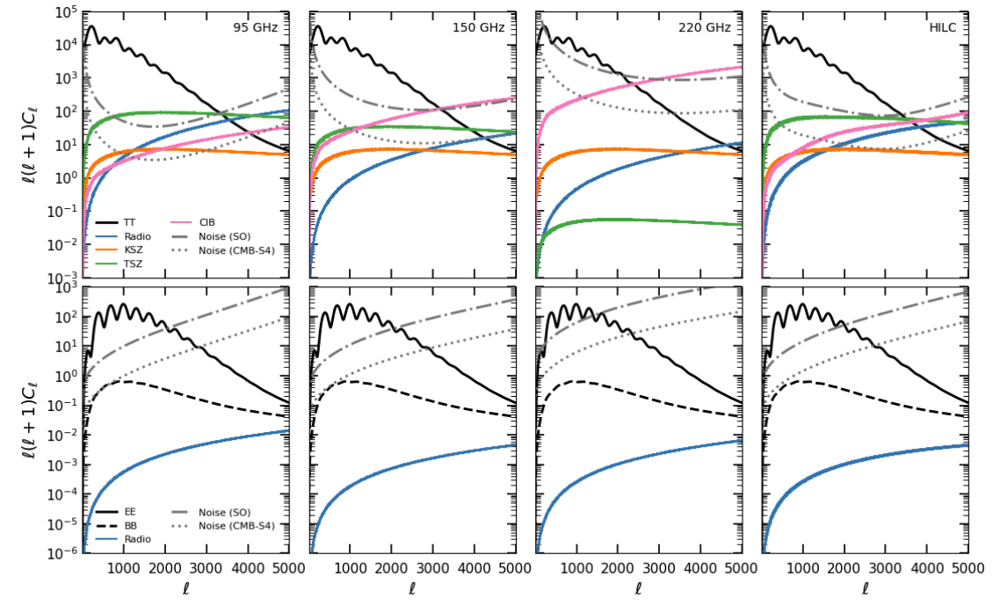
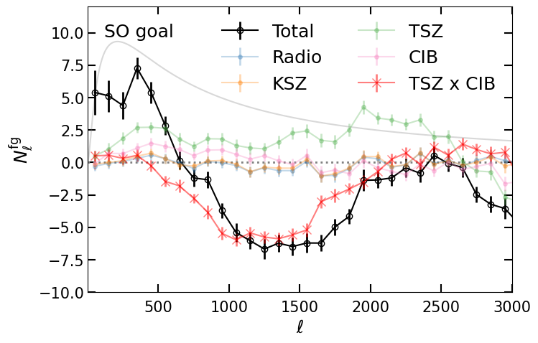
Foreground bias
E.g. using Agora sims
Robertson, Fabbian, Carron Lewis in prep.

Slide 19
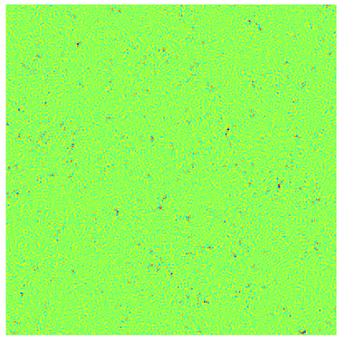
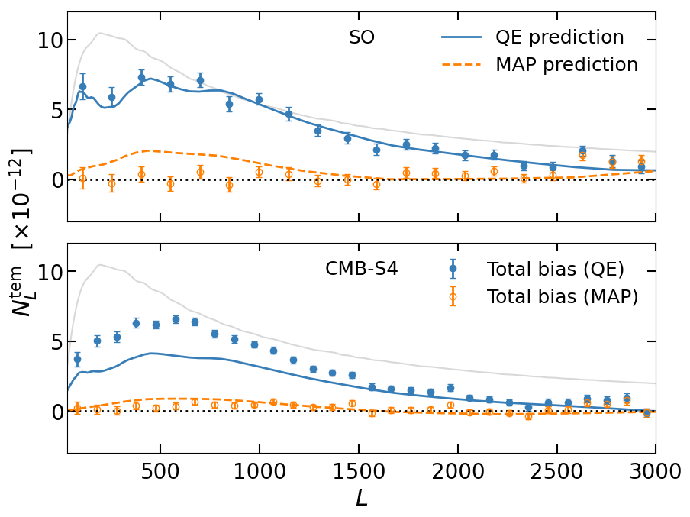
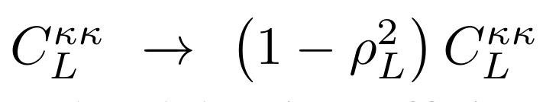




Iterative bias
$${\hat{ω}}^{iter}$$
$${\hat{ω}}^{tem}$$
$$=$$
$$(ω=0)$$

Slide 20


Spherical bispectrum mode expansion
Carron & Lewis in prep
Change variable
Configuration-space map
e.g. CMB lensing $B^{ψTT}$
Expand in eigenmodes of rotation
Define $m$-modes
magnification
shear

