Slide 1


a.k.a. B-mode shear (not polarization rotation)
+ Robertson, Fabbian, Carron, Lewis 2024 – see Mathew’s talk

Slide 2

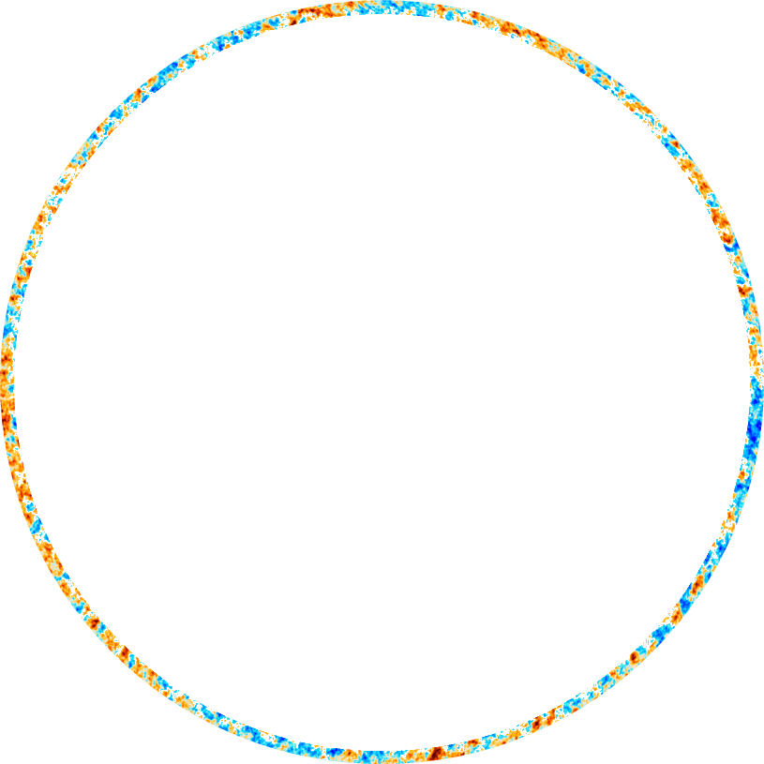
Born approximation CMB Lensing: 1st order light propagation
Spatially varying gravitational potentials: high-$z$ kernel, mostly linear
(perturbations here not to scale)

Slide 3



Lens remapping approximation: deflection angle $α$
Deflection related to shear $γ_{i}$ , convergence $κ$, and rotation $ω$
$$κ$$
Convergence
$$γ$$
Shear
$$ω$$
Rotation
Rotation $ω=0$ from scalar perturbations in linear perturbation theory
$$ω=0⇒α=∇φ$$

Slide 4
Post-Born CMB Lensing: e.g. 2nd order light propagation

Slide 5
Example with polarization
lensing though the centre of two shear fields
Source plane
Undeflected
ray
Image
Polarization

Slide 6
Example with polarization
lensing though the centre of two shear fields
Source plane
Undeflected
ray
Image
Polarization

Slide 7
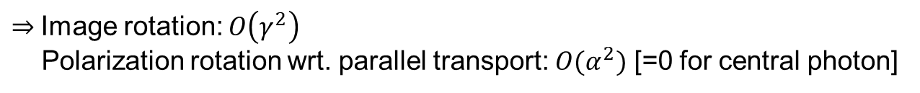
Example with polarization
lensing though the centre of two shear fields
Source plane
Undeflected
ray
$⇒$Image rotation: $O\left(γ^{2}\right)$
Polarization rotation wrt. parallel transport: $O(α^{2})$ [=0 for central photon]
Exactly analogous with (non-birefringent) glass with spatially varying refractive index

Slide 8

Lensing of polarization: good approximation
Polarization not rotated w.r.t. parallel transport (vacuum is not birefringent, $O\left(α^{2}\right)∼{10}^{−6}∼$ negligible)
Q and U Stokes parameters simply re-mapped by the same lensing deflection field, same as I (T)
e.g.
Deflection angle
Last scattering
Observed

Slide 9
Post-born effect on lensing convergence and (field) rotation power spectra
- Negligible change to convergence spectrum
- Non-zero rotation spectrum

Slide 10
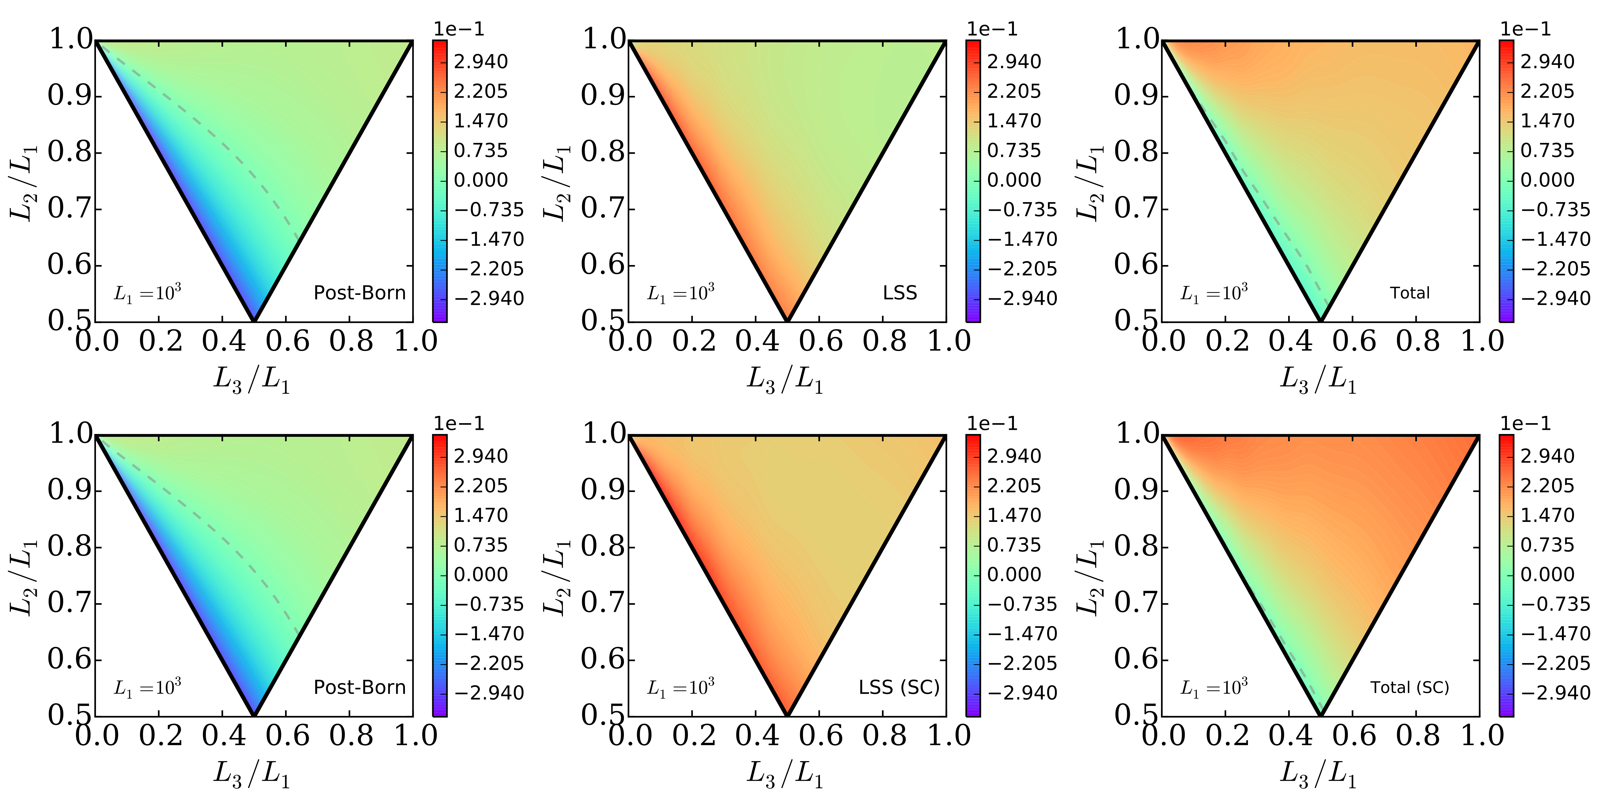
$κκκ$ bispectrum: non-negligible, but partly cancels with LSS bispectrum
Pratten & Lewis 2016

Slide 11
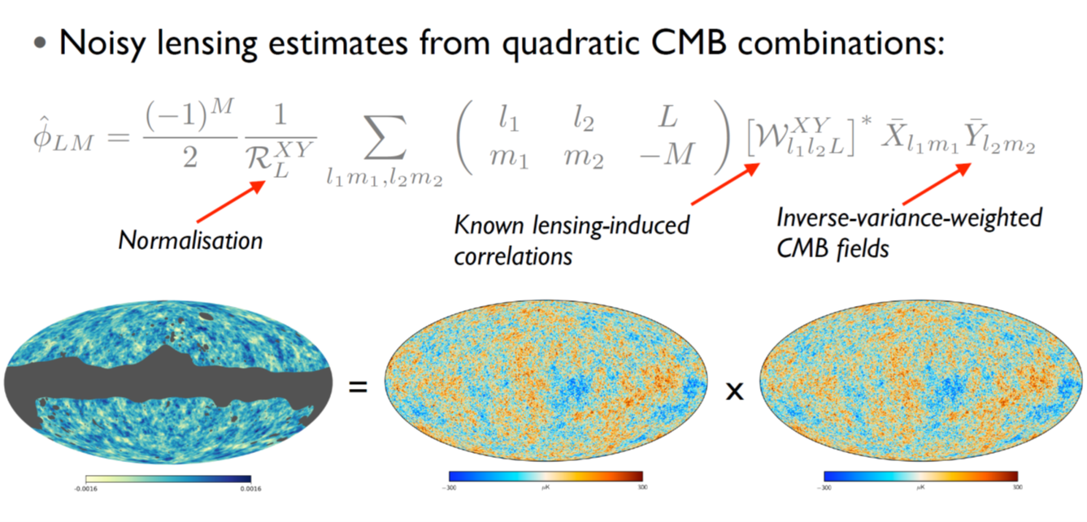
How do we measure the lensing?
Lensing Reconstruction – Quadratic Estimators
Credit: Anthony Challinor

Slide 12
Naïve S/N for post-Born $κ$ and total bispectrum
Small but may be important
Pratten & Lewis: arXiv:1605.05662

Slide 13
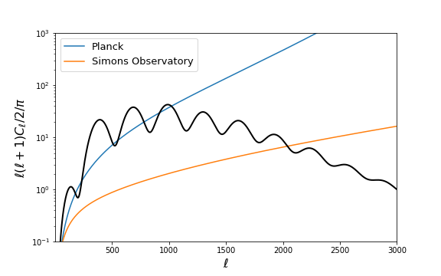
What’s coming in CMB/CMB lensing
High resolution/sensitivity polarization:
precision small-scale T, E + much better B
EE polarization noise
+ ActPol, SPTpol, Bicep,… (now)
+ CMB-S4 (?), LiteBird (?)
Lensing reconstruction
noise

Slide 14
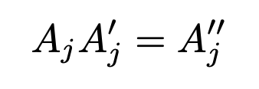
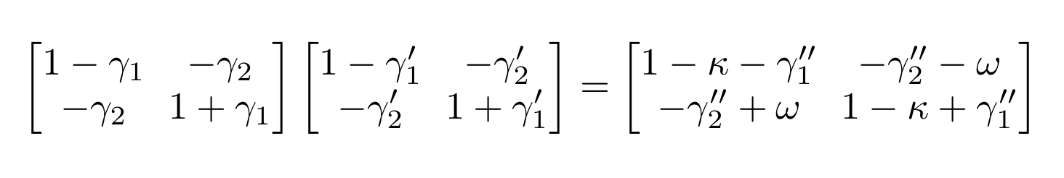
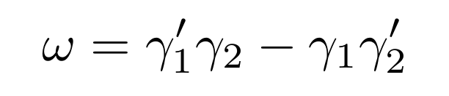

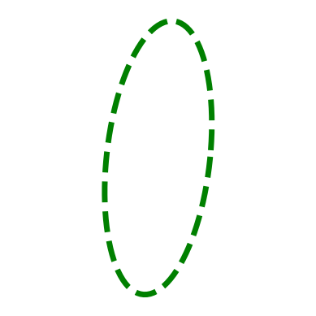
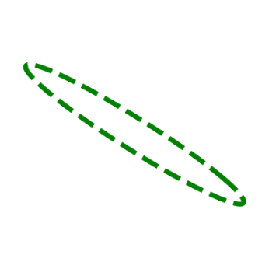
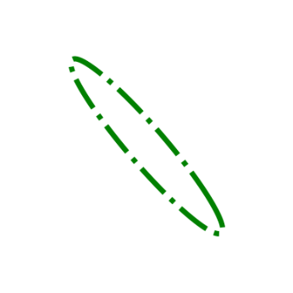
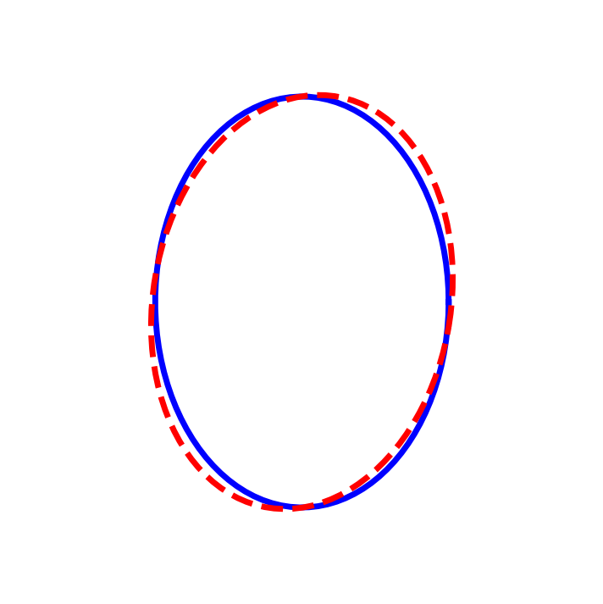

Lensing post-Born rotation
(lens-lens coupling)
+
=
$$∋$$
Source
Sheared
Sheared
Result
Rotation

Slide 15
CMB only reconstruction

Slide 16
CMB only reconstruction

Slide 17
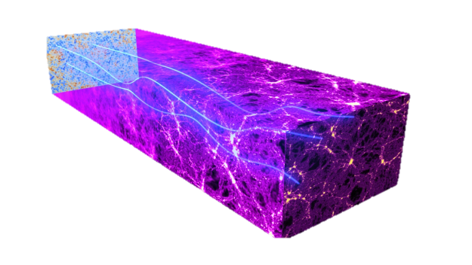
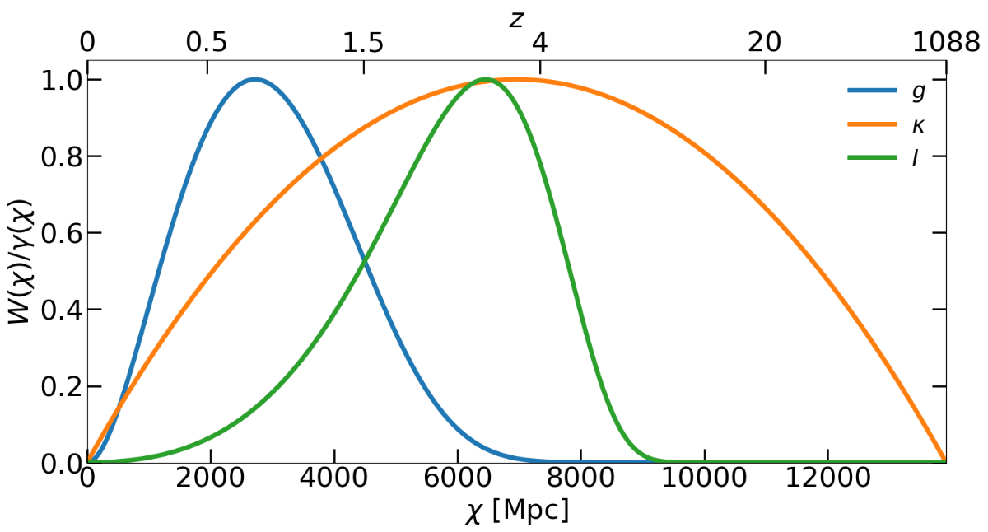
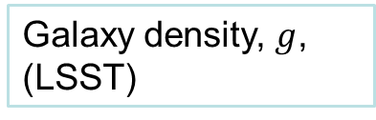
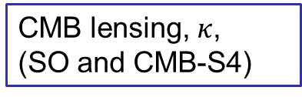
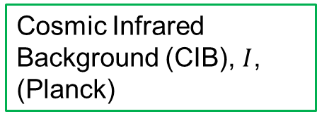
Large Scale Structure
CMB lensing, $κ$,
(SO and CMB-S4)
Galaxy density, $g$,
(LSST)
Cosmic Infrared Background (CIB), $I$,
(Planck)

Slide 18
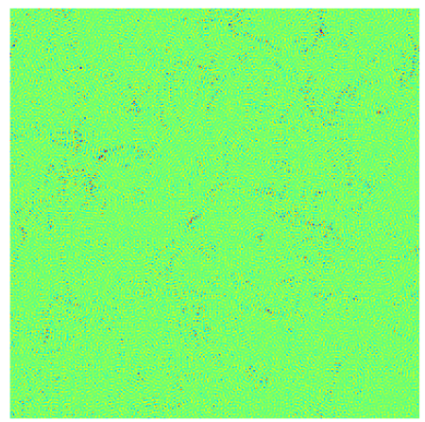
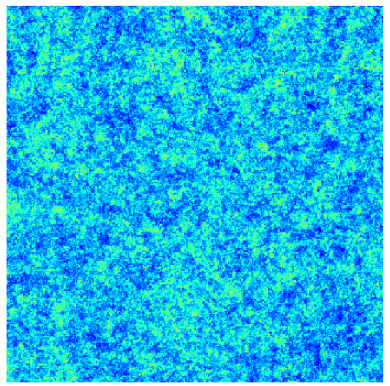
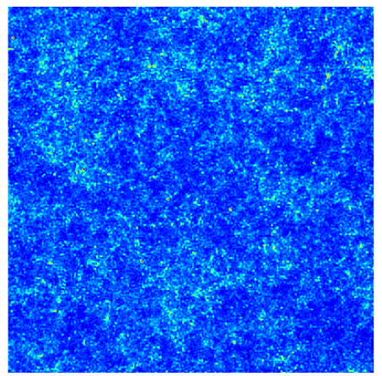
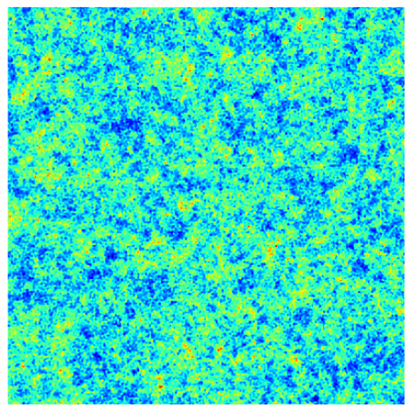






Optimal rotation template
$${\hat{ω}}^{tem}$$
$$\hat{κ}$$
$$\hat{g}$$
$$\hat{I}$$
Normalization so that:
Lensing reconstruction $×$ template $(\hat{ω}×ω^{tem})$
$⇒$ cross-spectrum estimate of the rotation power $≡$ $\hat{ω}×$ tracer $×$ tracer bispectrum

Slide 19
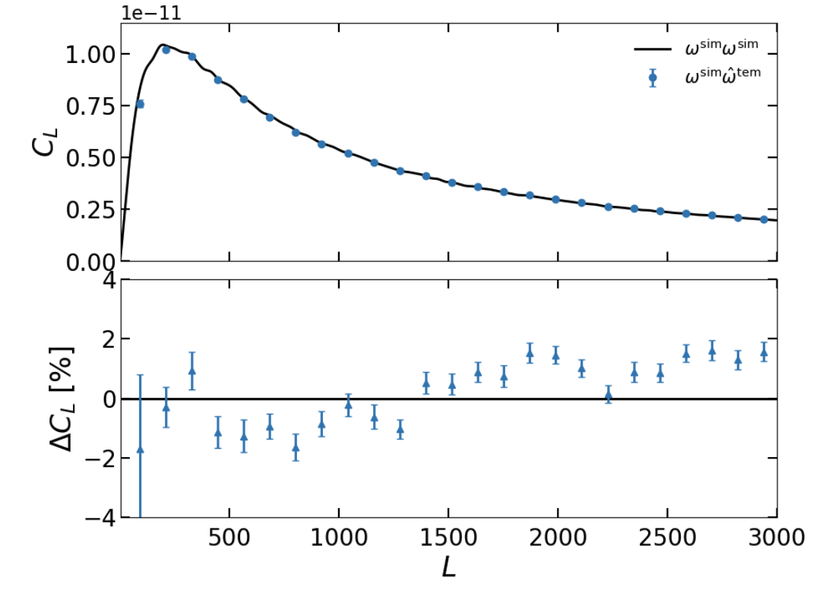
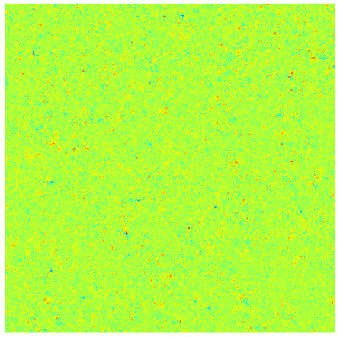



True x Template
$$ω^{sim}$$
$${\hat{ω}}^{tem}$$
$$=$$
Robertson, Fabbian, Carron & Lewis 2024

Slide 20
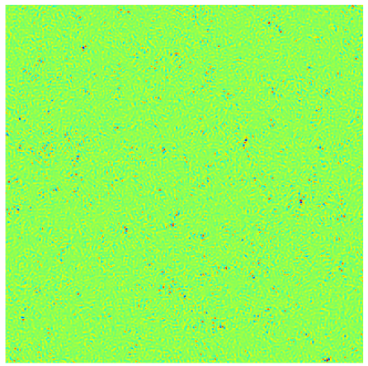
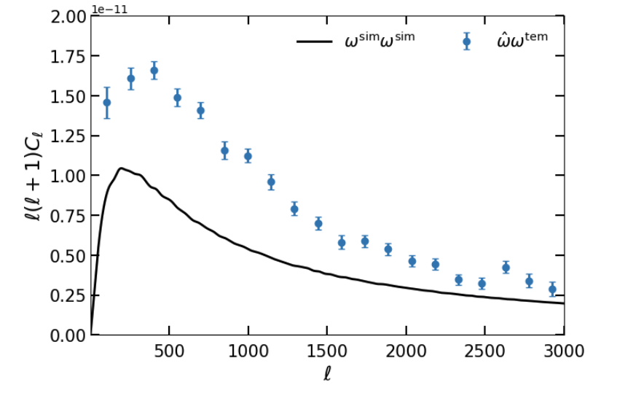

Reconstruction x Template
$$\hat{ω}$$
$${\hat{ω}}^{tem}$$
$$=$$
Robertson, Fabbian, Carron & Lewis 2024

Slide 21
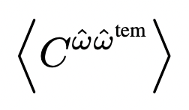
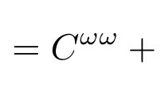
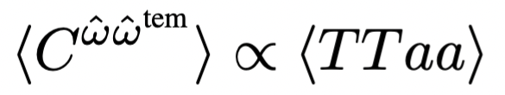
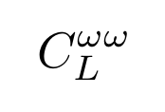

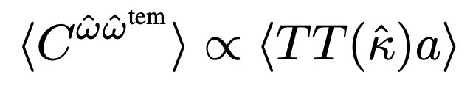
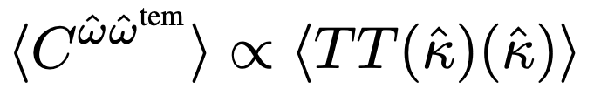









(Gaussian) Bias
bias
1
$$ω$$
$$ω$$
$$κκ$$
bias
2
3
$$TT$$
$$TTκ$$
$$a$$
bias
$$TT$$
$$TT$$
$$TT$$
bias

Slide 22
Gaussian biases
1.
2.
3.

Slide 23
Gaussian biases: $ω=0$ null hypothesis simulation vs theory
Gaussian biases can be predicted and subtracted
(+ reduction with iterative estimator, etc., see later)

Slide 24
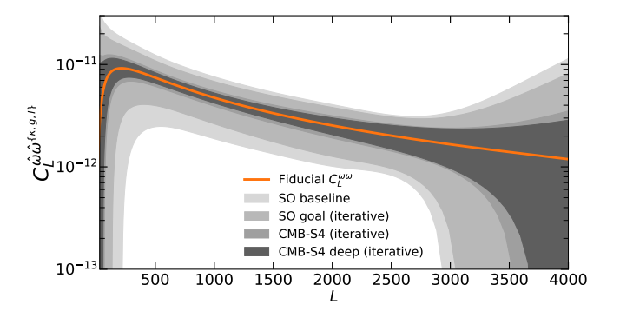
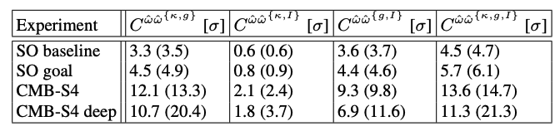

Cross spectra forecasts
$⇒$Should be detectable at high significance!

Slide 25
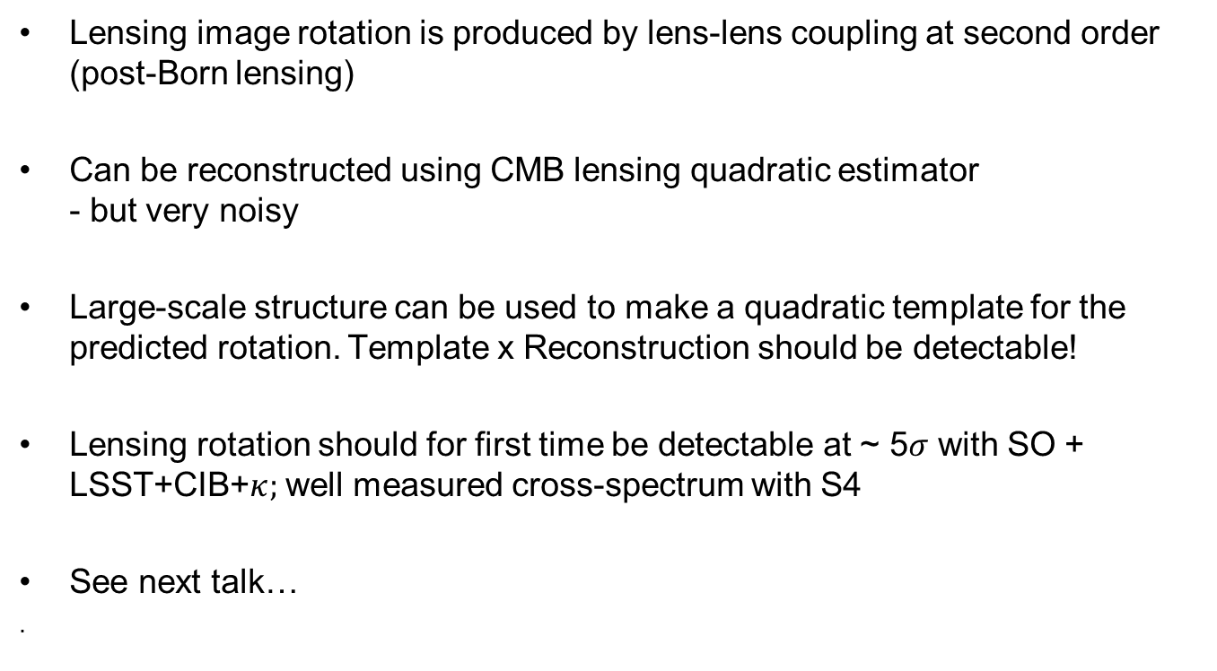
Conclusions
Lensing image rotation is produced by lens-lens coupling at second order (post-Born lensing)
Can be reconstructed using CMB lensing quadratic estimator
- but very noisy
Large-scale structure can be used to make a quadratic template for the predicted rotation. Template x Reconstruction should be detectable!
Lensing rotation should for first time be detectable at ~ 5$σ$ with SO + LSST+CIB+$κ;$ well measured cross-spectrum with S4
See next talk…
.

