Slide 1
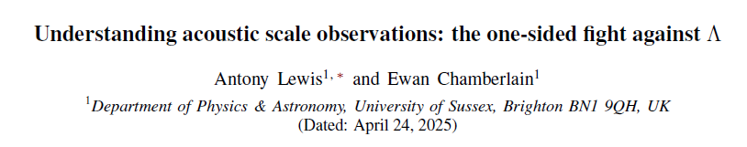


What do acoustic scale observations tell us about dark energy?
Antony Lewis

Slide 2
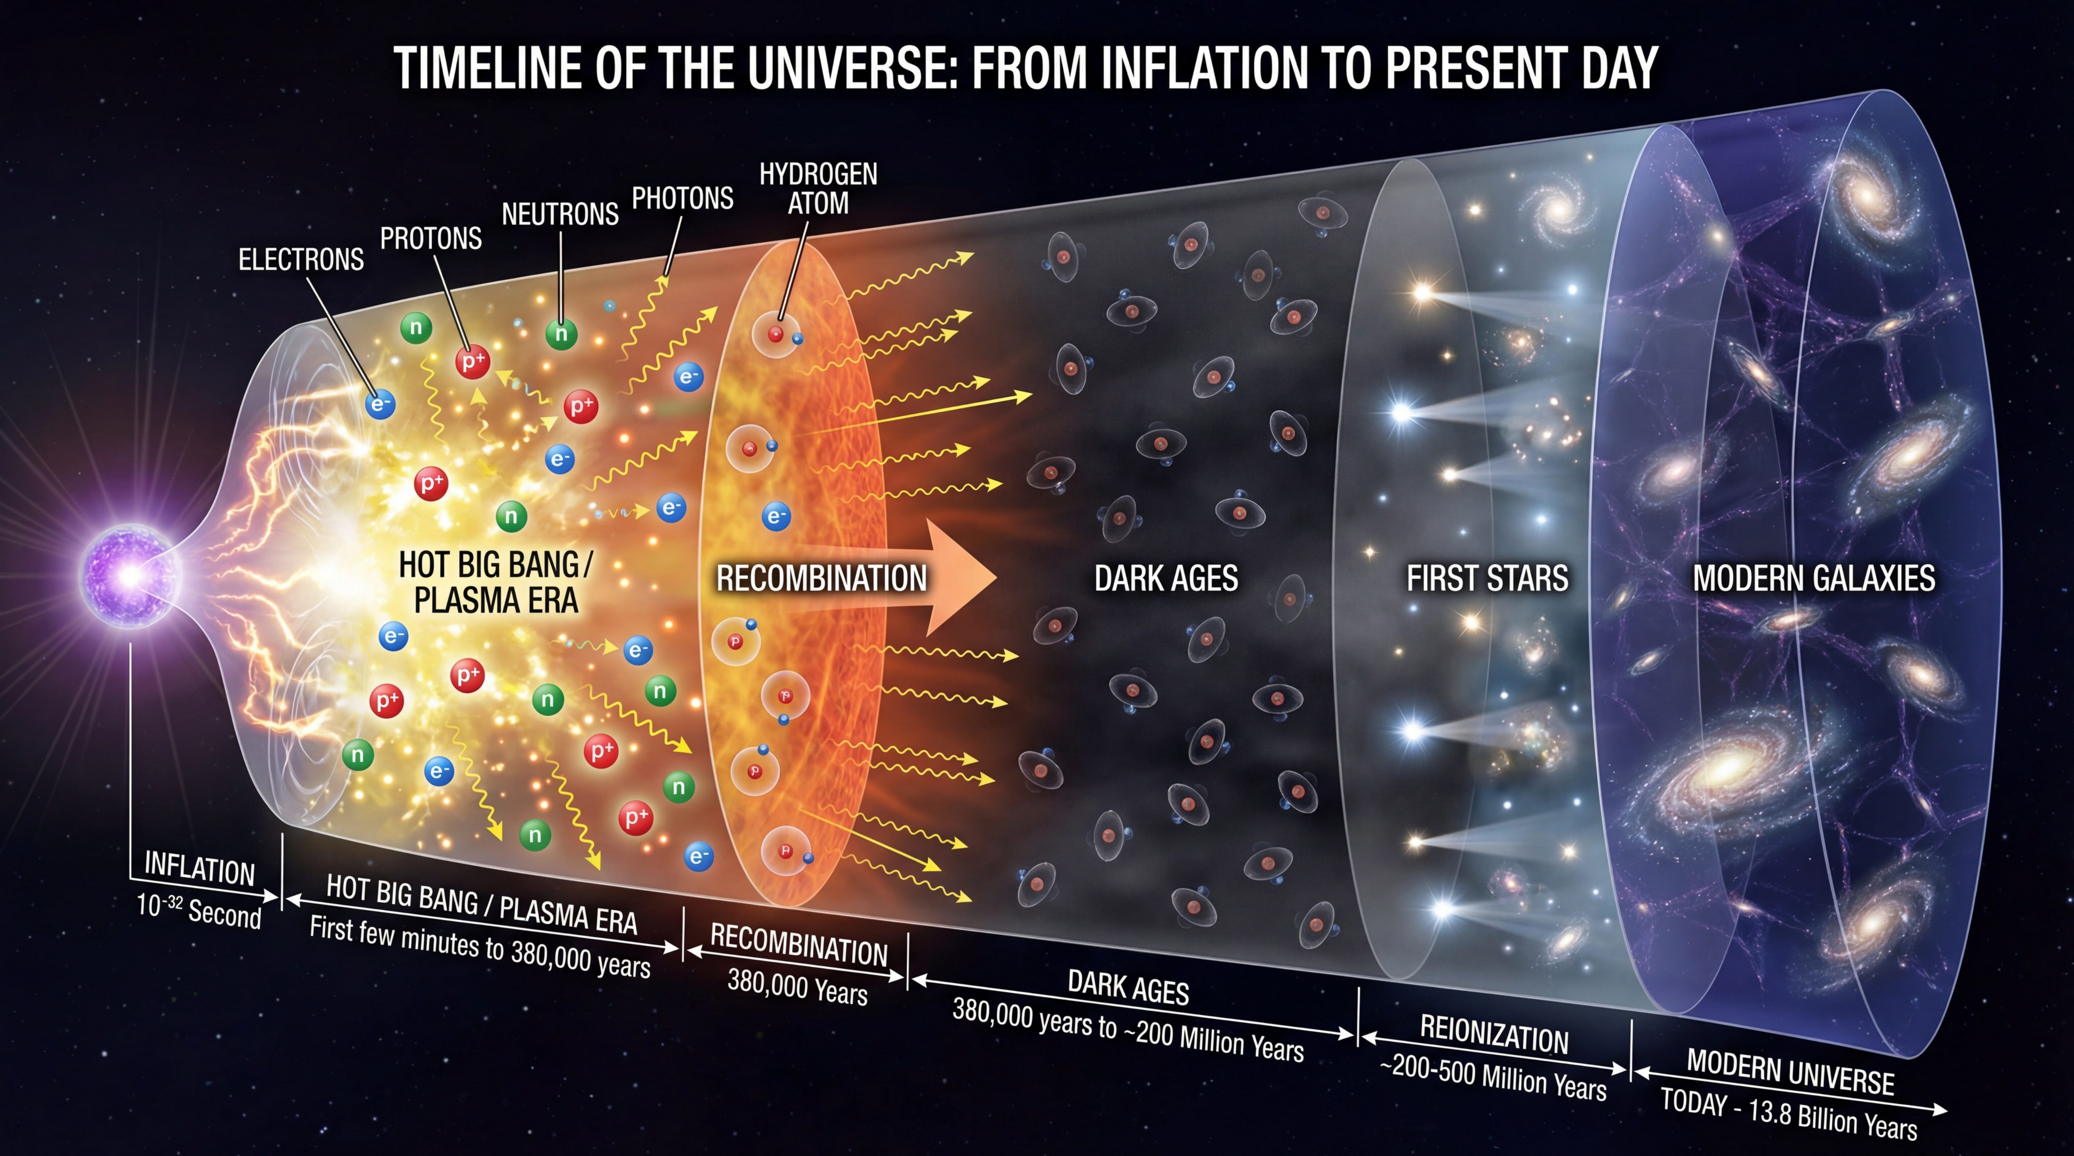
Opaque
Transparent
AI generated (gemini-3-pro-image-preview, following Hu & White, Sci. Am., 290 44 (2004))

Slide 3
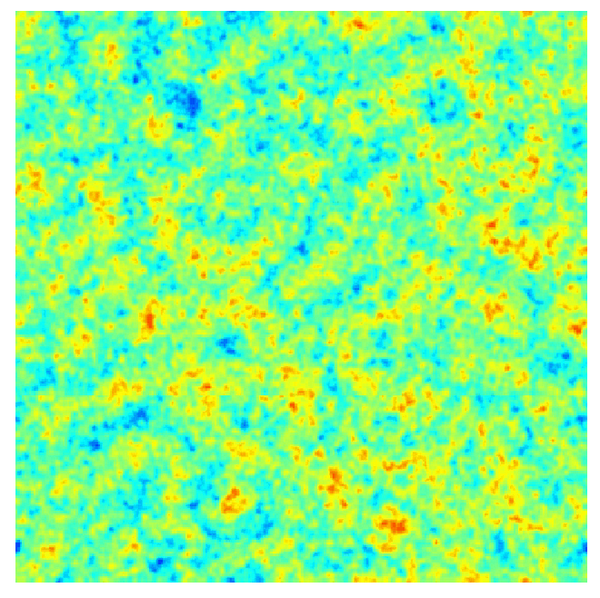
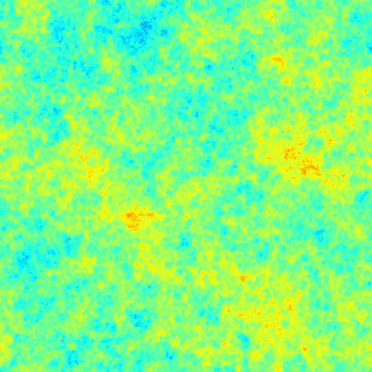

Perturbation evolution
Perturbations: start of hot big bang
Perturbations: Last scattering surface
gravity+
pressure+
diffusion
$$r_{s}$$

Slide 4
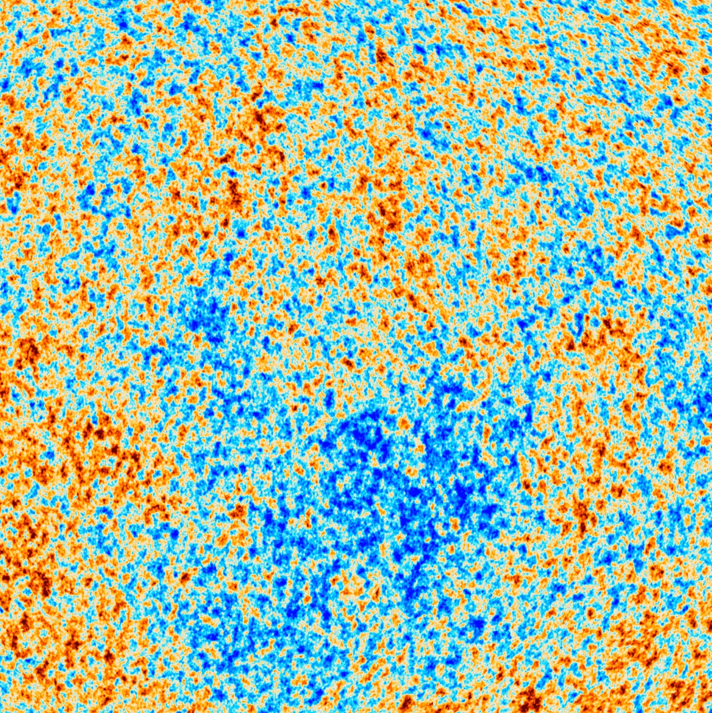

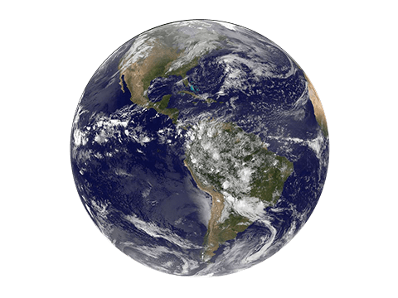




In comoving distance
$$T+ΔT$$
$$z∼0$$
Reionization
$z∼$7-8
Last scattering
$$z_{∗}∼1090$$
Comoving radial distance ~ 14000 Mpc ($ΛCDM$)

Slide 5




In Comoving Distance (not to scale!)
today
Comoving angular diameter distance
recombination
Hot big bang
Comoving sound horizon $r_{s}$:
$$θ_{∗}$$
$$z=0$$
CMB

Slide 6
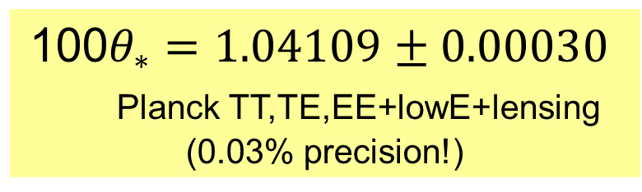
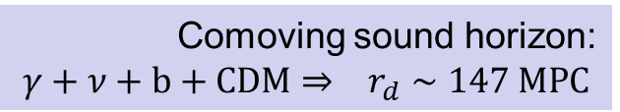

$$D_{M}$$
today
recombination
Hot big bang
100$θ_{∗}=1.04109±0.00030$
Planck TT,TE,EE+lowE+lensing
(0.03% precision!)
Comoving sound horizon:
$$γ+ν+b+CDM⇒ r_{d}∼147 MPC$$
$$θ_{∗}$$
$$z=0$$
CMB

Slide 7

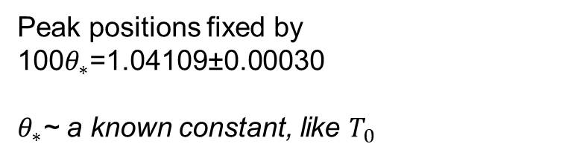

Harmonic space acoustic scale, $C_{l} \text{peak}$
Planck 2018
$$r_{s}$$
Peak positions fixed by
100$θ_{∗}$=1.04109±0.00030
$θ_{∗}$~ a known constant, like $T_{0}$

Slide 8
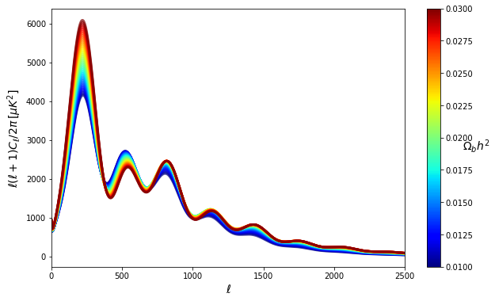
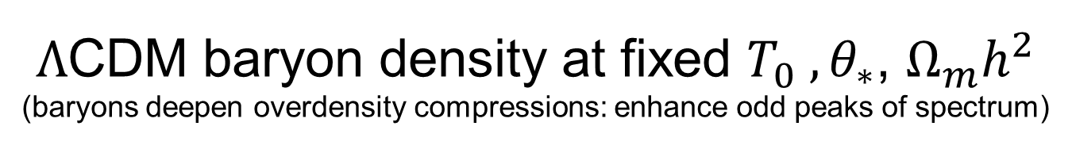

$Λ$CDM baryon density at fixed $T_{0} ,θ_{∗}$, $Ω_{m}h^{2}$
(baryons deepen overdensity compressions: enhance odd peaks of spectrum)
Odd/even height ratio distinctive and quite robust: $Ω_{b}h^{2}=0.0224±0.0002$

Slide 9
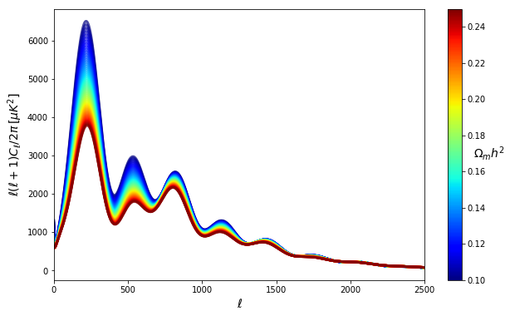
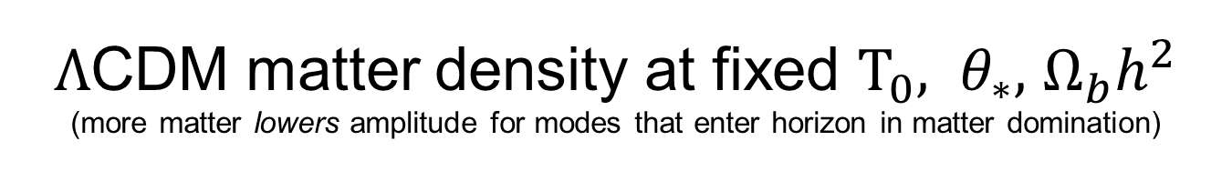
$Λ$CDM matter density at fixed $T_{0}, θ_{∗},$ $Ω_{b}h^{2}$
(more matter lowers amplitude for modes that enter horizon in matter domination)
Can be partly compensated by changing initial power $A_{s}, n_{s}$and foregrounds.
But detailed shape is still quite distinctive and robust:
$$Ω_{m}h^{2}=0.143±0.001$$

Slide 10

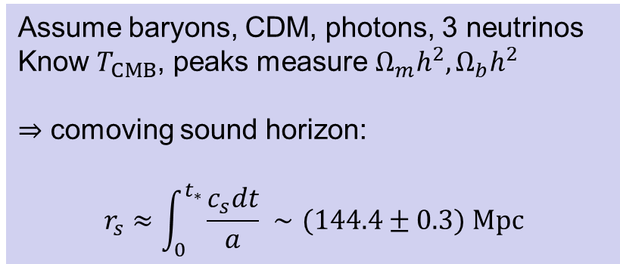
today
Assume baryons, CDM, photons, 3 neutrinos
Know $T_{CMB}$, peaks measure $Ω_{m}h^{2},Ω_{b}h^{2}$
$⇒$ comoving sound horizon:
$$r_{s}≈\int_{0}^{t_{∗}}{\frac{c_{s}dt}{a}} ∼(144.4±0.3) Mpc$$
recombination
Hot big bang
$$θ_{∗}$$
$$z=0$$
CMB ($z∼1090)$

Slide 11
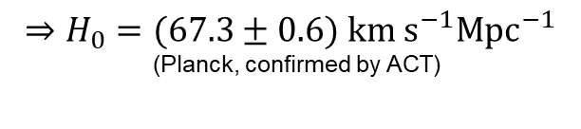




CMB
$$r_{s}, θ_{∗}⇒ D_{M}∼(13.87±0.03) Gpc$$
today
recombination
Hot big bang
$$r_{s}$$
$$θ_{∗}$$
$$D_{M}$$
Assuming flat $Λ$CDM cosmology
$$⇒H_{0}=(67.3±0.6) km s^{−1}Mpc^{−1}$$
(Planck, confirmed by ACT)
$$z=0$$
CMB ($z∼1090)$

Slide 12
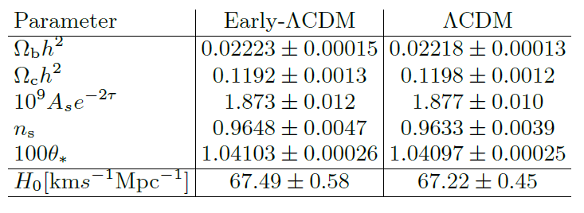

Observed CMB = Recombination + Lensing + ISW + Reionization
Empirically measured
Lensing reconstruction
Small effect, large scales only
+ constant damping
Cut/marginalize out remaining uncertainty
Independent of
late dark energy
Assuming
background$ΛCDM$
Lemos & Lewis: arXiv:2302.12911

Slide 13


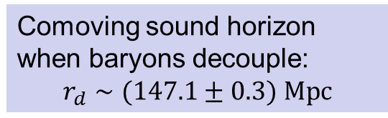
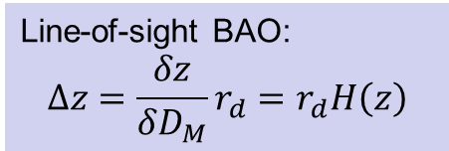
BAO acoustic scale
today
recombination
Hot big bang
Comoving sound horizon when baryons decouple:
$$r_{d}∼(147.1±0.3) Mpc$$
$$θ_{∗}$$
$$θ_{BAO}=r_{d}/D_{M}(z)$$
Line-of-sight BAO:
$$Δz=\frac{δz}{δD_{M}}r_{d}=r_{d}H\left(z\right)$$
$$z=0$$
BAO ($z∼0.5$)
CMB ($z∼1090)$

Slide 14
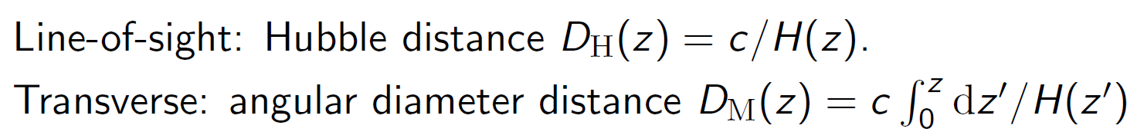
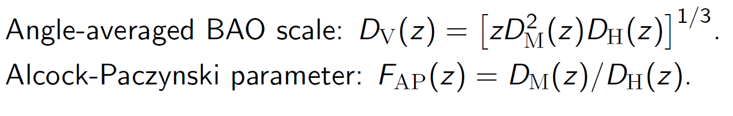
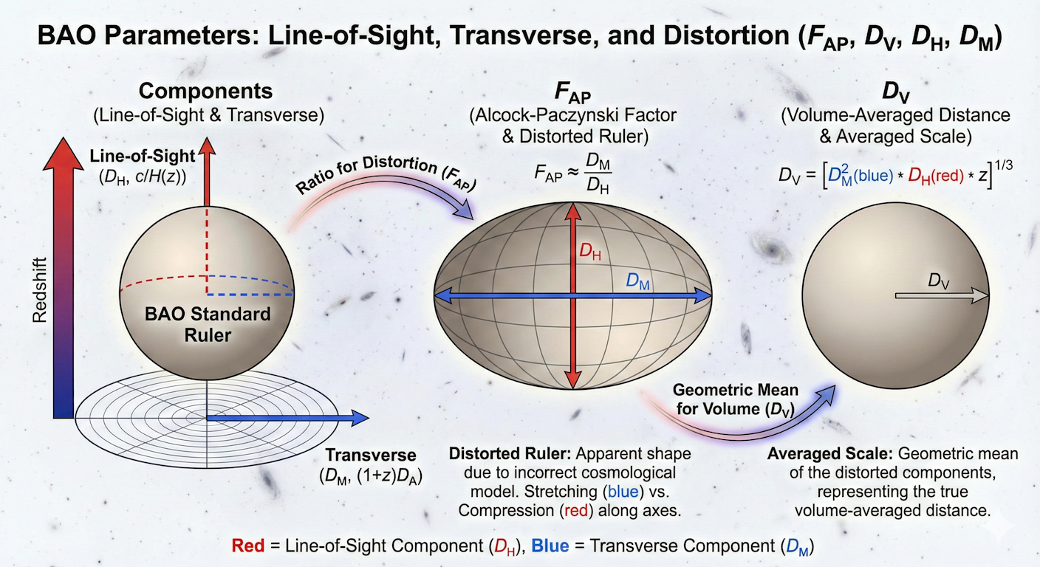
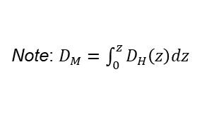
BAO observables
Note: $D_{M}=\int_{0}^{z}{D_{H}\left(z\right)dz}$
Alternative parameterization:
AI generated

Slide 15
How can we vary dark energy to fit BAO+CMB?

Slide 16





For any fixed $θ_{∗}$ and early-universe parameters
Physical densities $Ω_{b}h^{2}$ and $Ω_{c}h^{2}$ $∼$fixed $⇒ r_{s}, r_{d}{ and ρ}_{m}\left(z\right)$ fixed
$θ_{∗}$ fixed $⇒$ $D_{M}\left(z_{∗}\right)$ fixed
Non-phantom/NEC $⇒$ $\frac{dρ_{de}}{dz}≥0$ (for all non-interacting components)
NEC$≡$Null Energy Condition,
defined here for each component
$D_{M}\left(z_{∗}\right)∝$
$$⇒{D_{H}^{de}>D_{H}^{Λ} or H}_{0}^{de}<H_{0}^{Λ}$$
Can only make inferred $H_{0}$ lower than $ΛCDM$

Slide 17
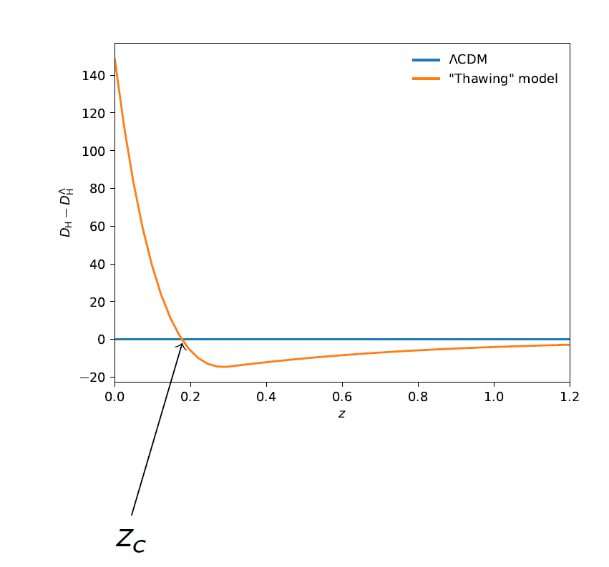





Credit: Ewan Chamberlain
Early universe
the same $\frac{D_{H}^{}}{D_{H}^{Λ}}→1$
$$z≤z_{c}:$$
$$z>z_{c}:$$

Slide 18
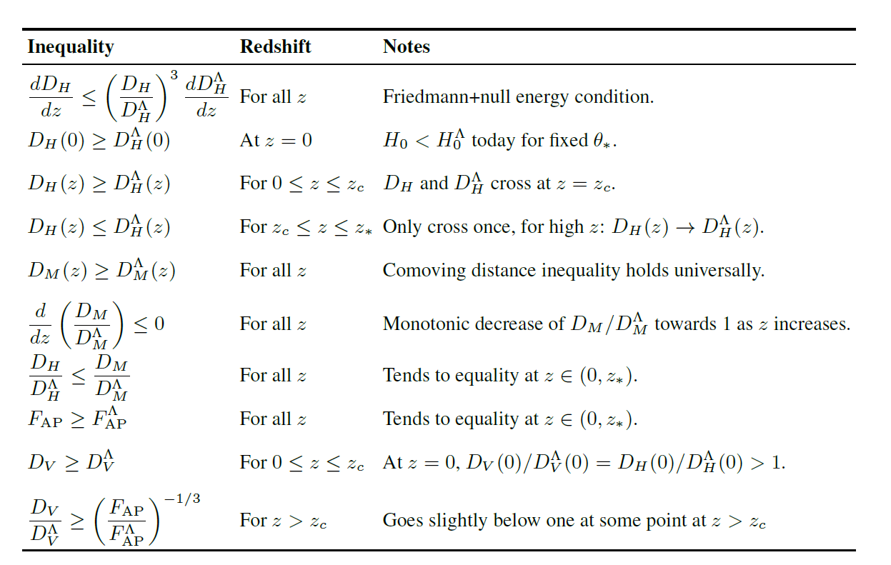
.. etc…

Slide 19
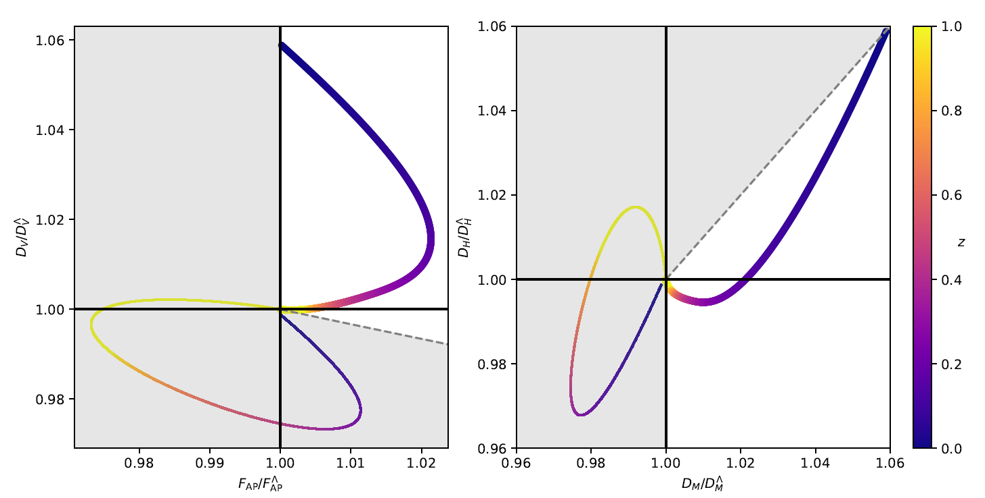

Thawing: Null-energy consistent

Slide 20
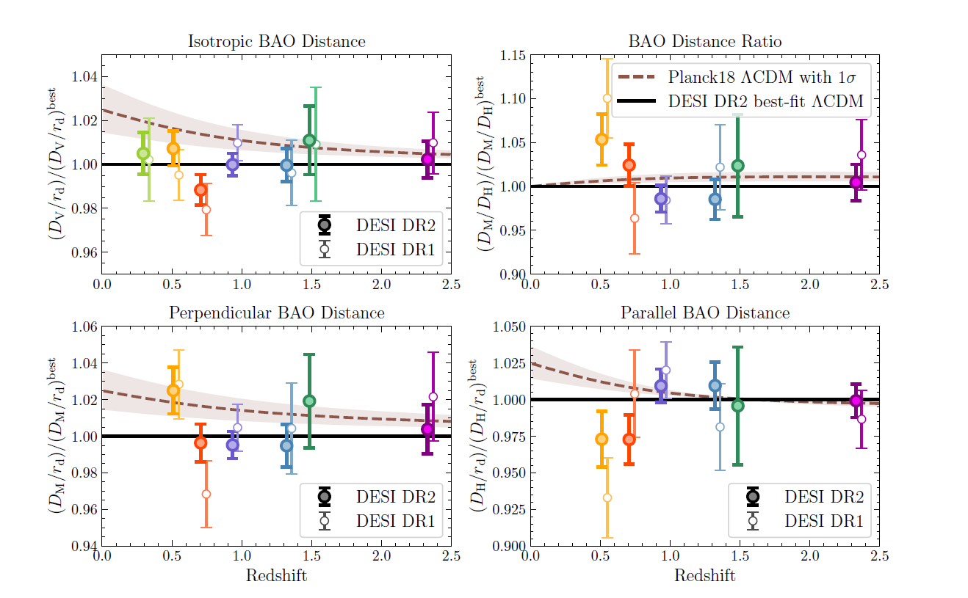






DESI DR2
Planck best fit $Λ$CDM
$$D_{V}$$
$$F_{AP}$$
DESI $Λ$CDM fit
$$D_{M}$$
$$D_{H}$$
arXiv:2503.14738

Slide 21

DESI DR2
Centre: Planck best fit $ΛCDM$

Slide 22
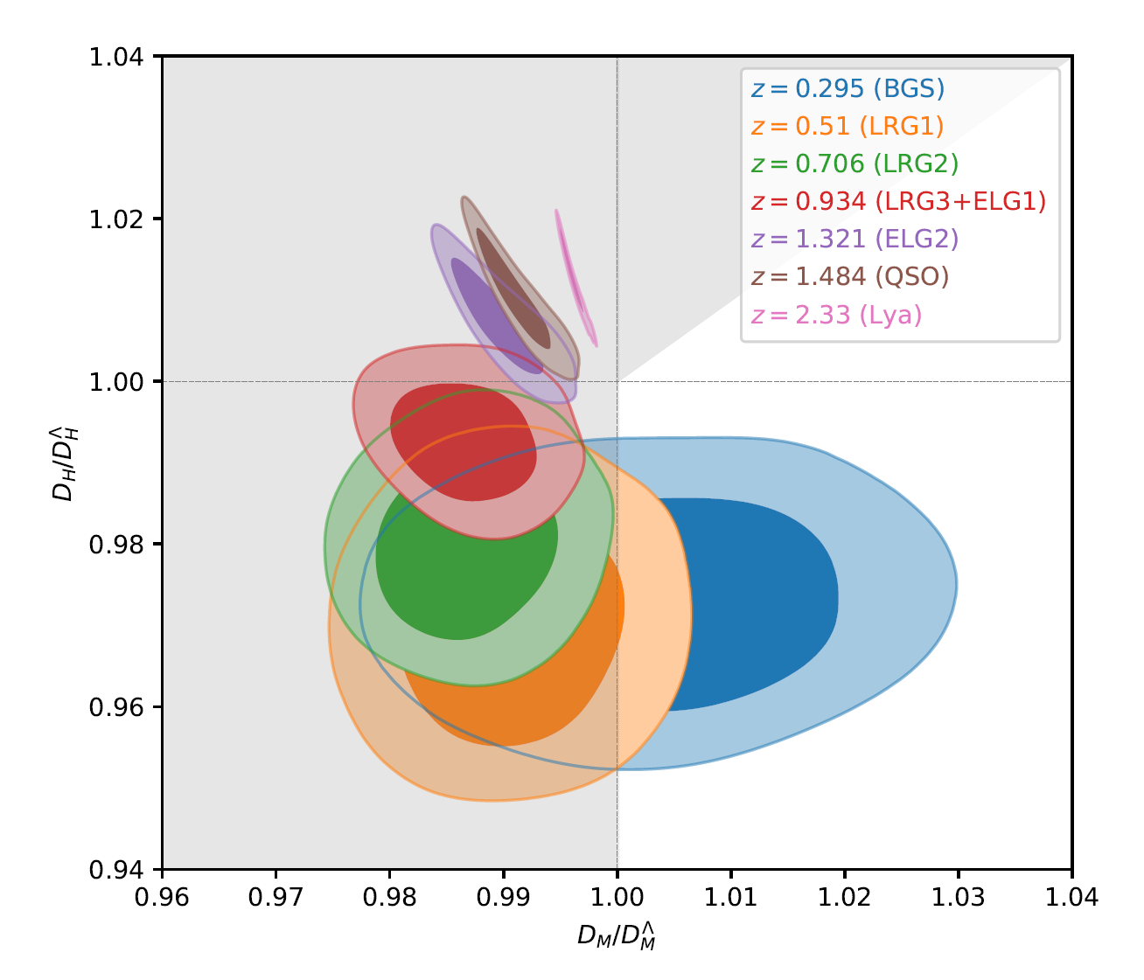
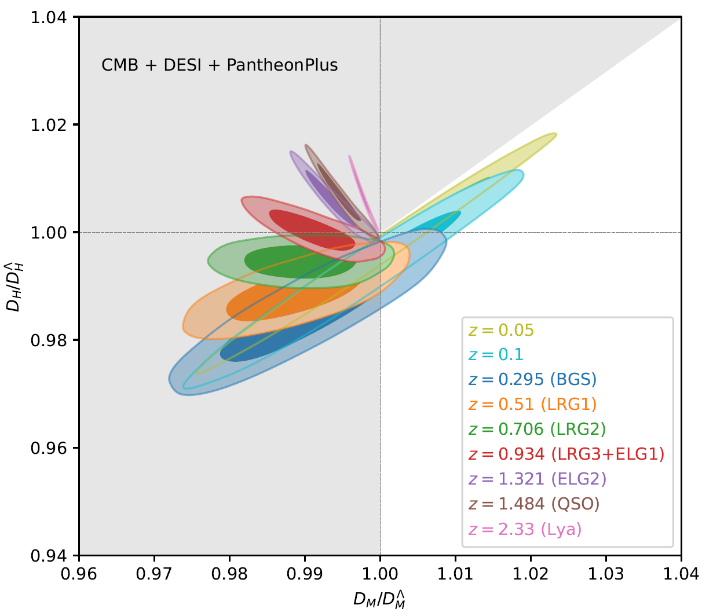
CPL
Planck +DESI posterior for BAO observables wrt. Planck $ΛCDM$ best fit

Slide 23
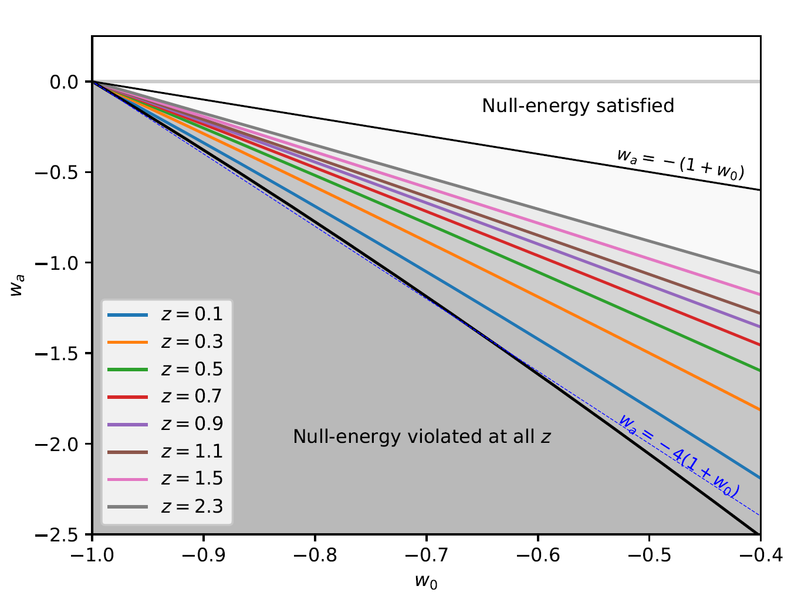



CPL as an effective model for parameterizing deviations?
$$D_{M}^{de}\left(0.5\right)=D_{M}^{Λ}(0.5)$$
$$H_{0}^{de}=H_{0}^{Λ}$$
For fixed $θ_{∗} , ρ_{m}$

Slide 24
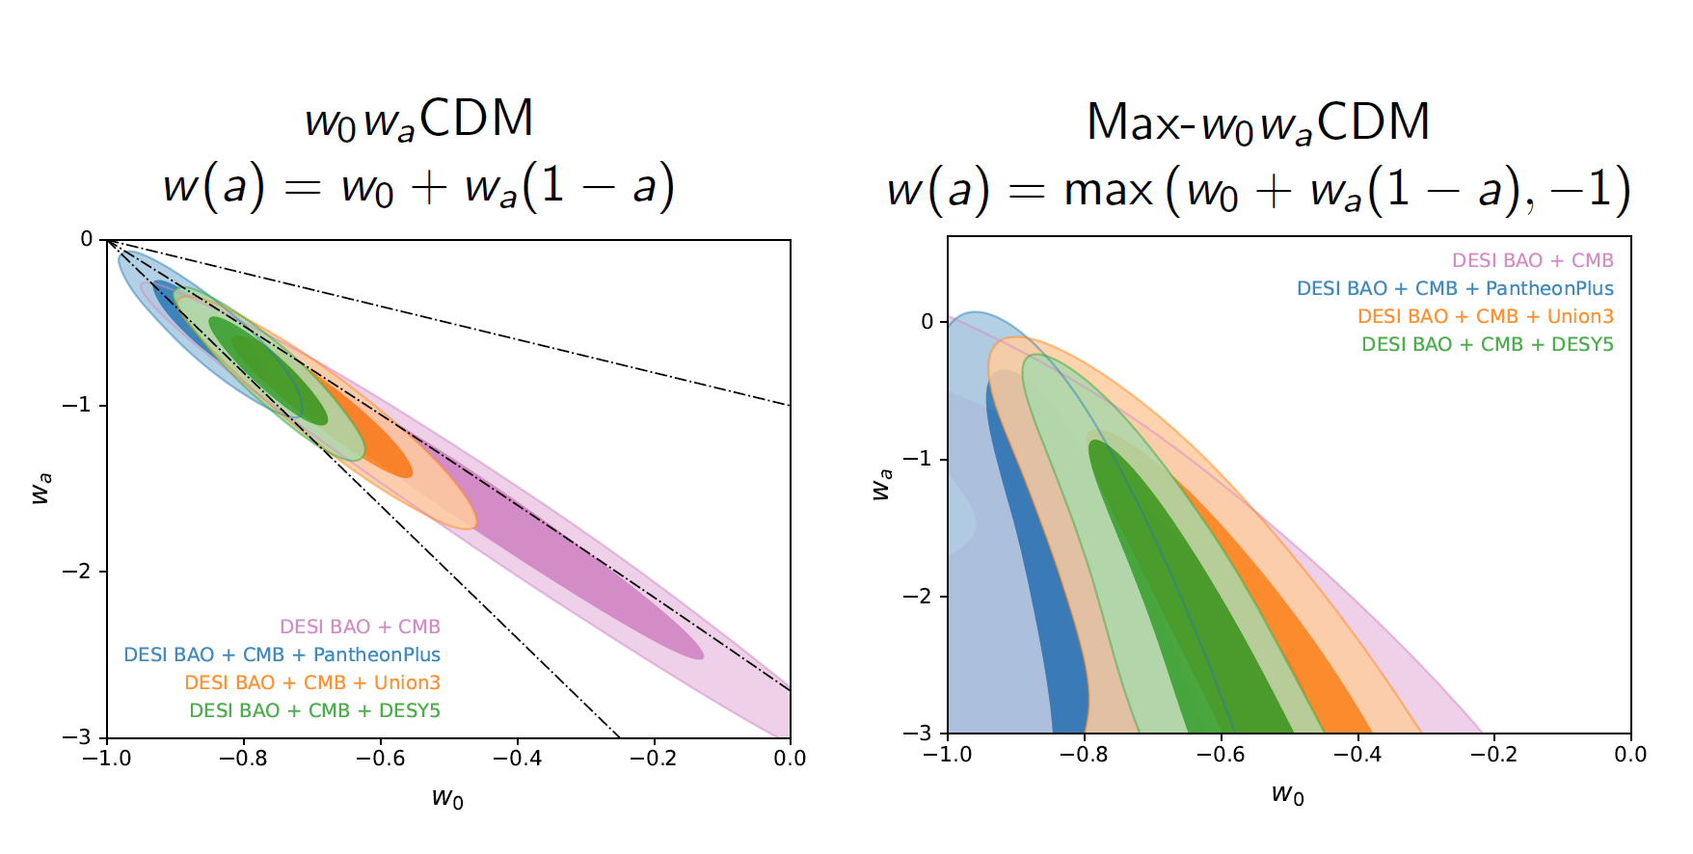

Slide 25
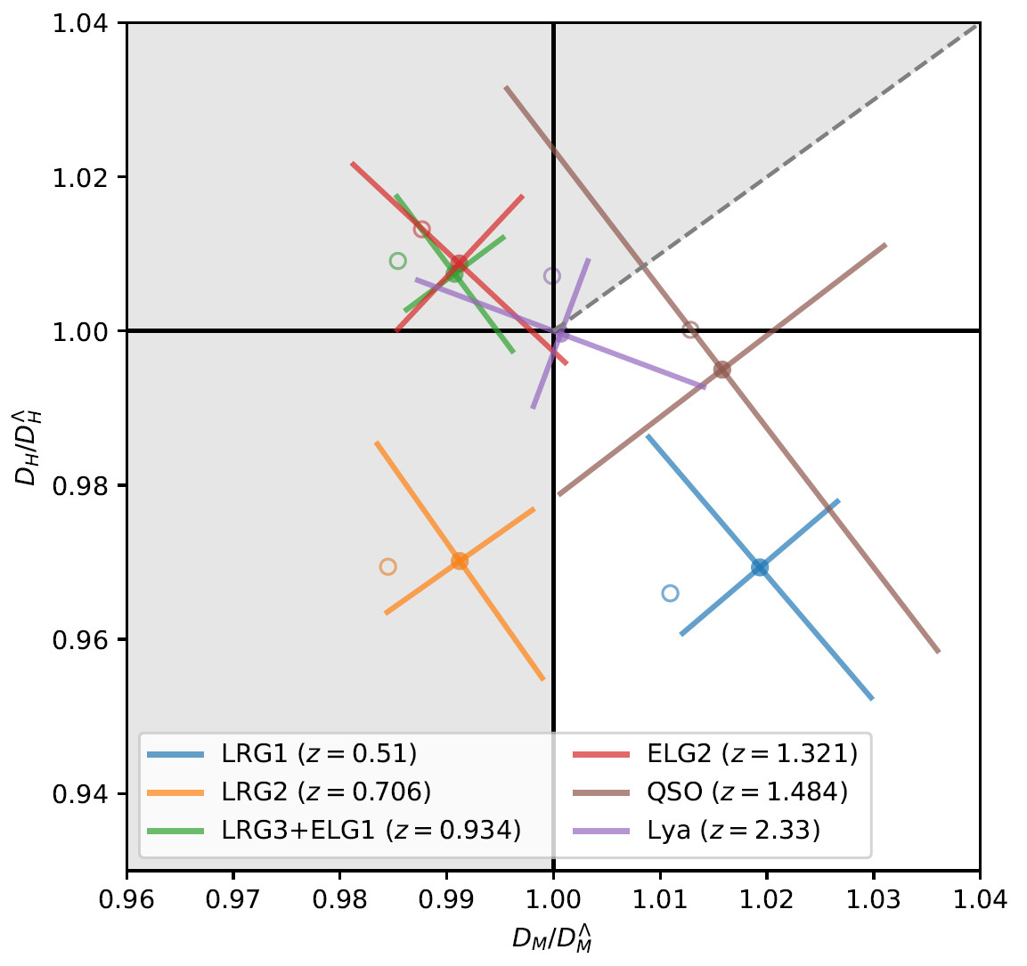
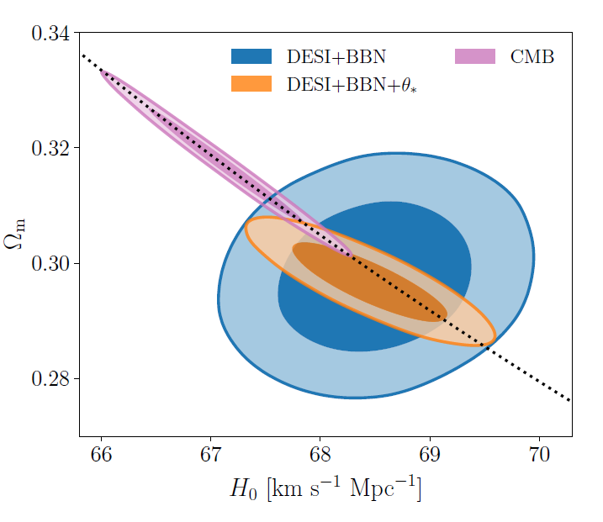
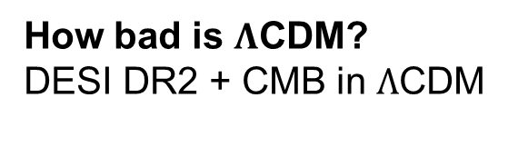

How bad is $Λ$CDM?
DESI DR2 + CMB in $Λ$CDM
DESI+Planck best fit $Λ$CDM fiducial
arXiv:2503.14738
arXiv:2503.14452
Open markers show the data points for Planck$ΛCDM$

Slide 26
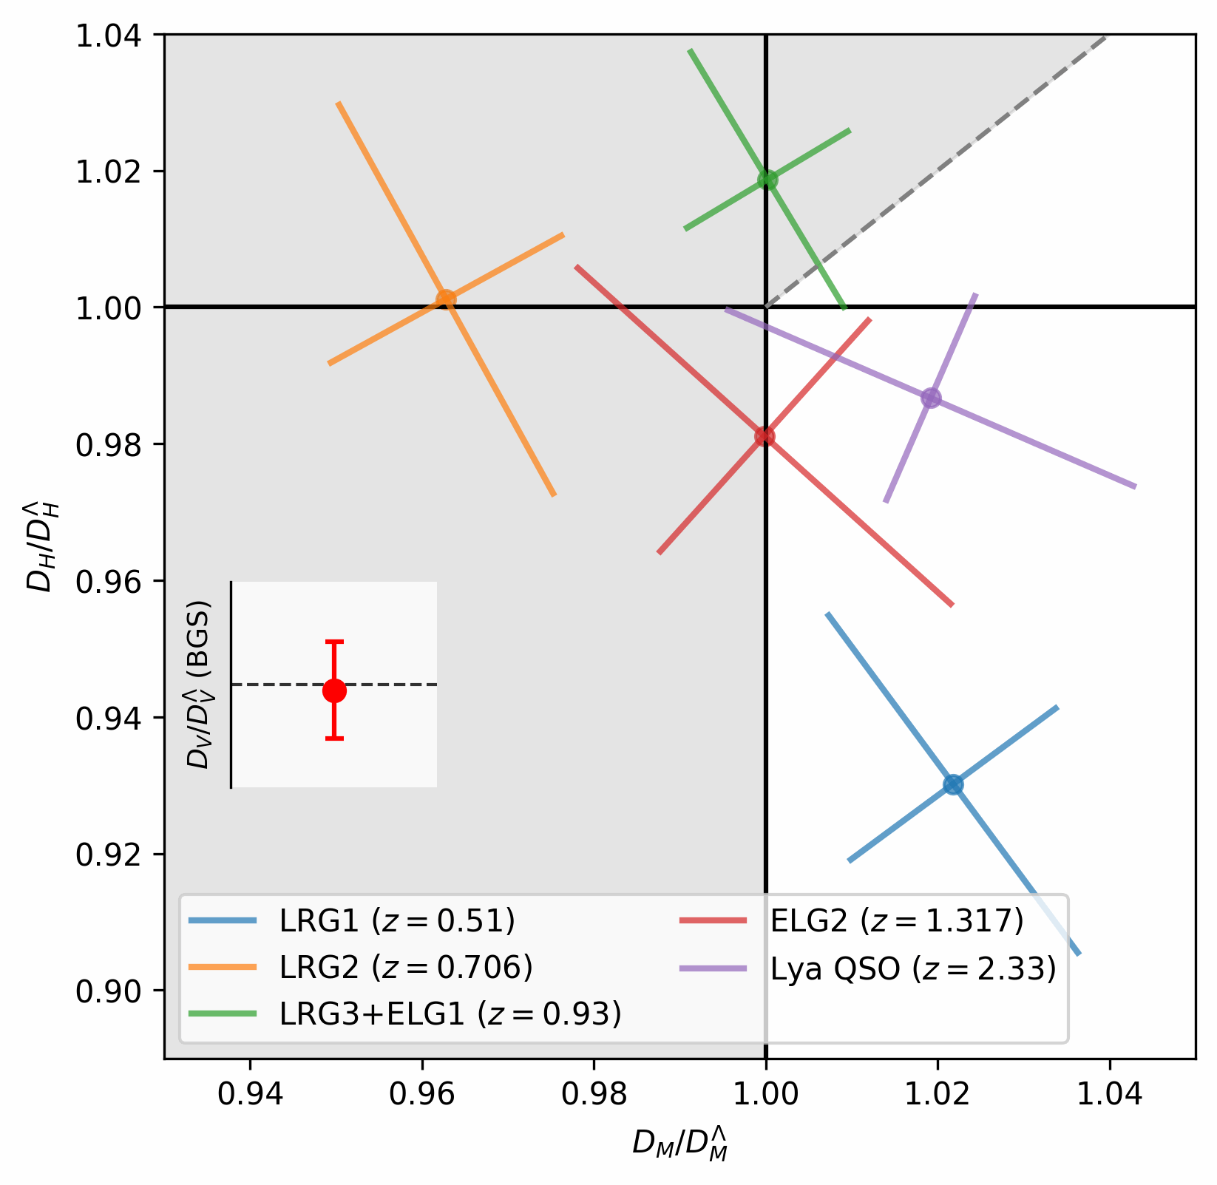

DR1 to DR2 vs Planck+DR2 best fit $ΛCDM$

Slide 27
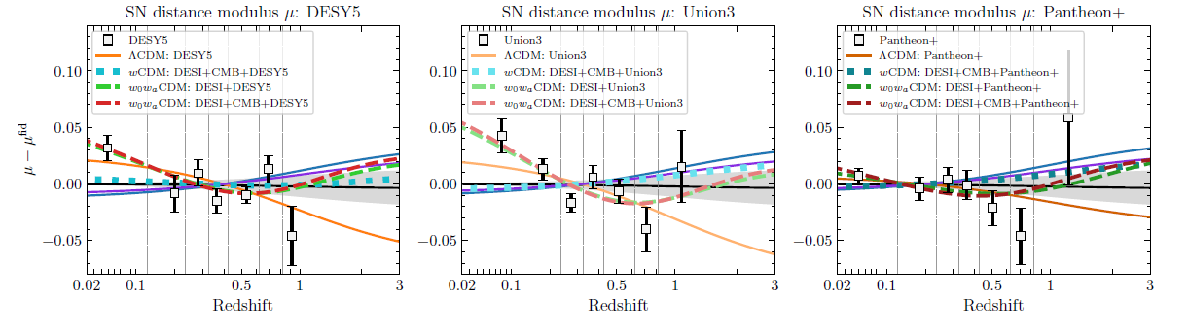
DESI DR2 paper: uncalibrated SN data/best-fits vs Planck 2018
DESI Collaboration: arXiv:2503.14738
Note: some shift with DES-Dovekie reanalysis
“only weak preference for evolving dark energy”.
arXiv:2511.07517
ALSO: $w_{0}w_{a}$ model fits to DESI + uncalibrated SN + CMB give $H_{0}$ similar to $ΛCDM$
- i.e. still inconsistent with the higher $H_{0}$ result obtained from calibrated SN

Slide 28
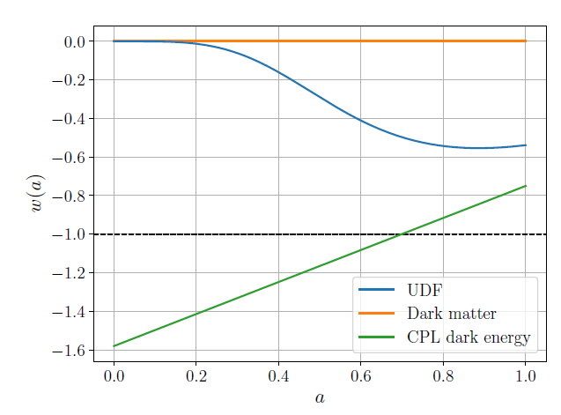
CPL-like evolution without null-energy violation?
e.g. CDM+DE unified fluid (UDF), interactions, modified gravity,…. etc.
UDF mimicking CPL best-fit
e.g. Kou, Lewis: arXiv:2509.16155

Slide 29
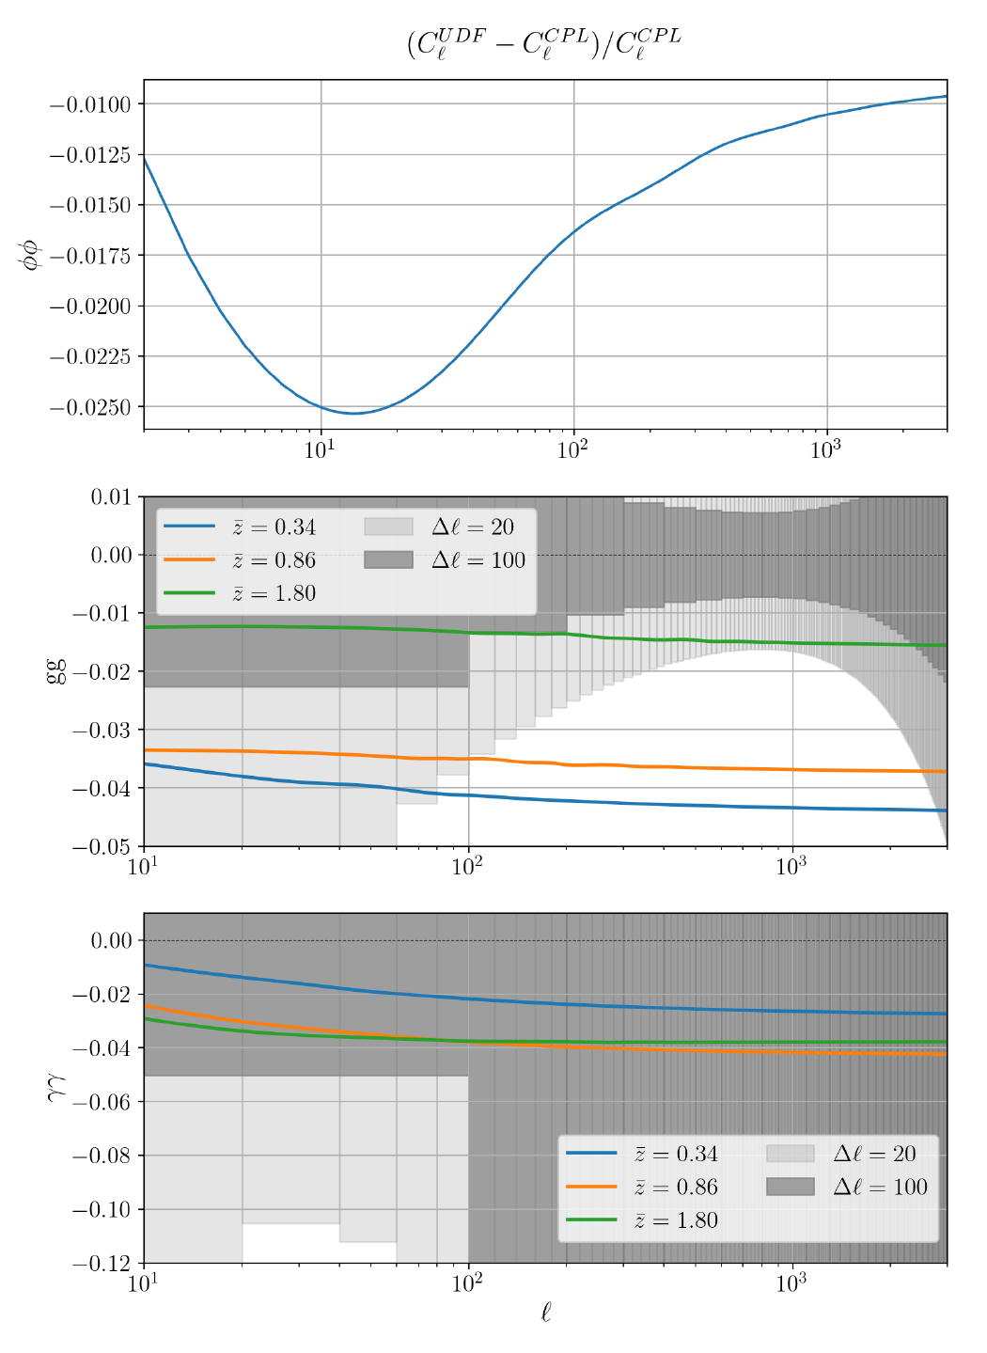
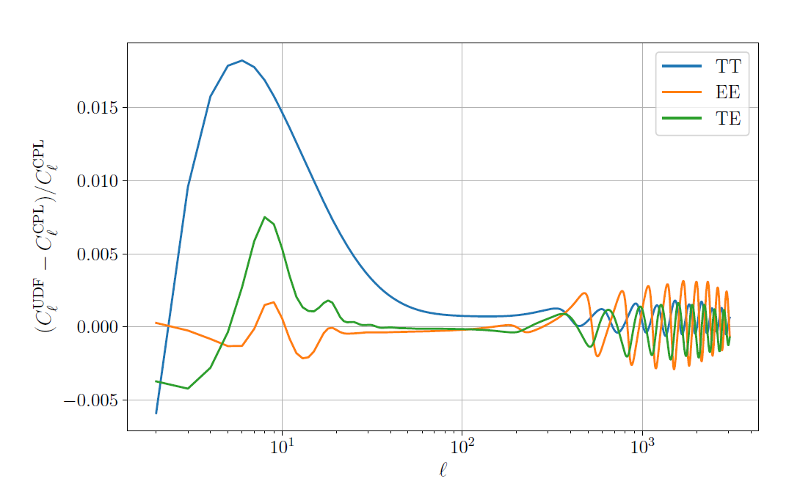
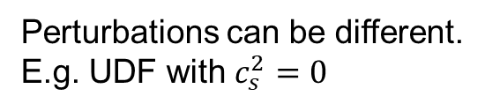
Perturbations can be different.
E.g. UDF with $c_{s}^{2}=0$
Very similar predictions to CPL
on linear level, modulo bias/degeneracies.
Kou, Lewis: arXiv:2509.16155

Slide 30
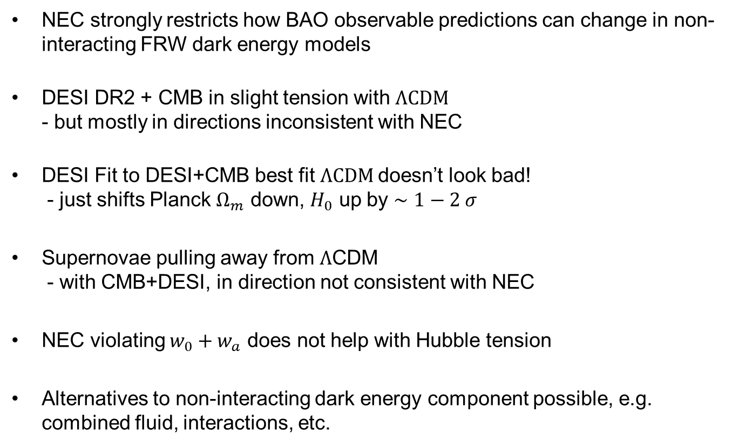
Conclusions
NEC strongly restricts how BAO observable predictions can change in non-interacting FRW dark energy models
DESI DR2 + CMB in slight tension with $ΛCDM$
- but mostly in directions inconsistent with NEC
DESI Fit to DESI+CMB best fit $ΛCDM$doesn’t look bad!
- just shifts Planck $Ω_{m}$ down, $H_{0}$ up by $∼1−2 σ$
Supernovae pulling away from $Λ$CDM
- with CMB+DESI, in direction not consistent with NEC
NEC violating $w_{0}+w_{a}$ does not help with Hubble tension
Alternatives to non-interacting dark energy component possible, e.g. combined fluid, interactions, etc.

Slide 33
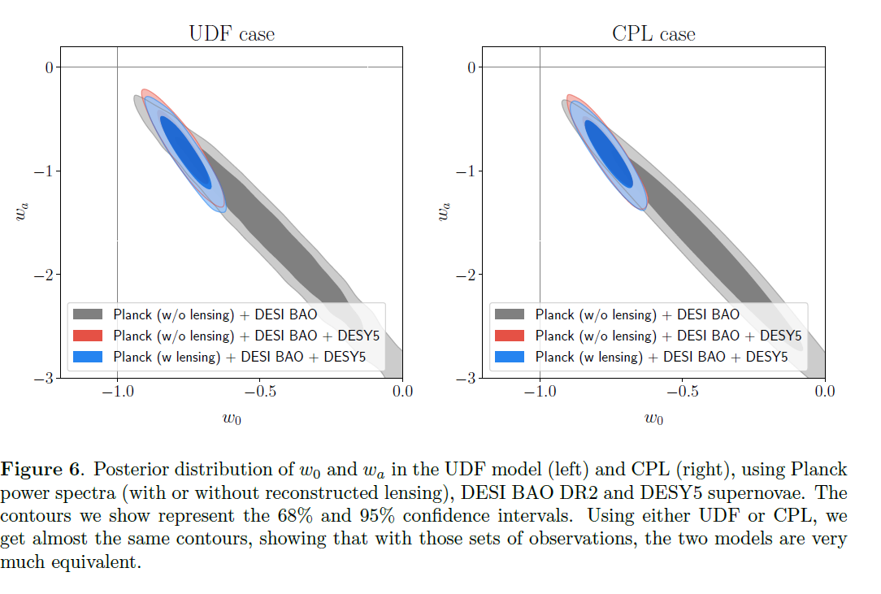

Slide 34
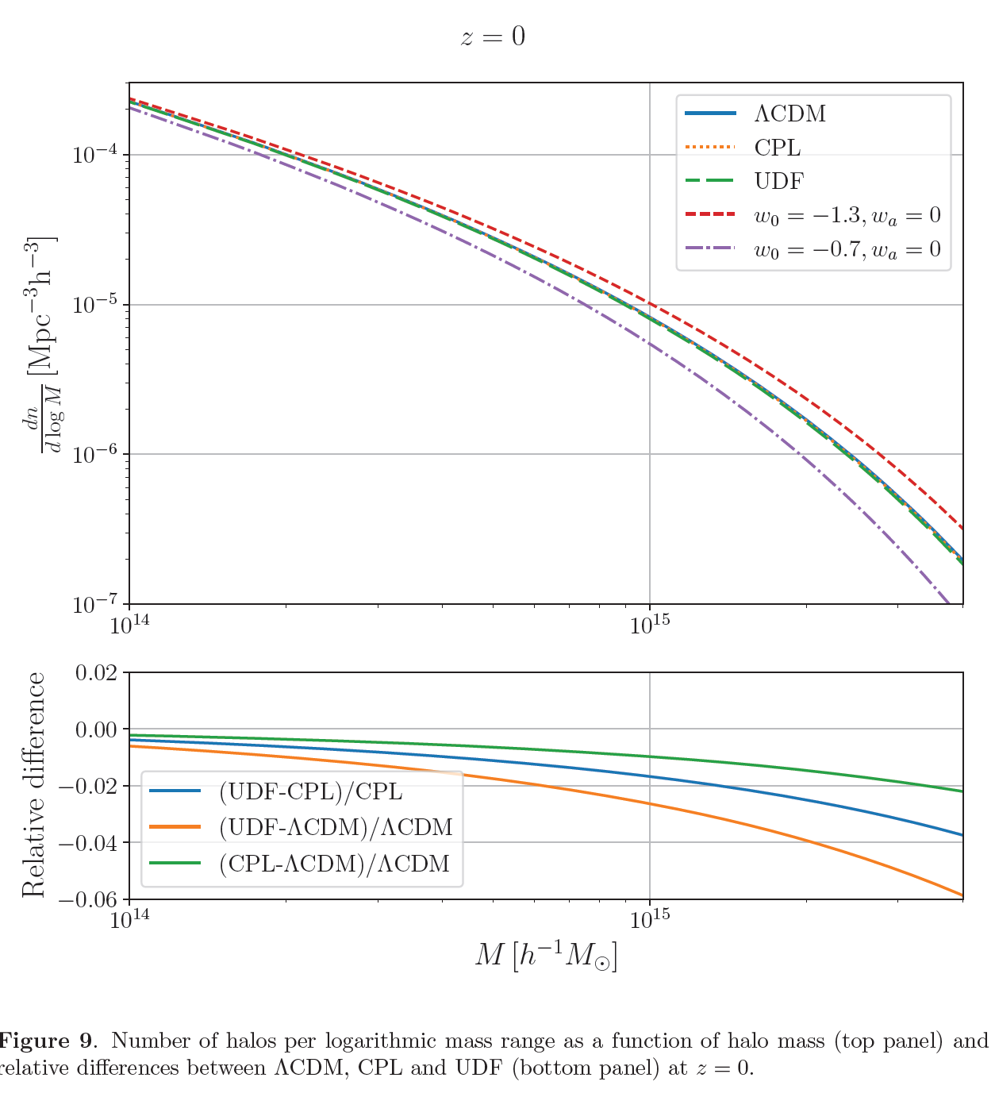

Slide 36
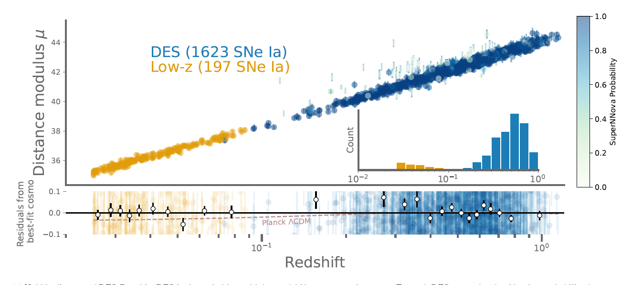

Slide 37
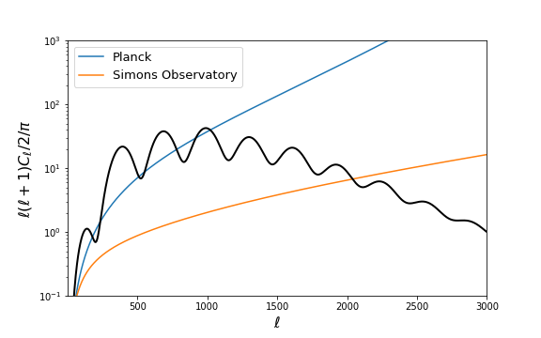
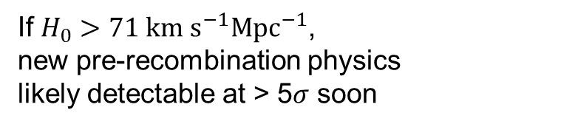
High resolution/sensitivity polarization:
precision small-scale EE, TE, TT power spectrum
EE polarization noise
e.g. Poulin et al. early dark energy model
If $H_{0}>71 km s^{−1}{Mpc}^{−1}$,
new pre-recombination physics
likely detectable at > 5$σ$ soon
Distinct physical models give
different precision predictions

