Slide 1
Stats for Engineers Lecture 7

Slide 2


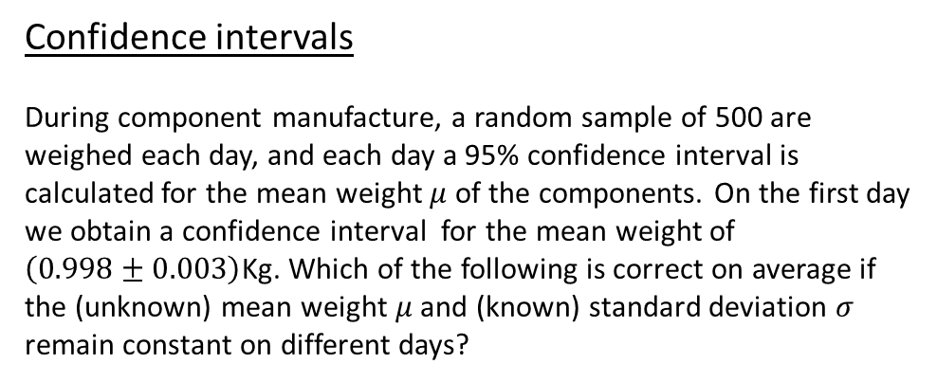
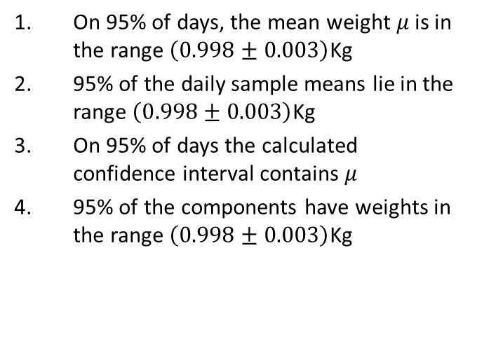
Confidence intervals
During component manufacture, a random sample of 500 are weighed each day, and each day a 95% confidence interval is calculated for the mean weight $μ$ of the components. On the first day we obtain a confidence interval for the mean weight of $\left(0.998±0.003\right)$Kg. Which of the following is correct on average if the (unknown) mean weight $μ$ and (known) standard deviation $σ$ remain constant on different days?
On 95% of days, the mean weight $μ$ is in the range $\left(0.998±0.003\right)$Kg
95% of the daily sample means lie in the range $\left(0.998±0.003\right)$Kg
On 95% of days the calculated confidence interval contains $μ$
95% of the components have weights in the range $\left(0.998±0.003\right)$Kg

Slide 3
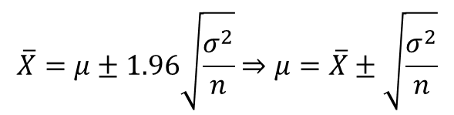
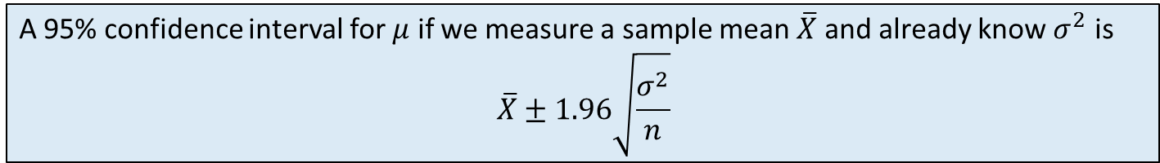
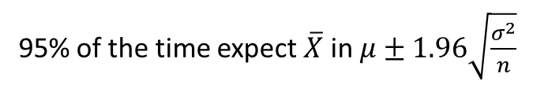

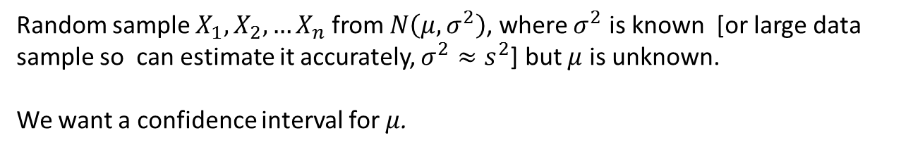
Recap: Confidence Intervals for the mean
Random sample $X_{1},X_{2},…X_{n}$ from $N\left(μ, σ^{2}\right)$, where $σ^{2}$ is known [or large data sample so can estimate it accurately, $σ^{2}≈s^{2}$] but $μ$ is unknown.
We want a confidence interval for $μ$.
Reminder: $\overline{X}∼N(μ,\frac{σ^{2}}{n})$
With probability 0.95, a Normal random variables lies within 1.96 standard deviations of the mean.
P=0.025
P=0.025
95% of the time expect $\overline{X}$ in $μ±1.96\sqrt{\frac{σ^{2}}{n}}$
$$\overline{X}=μ±1.96\sqrt{\frac{σ^{2}}{n}}⇒μ=\overline{X}±\sqrt{\frac{σ^{2}}{n}}$$
A 95% confidence interval for $μ$ if we measure a sample mean $\overline{X}$ and already know $σ^{2}$ is
$$\overline{X}±1.96\sqrt{\frac{σ^{2}}{n}}$$

Slide 4
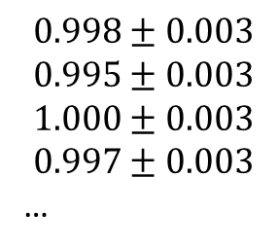
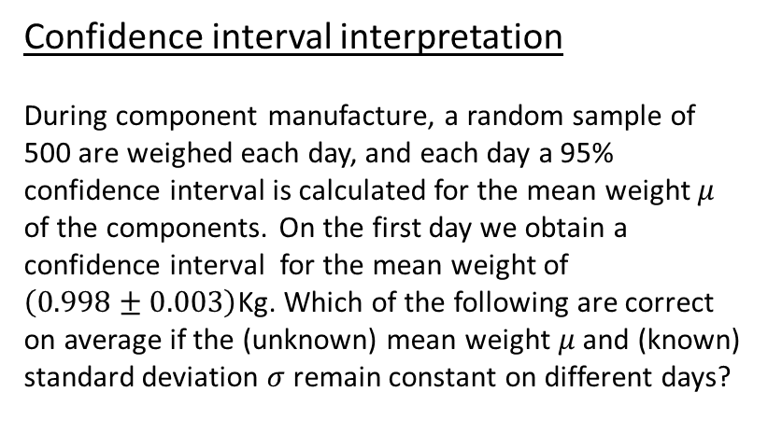
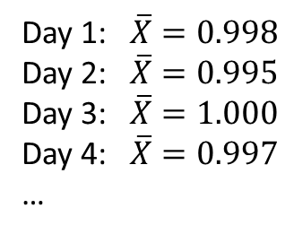



Confidence interval interpretation
During component manufacture, a random sample of 500 are weighed each day, and each day a 95% confidence interval is calculated for the mean weight $μ$ of the components. On the first day we obtain a confidence interval for the mean weight of $\left(0.998±0.003\right)$Kg. Which of the following are correct on average if the (unknown) mean weight $μ$ and (known) standard deviation $σ$ remain constant on different days?
$\overline{X}∼N\left(μ,\frac{σ^{2}}{n}\right)$, so 95% of the time the sample mean $\overline{X}$ lies in $\overline{X}=μ±1.96\sqrt{\frac{σ^{2}}{n}}$
here $μ±1.96\sqrt{\frac{σ^{2}}{n}}=μ±0.003$
Every day we get a different sample, so different $\overline{X}$.
e.g.
Confidence interval
Day 1: $\overline{X}=0.998$
Day 2: $\overline{X}=0.995$
Day 3: $\overline{X}=1.000$
Day 4: $\overline{X}=0.997$
…
$$0.998±0.003$$
$$0.995±0.003$$
$$1.000±0.003$$
$$0.997±0.003$$
…
95% of the time, $\overline{X}$ is in $μ±0.003$
$⇒$95% of the time, $μ$ is in $\overline{X}±0.003$

Slide 5
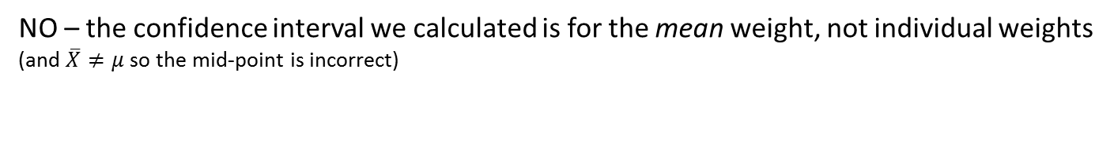
Other answers?
On 95% of days, the mean weight is in the range $\left(0.998±0.003\right)$Kg
NO - the mean weight $μ$ is assumed to be a constant.
It is either in the range or it isn’t – if true for one day it will be true for all days
95% of the components have weights in the range $\left(0.998±0.003\right)$Kg
NO – the confidence interval we calculated is for the mean weight, not individual weights
(and $\overline{X}≠μ$ so the mid-point is incorrect)
95% of the daily sample means lie in the range $\left(0.998±0.003\right)$Kg
NO – the correct statement is that 95% of the time $\overline{X}$ lies in $\left(μ±0.003\right)Kg$
Statement would only be true if on the first day we got $\overline{X}=μ$, which has negligible probability

Slide 6
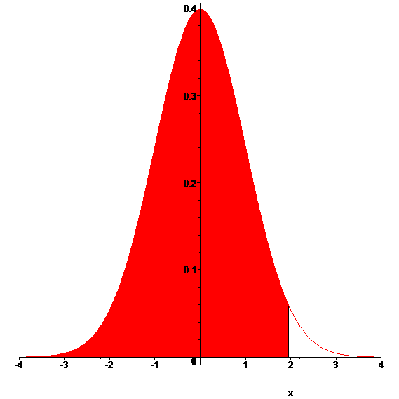
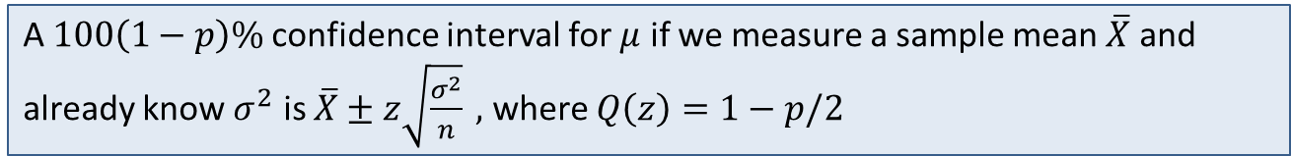
In general can use any confidence level, not just 95%.
95% confidence level has 5% in the tails, i.e. p=0.05 in the tails.
In general to have probability $p$ in the tails; for two tail, $p/2$ in each tail:
A $100\left(1−p\right)\%$confidence interval for $μ$ if we measure a sample mean $\overline{X}$ and already know $σ^{2}$ is $\overline{X}±z\sqrt{\frac{σ^{2}}{n}} ,$ where $Q\left(z\right)=1−p/2$
p/2
p/2
Q
E.g. for a 99% confidence interval, we would want $Q\left(z\right)=0.995$.

Slide 7
Two tail versus one tail
Does the distribution have two small tails or one? Or are we only interested in upper or lower limits?
If the distribution is one sided, or we want upper or lower limits, a one tail interval may be more appropriate.
95% One tail
95% Two tail
P=0.05
P=0.025
P=0.025

Slide 8
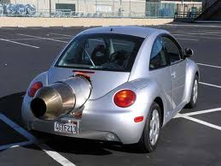
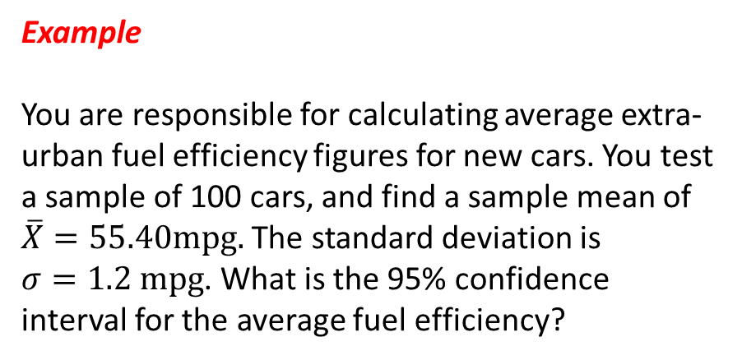
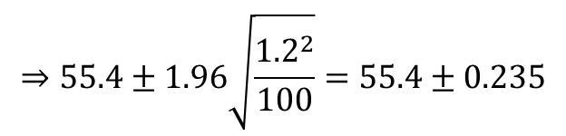
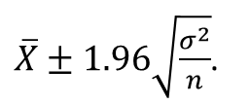
Example
You are responsible for calculating average extra-urban fuel efficiency figures for new cars. You test a sample of 100 cars, and find a sample mean of $\overline{X}=55.40mpg.$ The standard deviation is $σ=1.2 mpg$. What is the 95% confidence interval for the average fuel efficiency?
Answer:
$\overline{X}±1.96\sqrt{\frac{σ^{2}}{n}}$.
Sample size if $n=100$ and 95% confidence interval is
$$⇒55.4±1.96\sqrt{\frac{{1.2}^{2}}{100}}=55.4±0.235$$
i.e. mean $μ$ in 55.165 to 55.63 mpg at 95% confidence

Slide 9
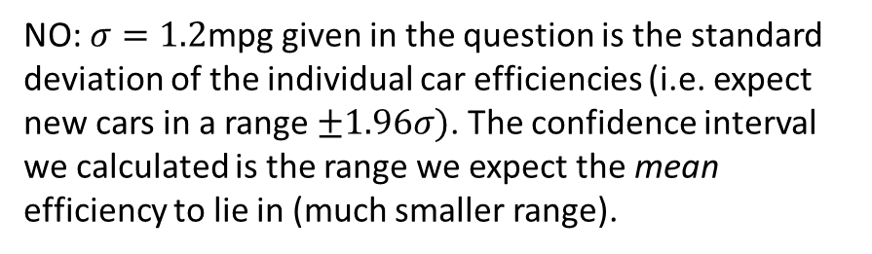
Confidence interval
Given the confidence interval just constructed, it is correct to say that approximately 95% of new cars will have efficiencies between 55.165 and 55.63 mpg?
Question from Derek Bruff
YES – high confidence
YES – low confidence
NO – high confidence
NO – low confidence
NO: $σ=1.2$mpg given in the question is the standard deviation of the individual car efficiencies (i.e. expect new cars in a range $±1.96σ)$. The confidence interval we calculated is the range we expect the mean efficiency to lie in (much smaller range).
10
Countdown

Slide 10
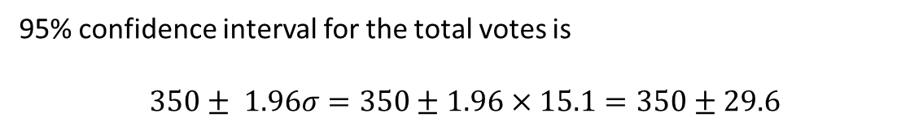


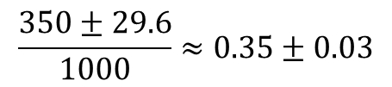
Example: Polling
A sample of 1000 random voters were polled, with 350 saying they will vote for the Conservatives and 650 saying another party. What is the 95% confidence interval for the Conservative share of the vote?
Answer: this is Binomial data, but large $n=1000$ so can approximate as Normal
Random variable $X$ is the number voting Conservative, $X∼N(μ,σ^{2})$
Take variance from the Binomial result with $p≈\frac{350}{1000}=0.35$
$$σ^{2}=np\left(1−p\right)≈1000×0.35×\left(1−0.35\right)=227.5$$
$$⇒σ=\sqrt{227.5}≈15.1$$
95% confidence interval for the total votes is
$$350± 1.96σ=350±1.96×15.1=350±29.6$$
$⇒$ 95% confidence interval for the fraction of the votes is
$$\frac{350±29.6}{1000}≈0.35±0.03$$
i.e. $±$3% confidence interval

Slide 11

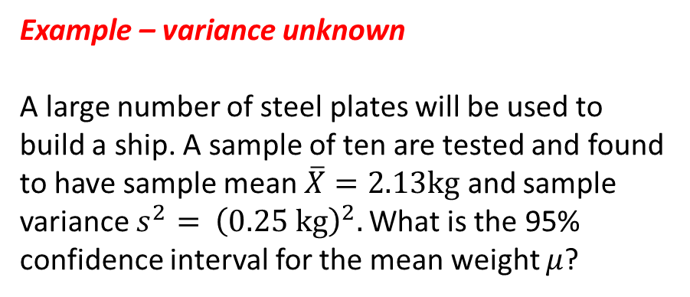
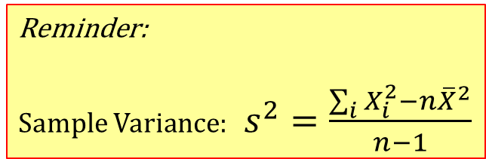
Example – variance unknown
A large number of steel plates will be used to build a ship. A sample of ten are tested and found to have sample mean $\overline{X}=2.13kg$ and sample variance $s^{2}=$ ${\left(0.25 kg\right)}^{2}.$ What is the 95% confidence interval for the mean weight $μ$?
Reminder:
Sample Variance:$s^{2}=\frac{\sum_{i}{X_{i}^{2}}−n{\overline{X}}^{2}}{n−1}$

Slide 12
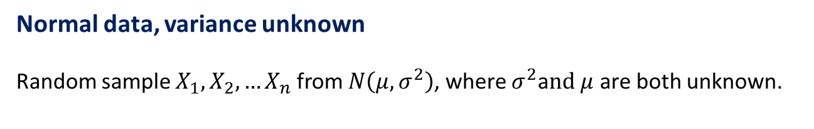
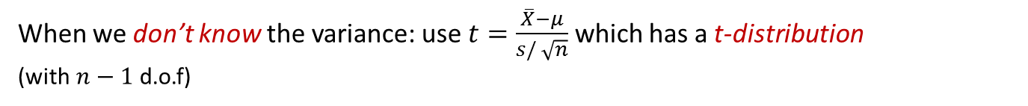

Normal data, variance unknown
Random sample $X_{1},X_{2},…X_{n}$ from $N\left(μ, σ^{2}\right)$, where $σ^{2}$a$nd μ$ are both unknown.
Want a confidence interval for $μ$, using observed sample mean and variance.
When we know the variance: use $z=$ $\frac{\overline{X}−μ}{σ/ \sqrt{n}}$ which is normally distributed
Remember: $\overline{X}∼N\left(μ,\frac{σ^{2}}{n}\right)$
But don’t know $σ^{2}$, so have to use sample estimate $s^{2}$
When we don’t know the variance: use $t=\frac{\overline{X}−μ}{s/ \sqrt{n}}$ which has a t-distribution
(with $n−1$ d.o.f)
Sometimes more fully as “Student’s t-distribution”
Wikipedia

Slide 13
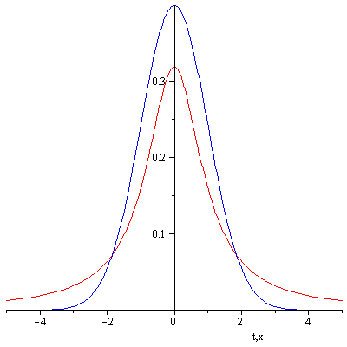
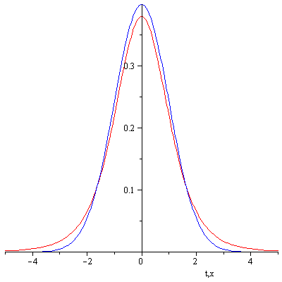



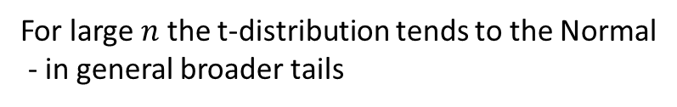
$$ν=n−1=1$$
$$ν=n−1=5$$
$$ν=n−1=50$$
Normal
t-distribution
For large $n$ the t-distribution tends to the Normal
- in general broader tails

Slide 14
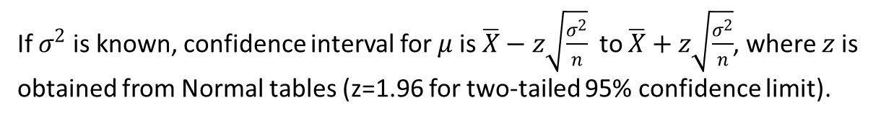
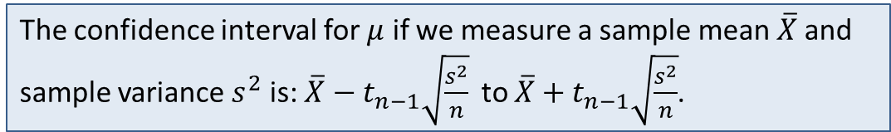

Confidence Intervals for the mean
If $σ^{2}$ is known, confidence interval for $μ$ is $\overline{X}−z\sqrt{\frac{σ^{2}}{n}}$ to $\overline{X}+z\sqrt{\frac{σ^{2}}{n}}$, where $z$ is obtained from Normal tables (z=1.96 for two-tailed 95% confidence limit).
If $σ^{2}$ is unknown, we need to make two changes:
(i) Estimate $σ^{2}$ by $s^{2}$, the sample variance;
(ii) replace z by $t_{n−1}$, the value obtained from t-tables,
The confidence interval for $μ$ if we measure a sample mean $\overline{X}$and sample variance $s^{2}$ is: $\overline{X}−t_{n−1}\sqrt{\frac{s^{2}}{n}}$ to $\overline{X}+t_{n−1}\sqrt{\frac{s^{2}}{n}}$.

Slide 15
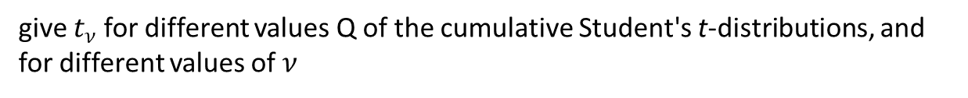
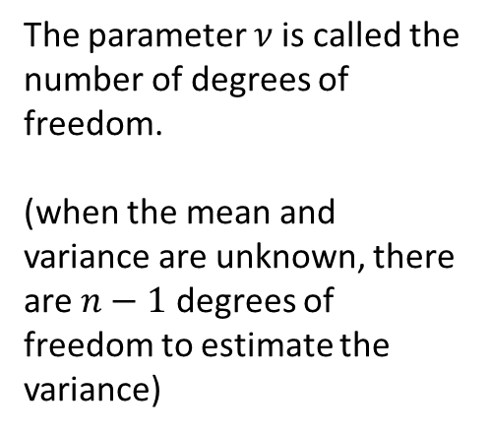
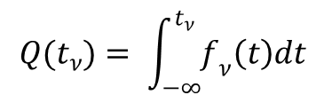

t-tables
give $t_{ν}$ for different values Q of the cumulative Student's t-distributions, and for different values of $ν$
$$Q(t_{ν})= \int_{−∞}^{t_{ν}}{f_{ν}\left(t\right)dt}$$
The parameter $ν$ is called the number of degrees of freedom.
(when the mean and variance are unknown, there are $n−1$ degrees of freedom to estimate the variance)
Q
$t_{ν}$

Slide 16
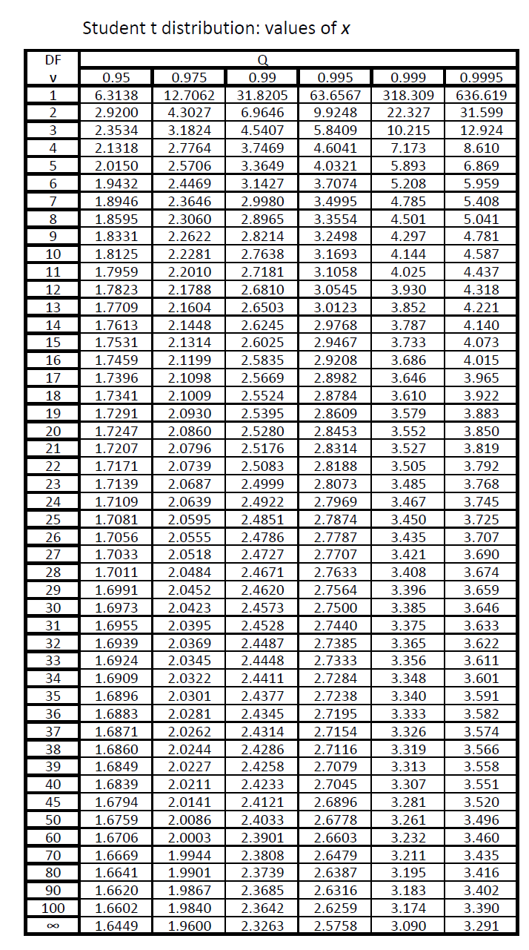

Q
$t_{ν}$
For a 95% confidence interval, we want the middle 95% region, so Q = 0.975
(0.05/2=0.025 in both tails).
Similarly, for a 99% confidence interval, we would want Q = 0.995.

Slide 17
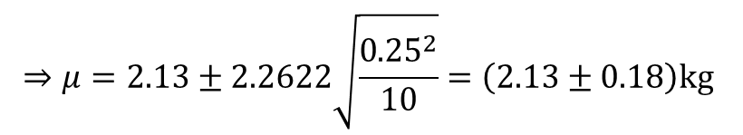
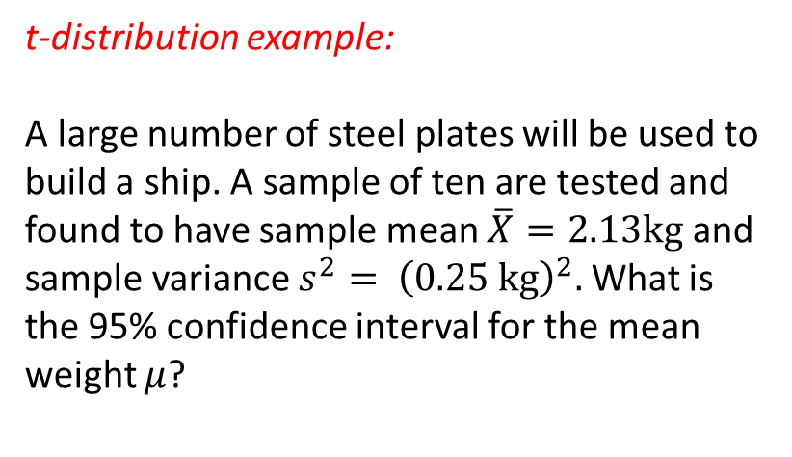



t-distribution example:
A large number of steel plates will be used to build a ship. A sample of ten are tested and found to have sample mean $\overline{X}=2.13kg$ and sample variance $s^{2}=$ ${\left(0.25 kg\right)}^{2}.$ What is the 95% confidence interval for the mean weight $μ$?
Answer:
From t-tables, $ν=n−1=9$for Q = 0.975
$t_{9}$ = 2.2622.
95% confidence interval for $μ$ is:
$$μ=\overline{X}±t_{n−1}\sqrt{\frac{s^{2}}{n}}$$
$$⇒μ=2.13±2.2622\sqrt{\frac{{0.25}^{2}}{10}}=\left(2.13±0.18\right)kg$$
i.e. 1.95 to 2.31

Slide 18
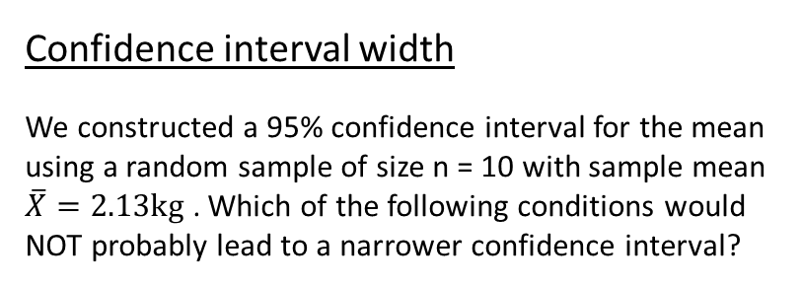
Confidence interval width
We constructed a 95% confidence interval for the mean using a random sample of size n = 10 with sample mean $\overline{X}=2.13kg$ . Which of the following conditions would NOT probably lead to a narrower confidence interval?
Question adapted from
Derek Bruff
If you decreased your confidence level
If you increased your sample size
If the sample mean was smaller
If the population standard deviation was smaller

Slide 19

Confidence interval width
We constructed a 95% confidence interval for the mean using a random sample of size n = 10 with sample mean $\overline{X}=2.13kg$ . Which of the following conditions would NOT probably lead to a narrower confidence interval?
95% confidence interval for $μ$ is:$μ=\overline{X}±t_{n−1}\sqrt{\frac{s^{2}}{n}}$; width is $2t_{n−1}\sqrt{\frac{s^{2}}{n}}$
Decrease your confidence level?
$⇒$ larger tail $⇒$ smaller $t_{ν}$ $⇒$ smaller confidence interval
Increase your sample size?
$⇒$ $n$ larger $⇒$ smaller confidence interval ($\frac{s^{2}}{n}$ and $t_{n−1}$ both likely to be smaller)
Smaller sample mean?
$⇒\overline{X}$ smaller $⇒$ just changes mid-point, not width
Smaller population standard deviation?
$⇒$ $s^{2}$ likely to be smaller $⇒$ smaller confidence interval

Slide 20

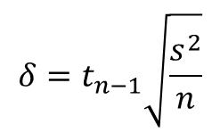


Sample size
How many random samples do you need to reach desired level of precision?
For example, for Normal data, confidence interval for $μ$ is $\overline{X}±t_{n−1}\sqrt{\frac{s^{2}}{n}}$.
Suppose we want to estimate $μ$ to within $±δ$, where $δ$ (and the degree of confidence) is given.
$$δ=t_{n−1}\sqrt{\frac{s^{2}}{n}}$$
Want
$$⇒n=\frac{t_{n−1}^{2}s^{2}}{δ^{2}}$$
Need:
- Estimate of $s^{2}$ (e.g. previous experiments)
- Estimate of $t_{n−1}$. This depends on n, but not very strongly.
e.g. take $t_{n−1}=2.1$ for 95% confidence.
Rule of thumb: for 95% confidence, choose $n=\frac{{2.1}^{2}×Estimate of variance}{δ^{2}}$

Slide 21
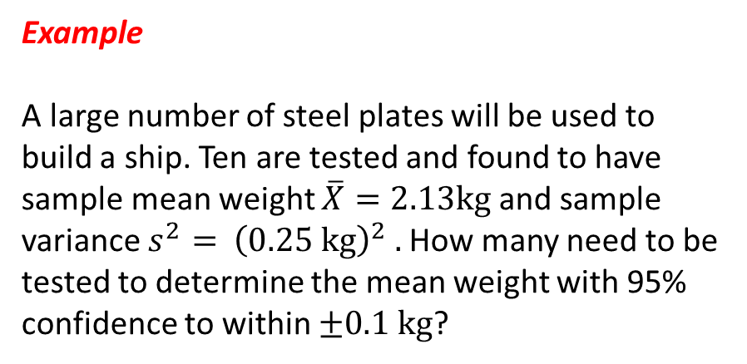

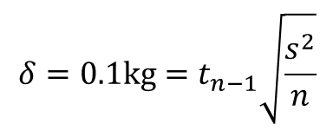
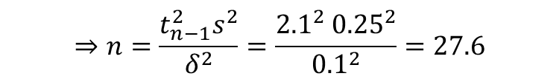
Example
A large number of steel plates will be used to build a ship. Ten are tested and found to have sample mean weight $\overline{X}=2.13kg$ and sample variance $s^{2}=$ ${\left(0.25 kg\right)}^{2} .$ How many need to be tested to determine the mean weight with 95% confidence to within $±0.1 kg$?
Answer:
$$δ=0.1kg=t_{n−1}\sqrt{\frac{s^{2}}{n}}$$
Want
Take $t_{n−1}=2.1$ for 95% confidence.
$$⇒n=\frac{t_{n−1}^{2}s^{2}}{δ^{2}}=\frac{{2.1}^{2} {0.25}^{2}}{{0.1}^{2}}=27.6$$
i.e. need to test about 28

Slide 22

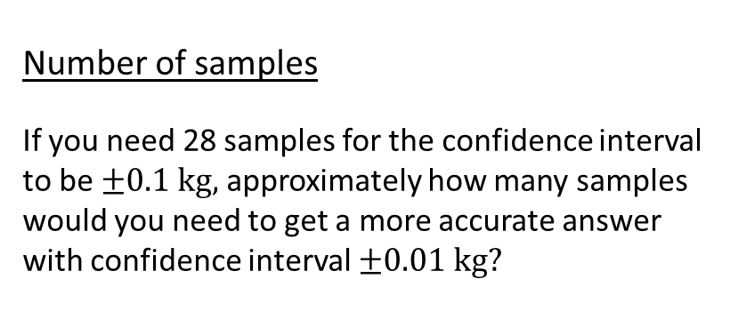
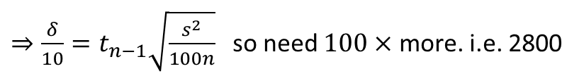
Number of samples
If you need 28 samples for the confidence interval to be $±0.1 kg,$ approximately how many samples would you need to get a more accurate answer with confidence interval $±0.01 kg?$
88.5
280
2800
28000
$$δ=t_{n−1}\sqrt{\frac{s^{2}}{n}}$$
$⇒\frac{δ}{10}=t_{n−1}\sqrt{\frac{s^{2}}{100n}}$ so need $100×$ more. i.e. 2800

Slide 23
Linear regression
We measure a response variable $y$ at various values of a controlled variable $x$
e.g. measure fuel efficiency $y$ at various values of an experimentally controlled external temperature $x$
Linear regression: fitting a straight line to the mean value of $y$ as a function of $x$

Slide 24
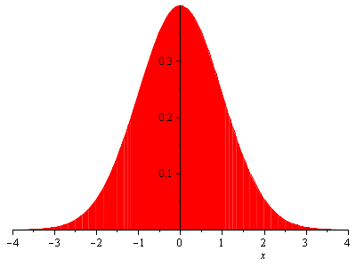

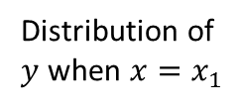
$$y$$
$$y=ax+b$$
Distribution of
$y$ when $x=x_{1}$
$$x_{1}$$
$$x_{2}$$
$$x_{3}$$
$$x$$
Regression curve:
fits the mean values of the $y$ distributions

Slide 25
From a sample of $y$ values at various $x$, we want to fit the regression curve.
e.g.

Slide 26
Or is it
What do we mean by a line being a ‘good fit’?

Slide 27
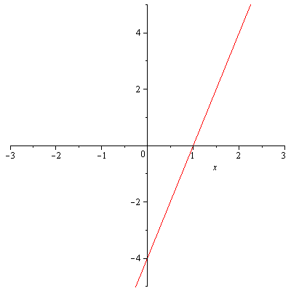
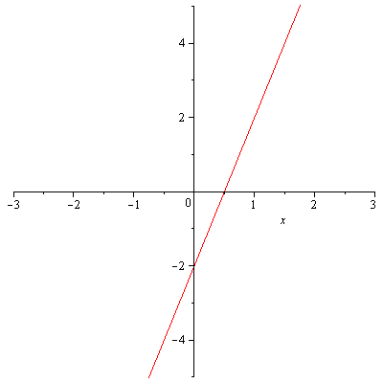
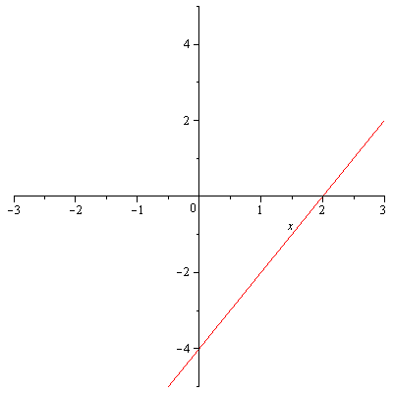
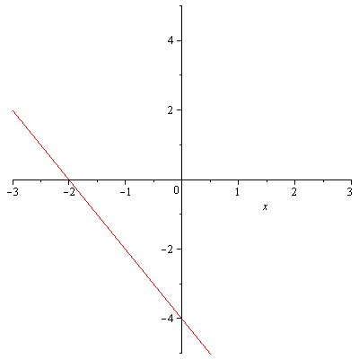
Straight line plots
Which graph is of the line $y=2x−4$?
$$y$$
$$x$$
1.
2.
Plot
Plot2
Plot3
Plot4
3.
4.

Slide 28


Equation of straight line is $y=a+bx$
Simple model for data:
$$y_{i}=a+b x_{i}+e_{i}$$
Straight line
Random error
Simplest assumption: $e_{i}∼N(0,σ^{2})$ for all $i$, and $e_{i}$'s are independent
- Linear regression model

Slide 29

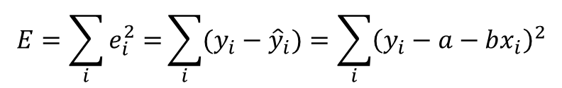

Model is $y_{i}=a+b x_{i}+e_{i}$
Want to estimate parameters a and b, using the data.
e.g. - choose $a$ and $b$ to minimize the errors
Maximum likelihood estimate = least -squares estimate
$$E=\sum_{i}{e_{i}^{2}=}\sum_{i}{(y_{i}−{\hat{y}}_{i})}=\sum_{i}{{\left(y_{i}−a−bx_{i}\right)}^{2}}$$
Minimize
Data point
Straight-line prediction
E is defined and can be minimized even when errors not Normal
– least-squares is simple general prescription for fitting a straight line
(but statistical interpretation in general less clear)

Slide 30





The line $y=4+2x$ has been proposed as a line of best fit for the following four sets of data. For which data set is this line the best fit (minimum $E=\sum_{i}{e_{i}^{2}}$)?
Question from Derek Bruff
1.
2.
Pic1
Pic2
Pic correct
pic4
3.
4.

Slide 31



How to find $a$ and $b$ that minimize $E=\sum_{i}{e_{i}^{2}=}\sum_{i}{{\left(y_{i}−a−bx_{i}\right)}^{2}}$ ?
For minimum want $\frac{∂E}{∂a}=0$ and $\frac{∂E}{∂b}=0$, see notes for derivation
Solution is the least-squares estimates $\hat{a}$ and $\hat{b}$:
$$\hat{b}=\frac{S_{xy}}{S_{xx}} and \hat{a}=\overline{y}−\hat{b} \overline{x}$$
Sample means
Where
$$S_{xx}= \sum_{i}{x_{i}^{2}}−\frac{{\left(\sum_{i}{x_{i}}\right)}^{2}}{n}=\sum_{i}{{\left(x_{i}− \overline{x}\right)}^{2}}$$
$$S_{xy}= \sum_{i}{x_{i}y_{i}}− \frac{\sum_{i}{x_{i}\sum_{i}{y_{i}}}}{n}=\sum_{i}{(x_{i}−\overline{x}){\left(y_{i}−\overline{y}\right)}_{}}$$
Equation of the fitted line is
$$\hat{y}=\hat{a}+\hat{b}x$$

Slide 32






Note that since $\hat{a}=\overline{y}−\hat{b} \overline{x}$
$$\hat{y}=\hat{a}+\hat{b}x \\ =\overline{y}−\hat{b}\overline{x}+\hat{b}x$$
$$⇒\hat{y}−\overline{y}=\hat{b}(x−\overline{x})$$
i.e. $(\overline{x},\overline{y})$ is on the line
$$\overline{y}$$
$$\overline{x}$$

Slide 33





Example:
The data y has been observed for various values of x, as follows:
$$\hat{b}=\frac{S_{xy}}{S_{xx}} and \hat{a}=\overline{y}−\hat{b} \overline{x}$$
$$S_{xx}= \sum_{i}{x_{i}^{2}}−\frac{{\left(\sum_{i}{x_{i}}\right)}^{2}}{n}$$
y | 240 | 181 | 193 | 155 | 172 | 110 | 113 | 75 | 94
x | 1.6 | 9.4 | 15.5 | 20.0 | 22.0 | 35.5 | 43.0 | 40.5 | 33.0
Fit the simple linear regression model using least squares.
$$S_{xy}= \sum_{i}{x_{i}y_{i}}− \frac{\sum_{i}{x_{i}\sum_{i}{y_{i}}}}{n}$$
Answer:
Want to fit $\hat{y}=\hat{a}+\hat{b}x$
n = 9
$\sum_{i}{x_{i}=220.5}$ , $\sum_{i}{y_{i}=1333.0}$
$\sum_{i}{y_{i}^{2}}=220549,$
$\sum_{i}{x_{i}y_{i}=26864}$
$\sum_{i}{x_{i}^{2}=7053.7}$,
$$S_{xx}= 7053.7−\frac{{220.5}^{2}}{9}$$
$$=1651.42$$
$$S_{xy}= 26864−\frac{220.50×1333.0}{9}$$
$$=−5794.1$$
$$⇒\hat{b}=\frac{S_{xy}}{S_{xx}}=−\frac{5794.5}{1651.45}$$
$$=−3.5086$$

Slide 34







Answer:
$$\hat{b}=\frac{S_{xy}}{S_{xx}} and \hat{a}=\overline{y}−\hat{b} \overline{x}$$
Want to fit $\hat{y}=\hat{a}+\hat{b}x$
n = 9
$\sum_{i}{x_{i}=220.5}$ , $\sum_{i}{y_{i}=1333.0}$
$$S_{xx}= \sum_{i}{x_{i}^{2}}−\frac{{\left(\sum_{i}{x_{i}}\right)}^{2}}{n}$$
$\sum_{i}{y_{i}^{2}}=220549,$
$\sum_{i}{x_{i}y_{i}=26864}$
$\sum_{i}{x_{i}^{2}=7053.7}$,
$$S_{xy}= \sum_{i}{x_{i}y_{i}}− \frac{\sum_{i}{x_{i}\sum_{i}{y_{i}}}}{n}$$
$$S_{xx}= 7053.7−\frac{{220.5}^{2}}{9}$$
$$=1651.42$$
$$S_{xy}= 26864−\frac{220.50×1333.0}{9}$$
$$=−5794.1$$
$$⇒\hat{b}=\frac{S_{xy}}{S_{xx}}=−\frac{5794.5}{1651.45}$$
$$=−3.5086$$
Now just need $\hat{a}$
$$\hat{a}=\overline{y}−\hat{b}\overline{x}$$
$$=\frac{1333.0}{9}−(−3.5086)×\frac{\left(220.50\right)}{9}=234.1$$
So the fit is approximately
$$y=234.1−3.509x$$

Slide 35
Which of the following data are likely to be most appropriately modelled using a linear regression model?
1.
2.
Correct
Errors change
Not straight
3.

Slide 36




Quantifying the goodness of the fit
Estimating $σ^{2}$: variance of y about the fitted line
Estimated error is: ${\hat{e}}_{i}=y_{i}−{\hat{y}}_{i}$
$μ_{e}=0$, so the ordinary sample variance of the $e_{i}$'s is $∼\frac{1}{n−1}\sum_{i}{{\hat{e}}_{i}^{2}}$
In fact, this is biased since two parameters, a and b have been estimated. The unbiased estimate is:
$${\hat{σ}}^{2}=\frac{1}{n−2} \sum{{\hat{e}}_{i}^{2}}=\frac{1}{n−2}\sum{{\left(y_{i}− {\hat{y}}_{i}\right)}^{2}}$$
$$=\frac{S_{yy}− \hat{b}S_{xy}}{n−2}$$
[derivation in notes]
Residual sum of squares

Slide 37




Which of the following plots would have the greatest residual sum of squares [variance of $y$ about the fitted line]?
Question from Derek Bruff
2.
Pic1
Pic2
Pic correct
1.
3.

Slide 38


Confidence interval for the slope, b
E.g. if you want to see if $b$ is significantly non-zero
Reminder: Normal data with unknown variance, confidence interval for $μ$ is:
to
$s^{2}/n$ is the estimate of $σ^{2}/n$, the variance of $\overline{X}$
It can be shown that $var\left(\hat{b}\right)=\frac{σ^{2}}{S_{xx}}$, estimated by $\frac{{\hat{σ}}^{2}}{S_{xx}}$ ($n−2$ degrees of freedom).
Confidence interval for b is
to

Slide 39




Predictions
For given $x$ of interest, what is mean $y$?
Predicted mean value: $\hat{y}=\hat{a}+\hat{b}x$.
What is the error bar?
It can be shown that
$$var\left(\hat{y} | x\right)=var\left(\hat{a}+\hat{b}x\right)=σ^{2}\left(\frac{1}{n}+\frac{{\left(x−\overline{x}\right)}^{2}}{S_{xx}}\right)$$
Confidence interval for mean y at given x
$\hat{y}±t_{n−2}\sqrt{{\hat{σ}}^{2}\left(\frac{1}{n}+\frac{{\left(x−\overline{x}\right)}^{2}}{S_{xx}}\right)}$
Extrapolation: Often not reliable

