Slide 1
Stats for Engineers Lecture 11

Slide 2
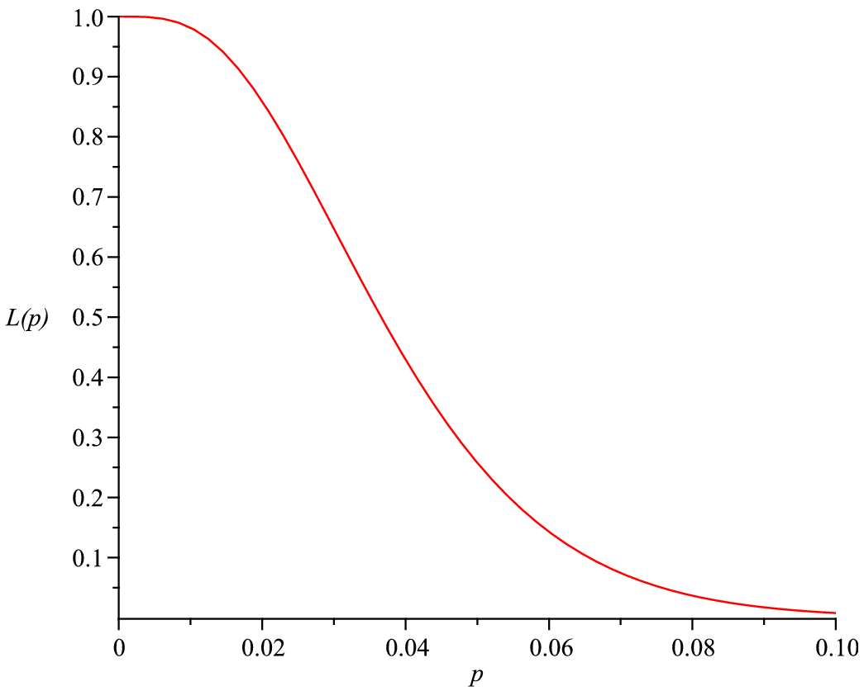
Acceptance Sampling Summary
Acceptable quality level: $p_{1}$ (consumer happy, want to accept with high probability)
Unacceptable quality level: $p_{2}$ (consumer unhappy, want to reject with high probability)
Producer’s Risk: reject a batch that has acceptable quality
$α=P\left(Reject batch when p=p_{1}\right)$
Consumer’s Risk: accept a batch that has unacceptable quality
$β=P\left(Accept batch when p=p_{2}\right)$
One stage plan: can use table to find number of samples and criterion
Two stage plan: more complicated, but can require fewer samples
Operating characteristic curve $L\left(p\right):\text{probability} \text{of} \text{accepting} \text{the} \text{batch}$

Slide 3
Is acceptance sampling a good way of quality testing?
Problems:
It is too far downstream in the production process; better if you can identify where things are going wrong.
It is 0/1 (i.e. defective/OK) - not efficient use of data; large samples are required.
- better to have quality measurements on a continuous scale: earlier warning of deteriorating quality and less need for large sample sizes.
Doesn’t use any information about distribution of defective rates

Slide 4
Reliability: Exponential Distribution revision Which of the following has an exponential distribution?
The time until a new car’s engine develops a leak
The number of punctures in a car’s lifetime
The working lifetime of a new hard disk drive
1 and 3 above
None of the above
Exponential distribution gives the time until or between random independent events that happen at constant rate. (2) is a discrete distribution. (1) and (3) are times to random events, but failure rate almost certainly increases with time.

Slide 5
Reliability
Problem: want to know the time till failure of parts
E.g.
- what is the mean time till failure?
- what is the probability that an item fails before a specified time?
If a product lasts for many years, how do you quickly get an idea of the failure time?
accelerated life testing:
Compressed-time testing: product is tested under usual conditions but more intensively than usual (e.g. a washing machine used almost continuously)
Advanced-stress testing: product is tested under harsher conditions than normal so that failure happens soon (e.g. refrigerator motor run at a higher speed than if operating within a fridge). - requires some assumptions

Slide 6
How do you deal with items which are still working at the end of the test programme?
An example of censored data. – we don’t know all the failure times at the end of the test
Exponential data (failure rate $ν$ independent of time)
Test components up to a time $t_{0}$
- assuming a rate, can calculate probability of no failures in $t_{0}$.
- calculate probability of getting any set of failure times (and non failures by $t_{0}$)
- find maximum-likelihood estimator for the failure rate in terms of failure times
For failure times $t_{i}$, with $t_{i}=t_{0}$ for parts working at $t_{0}$, and $n_{f}$ failures
$$⇒Estimate of failure rate is \hat{ν}=\frac{n_{f}}{\sum_{i}{t_{i}}}$$
[see notes for derivation]

Slide 7
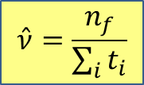
Example:
50 components are tested for two weeks. 20 of them fail in this time, with an average failure time of 1.2 weeks.
What is the mean time till failure assuming a constant failure rate?
Answer:
$$\hat{ν}=\frac{n_{f}}{\sum_{i}{t_{i}}}$$
$n=50$, $n_{f}=20$
$$\sum_{i}{t_{i}}=20×1.2+30×2$$
$=84$ weeks
$$⇒\hat{ν}=\frac{n_{f}}{\sum_{i}{t_{i}}}=\frac{20}{84}=0.238/week$$
$⇒$ mean time till failure is estimated to be $\frac{1}{\hat{ν}}=\frac{1}{0.238}=4.2 weeks$

Slide 8

Reliability function and failure rate
For a pdf $f(x)$ for the time till failure, define:
Reliability function
Probability of surviving at least till age $t$. i.e. that failure time is later than $t$
$$R\left(t\right)=P\left(T>t\right)=\int_{t}^{∞}{f\left(x\right)dx}$$
$$=1−F(t)$$
$F\left(t\right)=\int_{0}^{t}{f\left(t\right)dt}$is the cumulative distribution function.
Failure rate
$$φ\left(t\right)=\frac{f\left(t\right)}{R\left(t\right)}$$
This is failure rate at time $t$ given that it survived until time $t$:

Slide 9
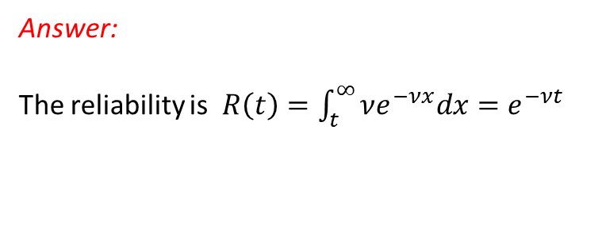
Example: Find the failure rate of the Exponential distribution
Answer:
The reliability is $R\left(t\right)=\int_{t}^{∞}{νe^{−νx}dx}=e^{−νt}$
Failure rate, $φ\left(t\right)=\frac{f\left(t\right)}{R\left(t\right)}=\frac{νe^{−νt}}{e^{−νt}}=ν$
Note: $ν$ is a constant
The fact that the failure rate is constant is a special “lack of ageing property” of the exponential distribution.
- But often failure rates actually increase with age.

Slide 10
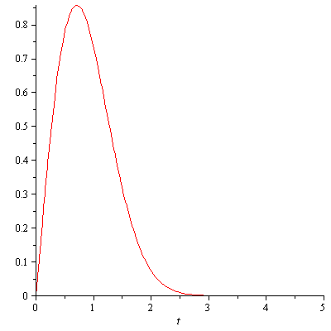
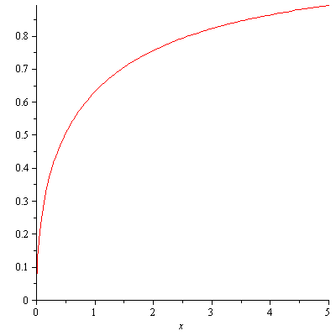
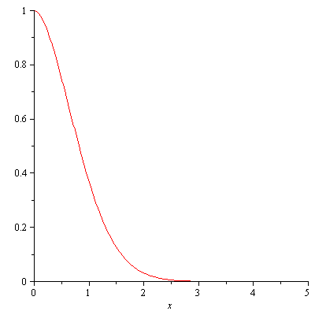
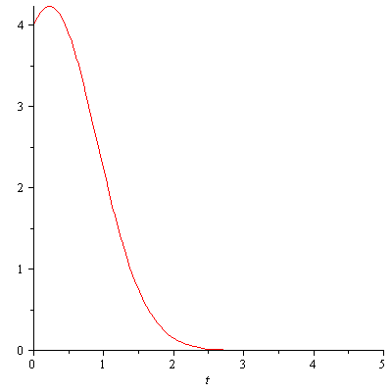
Reliability function Which of the following could be a plot of a reliability function? ($R\left(t\right):$ probability of surviving at least till age $t$. i.e. that failure time is later than $t$)
1.
2.
Wrong1
Wrong2
Correct
wrong3
3.
$$t$$
$$t$$
4.
$$t$$
$$t$$

Slide 11
If we measure the failure rate $φ\left(t\right)$, how do we find the pdf?
$$φ\left(t\right)=\frac{f\left(t\right)}{R\left(t\right)}=\frac{\left(\frac{dF}{dt}\right)}{1−F\left(t\right)}$$
$$=−\frac{d}{dt}\left[ln\left(1−F\left(t\right)\right)\right]$$
$$⇒\ln\left[1−F\left(t\right)\right]=−\int_{0}^{t}{φ\left(t′\right)dt′}$$
$$F\left(0\right)=0$$
- can hence find $F(t)$, and hence $f\left(t\right), R(t)$
Example
Say failure rate $φ(t)$ measured to be a constant, $φ\left(t\right)=ν$
$$⇒ln\left[1−F\left(t\right)\right]=−\int_{0}^{t}{νdt}=−νt$$
$$⇒1−F\left(t\right)=e^{−νt}$$
$$⇒f\left(t\right)=\frac{dF\left(t\right)}{dt}={νe}^{−νt}$$
$$⇒F\left(t\right)=1−e^{−νt}$$
- Exponential distribution

Slide 12
The Weibull distribution
- a way to model failure rates that are not constant
Failure rate: $φ\left(t\right)=mνt^{m−1}$
Parameters $m$ (shape parameter) and $ν$ (scale parameter)
$m=1:$ failure rate constant, Weibull=Exponential
$m>1:$ failure rate increases with time
$m<1:$ failure rate decreases with time

Slide 13
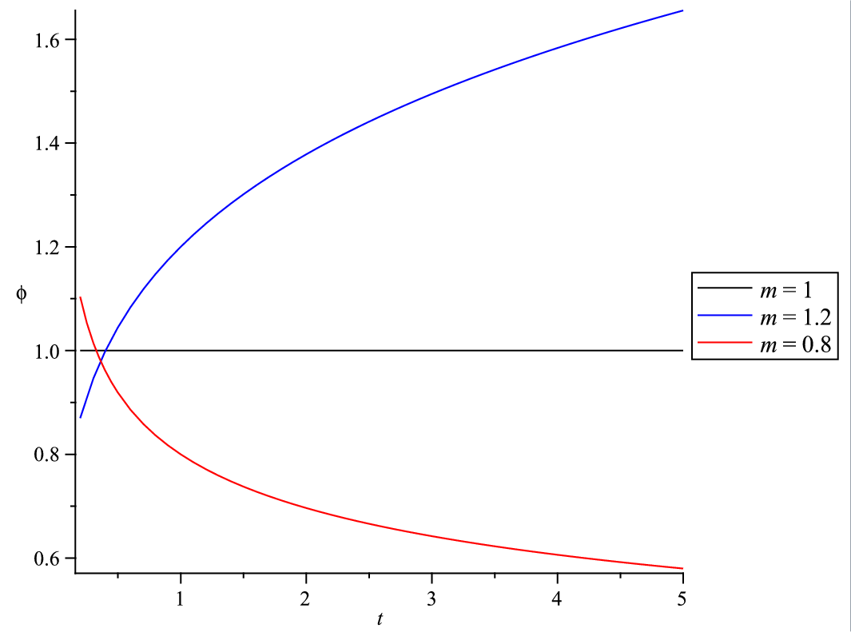
Failure rate: $φ\left(t\right)=mνt^{m−1}$
$$⇒ln\left(1−F\left(t\right)\right)=−\int_{0}^{t}{mνx^{m−1}dx}=−νt^{m}$$
$$⇒F\left(t\right)=1−e^{−νt^{m}}$$
Reliability: $R\left(t\right)=e^{−νt^{m}}$
Pdf: $f\left(t\right)=\frac{dF\left(t\right)}{dt}=mνt^{m−1}e^{−νt^{m}}$

Slide 14
The End!

Slide 16
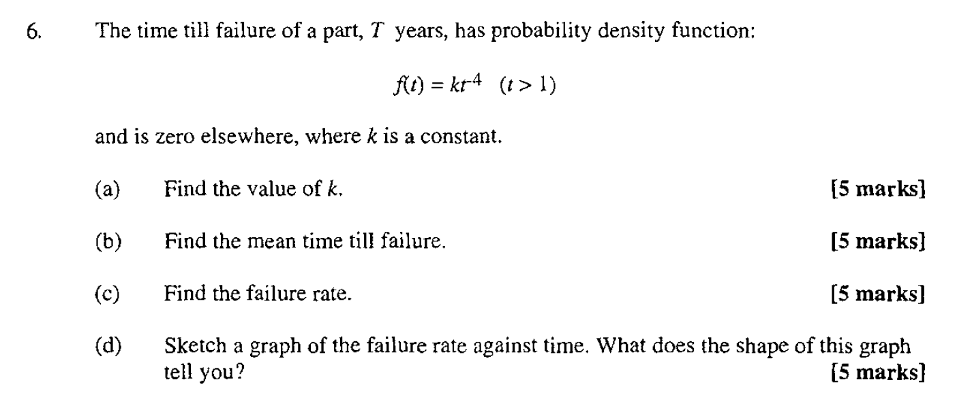
[Note: as from 2011 questions are out of 25 not 20]

Slide 17
Reliability: exam question
$f\left(t\right)=kt^{−4}$ ($t>1)$
1/4
3
4
-3
1/3

Slide 18
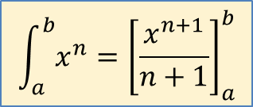
Answer
$$\int_{a}^{b}{x^{n}}={\left[\frac{x^{n+1}}{n+1}\right]}_{a}^{b}$$
$$\int_{−∞}^{∞}{f\left(t\right)=1}⇒\int_{1}^{∞}{kt^{−4}}dt=1$$
$$\int_{1}^{∞}{kt^{−4}}dt={\left[\frac{kt^{−3}}{−3}\right]}_{1}^{∞}$$
=$0−\left(−\frac{k}{3}\right)=\frac{k}{3}$
$$⇒k=3$$

Slide 19
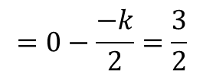
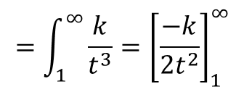
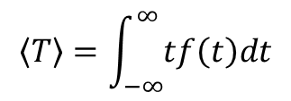
Answer
Know $k=3$
$$〈T〉=\int_{−∞}^{∞}{tf\left(t\right)dt}$$
$$=\int_{1}^{∞}{\frac{k}{t^{3}}}={\left[\frac{−k}{2t^{2}}\right]}_{1}^{∞}$$
$$=0−\frac{−k}{2}=\frac{3}{2}$$

Slide 20
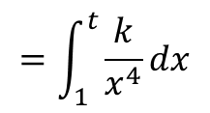
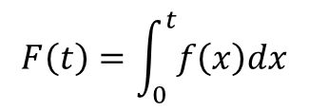
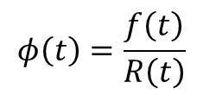
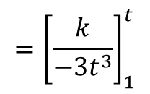
Answer
$$φ\left(t\right)=\frac{f\left(t\right)}{R\left(t\right)}$$
$$R\left(t\right)=1−F(t)$$
$$F\left(t\right)=\int_{0}^{t}{f\left(x\right)dx}$$
$$=\int_{1}^{t}{\frac{k}{x^{4}}dx}$$
$$={\left[\frac{k}{−3t^{3}}\right]}_{1}^{t}$$
$$=−\frac{k}{3t^{3}}−\left(−\frac{k}{3}\right)=1−\frac{1}{t^{3}}$$
$$⇒R\left(t\right)=1−F\left(t\right)=\frac{1}{t^{3}}$$
$$⇒φ\left(t\right)=\frac{f\left(t\right)}{R\left(t\right)}=\frac{k}{t^{4}}×t^{3}=\frac{3}{t}$$
($t>1$), otherwise 0

Slide 21
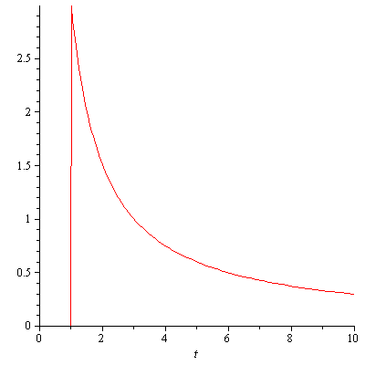
Answer
$$φ\left(t\right)$$

