Slide 1

Statistics for Engineers
Antony Lewis
http://cosmologist.info/teaching/STAT/

Slide 2
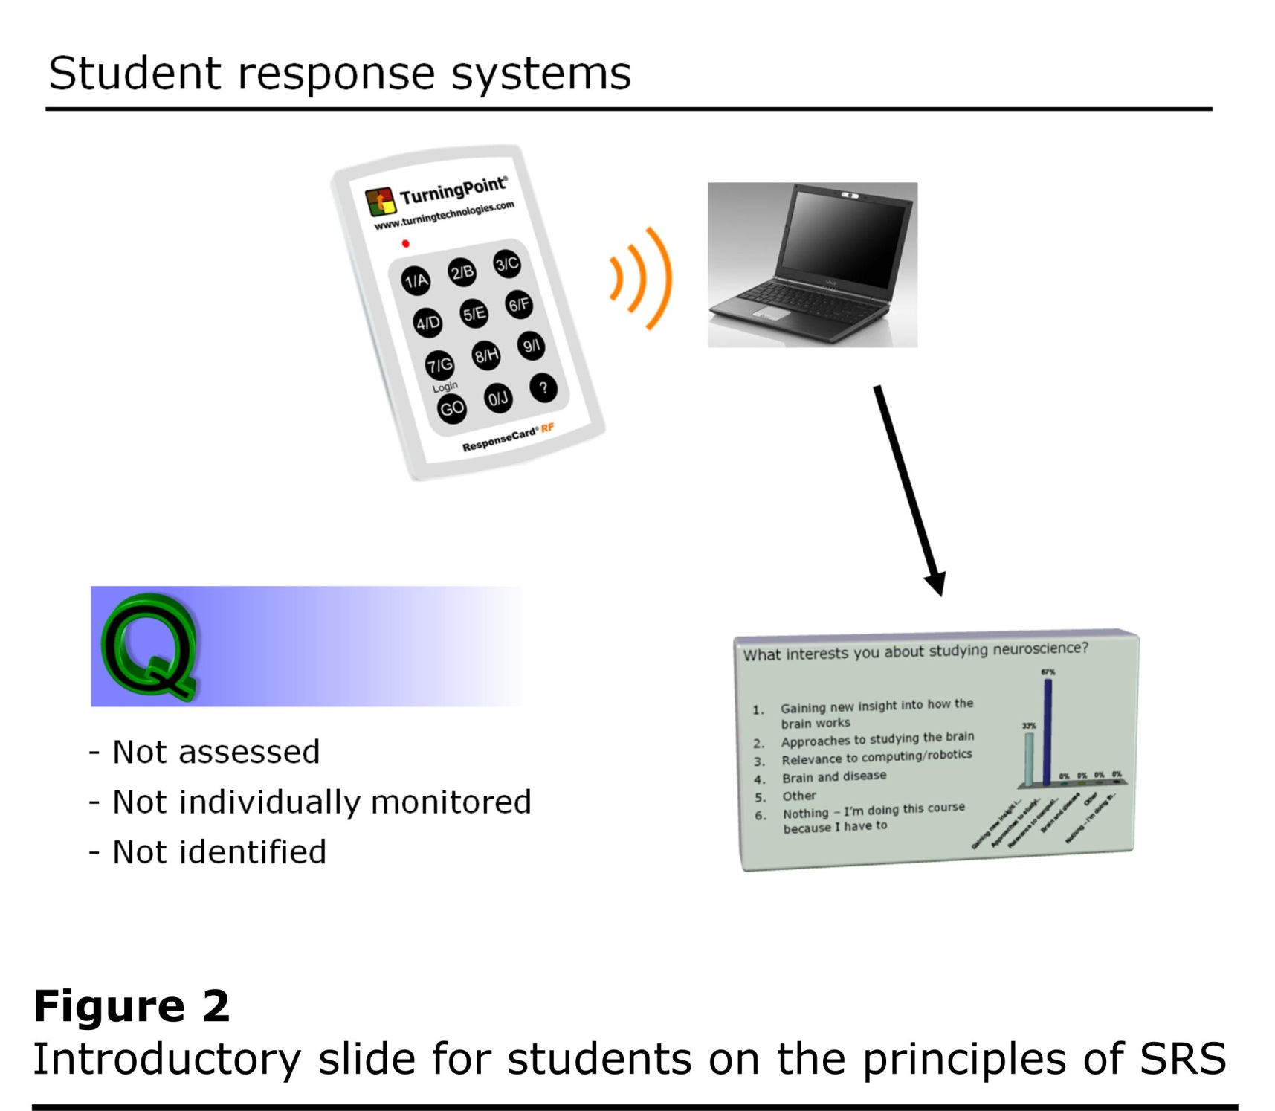
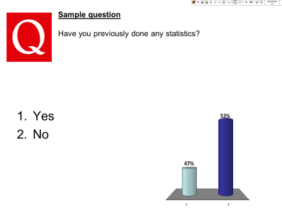

Slide 3


Starter question
Have you previously done any statistics?
Yes
No

Slide 4


BOOKS
Chatfield C, 1989. Statistics for Technology, Chapman & Hall, 3rd ed.
Mendenhall W and Sincich T, 1995. Statistics for Engineering and the Sciences

Slide 5


Books
Devore J L, 2004.
Probability and Statistics for Engineering and the Sciences, Thomson, 6th ed.
Richard A. Johnson
Miller and Freund's Probability and Statistics for Engineers
Wikipedia also has good articles on many topics covered in the course.

Slide 6
Workshops
Doing questions for yourself is very important to learn the material
Hand in questions at the workshop, or ask your tutor when they want it for next week (hand in at the maths school office in Pevensey II).
Marks do not count, but good way to get feedback

Slide 7
Probability
Event: a possible outcome or set of possible outcomes of an experiment or observation. Typically denoted by a capital letter: A, B etc.
E.g. The result of a coin toss
Probability of an event A: denoted by P(A).
Measured on a scale between 0 and 1 inclusive. If A is impossible P(A) = 0, if A is certain then P(A)=1.
E.g. P(result of a coin toss is heads)

Slide 8
If there a fixed number of equally likely outcomes $P(A)$ is the fraction of the outcomes that are in A.
Event has not occurred
All possible outcomes
A
Event has occurred
E.g. for a coin toss there are two possible outcomes, Heads or Tails
H
T
P(result of a coin toss is heads) = 1/2.
Intuitive idea: P(A) is the typical fraction of times A would occur if an experiment were repeated very many times.

Slide 9
Probability of a statement S:
P(S) denotes degree of belief that S is true.
E.g. P(tomorrow it will rain).
Conditional probability: P(A|B) means the probability of A given that B has happened or is true.
e.g. P(result of coin toss is heads | the coin is fair) =1/2
P(Tomorrow is Tuesday | it is Monday) = 1
P(card is a heart | it is a red suit) = 1/2

Slide 10
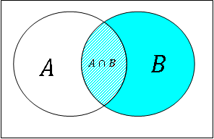


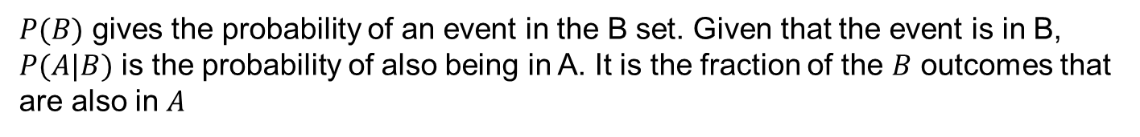

Conditional Probability
In terms of P(B) and P(A and B) we have
$$P\left(A | B\right)=\frac{P\left(A\text{∩}\text{B}\right)}{P\left(B\right)}$$
$$A$$
$$B$$
$P(B)$ gives the probability of an event in the B set. Given that the event is in B, $P(A|B)$ is the probability of also being in A. It is the fraction of the $B$ outcomes that are also in $A$
Probabilities are always conditional on something, for example prior knowledge, but often this is left implicit when it is irrelevant or assumed to be obvious from the context.

Slide 11



Rules of probability
1. Complement Rule
Denote “all events that are not A” as A^{c}.
$$A$$
$$A^{c}$$
Since either A or not A must happen, P(A) + P(A^{c}) = 1.
Hence
P(Event happens) = 1 - P(Event doesn't happen)
so
$P\left(A\right)= 1−P\left(A^{c}\right)$
$P\left(A^{c}\right)= 1−P(A)$
E.g. when throwing a fair dice, P(not 6) = 1-P(6) = 1 – 1/6 = 5/6.

Slide 12
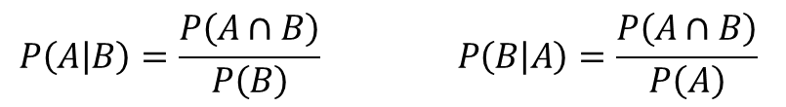



2. Multiplication Rule
We can re-arrange the definition of the conditional probability
$$P\left(A | B\right)=\frac{P\left(A∩B\right)}{P\left(B\right)} P\left(B | A\right)=\frac{P\left(A∩B\right)}{P\left(A\right)}$$
$$P\left(A∩B\right)=P\left(A | B\right)P(B)$$
or
$$P\left(A∩B\right)=P\left(B | A\right)P(A)$$
You can often think of $P(A \text{and} B)$ as being the probability of first getting $A$ with probability $P(A)$, and then getting $B$ with probability $P\left(B | A\right).$
This is the same as first getting $B$ with probability $P(B)$ and then getting $A$ with probability $P\left(A | B\right).$

Slide 13

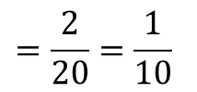


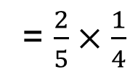

Example:
A batch of 5 computers has 2 faulty computers. If the computers are chosen at random (without replacement), what is the probability that the first two inspected are both faulty?
Answer:
P(first computer faulty AND second computer faulty)
Use $P\left(A∩B\right)=P(A)P\left(B | A\right)$
= P(first computer faulty) $×$ P(second computer faulty | first computer faulty)
$$\frac{2}{5}$$
$$\frac{1}{4}$$
= $\frac{2}{5}×\frac{1}{4}$
$$=\frac{2}{20}=\frac{1}{10}$$

Slide 14

Drawing cards
Drawing two random cards from a pack without replacement, what is the probability of getting two hearts?
[13 of the 52 cards in a pack are hearts]
1/16
3/51
3/52
1/4

Slide 15

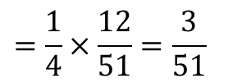
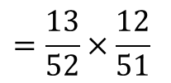
Drawing cards
Drawing two random cards from a pack without replacement, what is the probability of getting two hearts?
To start with 13/52 of the cards are hearts.
After one is drawn, only 12/51 of the remaining cards are hearts.
So the probability of two hearts is
$P\left(\text{first} \text{is} \text{a} \text{heart} \text{AND} \text{second} \text{is} \text{a} \text{heart}\right)= P\left(\text{first} \text{is} \text{a} \text{heart}\right)×P\left(\text{second} \text{is} \text{a} \text{heart} \right| \text{first} \text{is} \text{a} \text{heart}\text{)}$
$$=\frac{13}{52}×\frac{12}{51}$$
$$=\frac{1}{4}×\frac{12}{51}=\frac{3}{51}$$

Slide 16


Special Multiplication Rule
If two events A and B are independent then P(A| B) = P(A) and P(B| A) = P(B): knowing that A has occurred does not affect the probability that B has occurred and vice versa.
In that case
P(A and B) $=P\left(A∩B\right)=P\left(A\right)P\left(B | A\right)=P\left(A\right)P(B)$
Probabilities for any number of independent events can be multiplied to get the joint probability.
E.g. A fair coin is tossed twice, what is the chance of getting a head and then a tail?
P(H1 and T2) = P(H1)P(T2) = ½ x ½ = ¼.
E.g. Items on a production line have 1/6 probability of being faulty. If you select three items one after another, what is the probability you have to pick three items to find the first faulty one?
$$=\frac{5}{6}×\frac{5}{6}×\frac{1}{6}$$
$$=\frac{25}{216}=0.116..$$
$$P\left(1st OK\right)P\left(2nd OK\right)P\left(3rd faulty\right)$$

Slide 17


3. Addition Rule
For any two events $A$ and $B$,
$$P\left(A or B\right)=P\left(A∪B\right)=P\left(A\right)+P\left(B\right)−P(A∩B)$$
Note: “A or B” = $A∪B$ includes the possibility that both A and B occur.

Slide 18

Throw of a die
Throwing a fair dice, let events be
A = get an odd number
B = get a 5 or 6
What is P(A or B)?
1/6
1/3
1/2
2/3
5/6

Slide 19

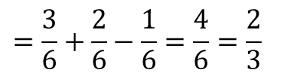
Throw of a die
Throwing a fair dice, let events be
A = get an odd number
B = get a 5 or 6
What is P(A or B)?
$P\left(A or B\right)=P\left(A∪B\right)=P\left(A\right)+P\left(B\right)−P\left(A∩B\right)$
$$=P\left(odd\right)+P\left(5 or 6\right)−P\left(5\right)$$
$$=\frac{3}{6}+\frac{2}{6}−\frac{1}{6}=\frac{4}{6}=\frac{2}{3}$$
This is consistent since $P\left(A∪B\right)=P\left(\left\{1,3,5,6\right\}\right)=\frac{4}{6}=\frac{2}{3}$

Slide 20
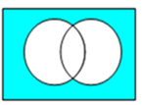
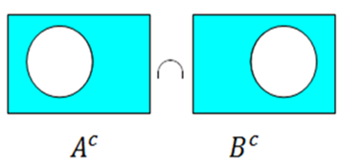





Alternative
“Probability of not getting either A or B = probability of not getting A and not getting B”
=
$${\left(A∪B\right)}^{c}$$
$${\left(A∪B\right)}^{c}=A^{c}∩B^{c}$$
Complements Rule
$$⇒P\left(A∪B\right)=1−P(A^{c}∩B^{c})$$
=
i.e. P(A or B) = 1 – P(“not A” and “not B”)

Slide 21
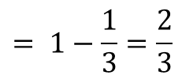


Throw of a dice
Throwing a fair dice, let events be
A = get an odd number
B = get a 5 or 6
What is P(A or B)?
Alternative answer
$A^{c}$={2,4,6}, $B^{c}$ = {1,2,3,4} so $A^{c}∩B^{c}=${2,4}.
Hence
$$P\left(A \text{or} B\right)=1−P\left(A^{c}∩B^{c}\right)$$
$$= 1−P\left(\left\{2,4\right\}\right)$$
$$= 1−\frac{1}{3}=\frac{2}{3}$$

Slide 22

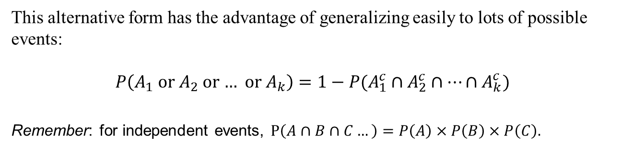
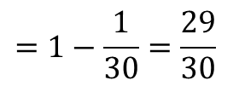

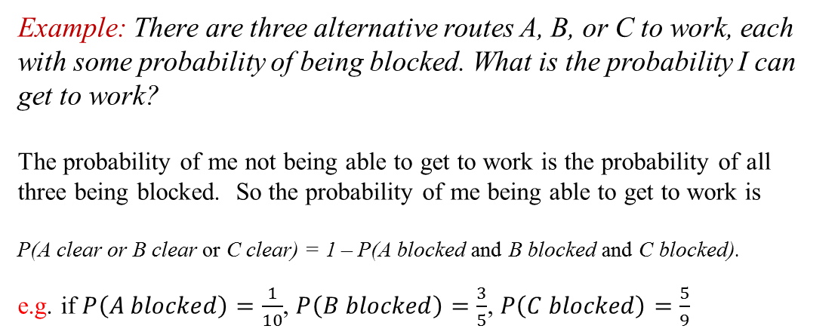
Lots of possibilities
This alternative form has the advantage of generalizing easily to lots of possible events:
$$P\left(A_{1} \text{or} A_{2} \text{or}\text{ … }\text{or} A_{k}\right)=1−P(A_{1}^{c}∩A_{2}^{c}∩…∩A_{k}^{c})$$
Remember: for independent events, $P\left(A∩B∩C…\right)=P\left(A\right)×P\left(B\right)×P\left(C\right).$
Example: There are three alternative routes A, B, or C to work, each with some probability of being blocked. What is the probability I can get to work?
The probability of me not being able to get to work is the probability of all three being blocked. So the probability of me being able to get to work is
P(A clear or B clear or C clear) = 1 – P(A blocked and B blocked and C blocked).
e.g. if $P\left(A blocked\right)=\frac{1}{10}$, $P\left(B blocked\right)=\frac{3}{5}$, $P\left(C blocked\right)=\frac{5}{9}$
then
P(can get to work) = P(A clear or B clear or C clear)
= 1 – P(A blocked and B blocked and C blocked
= $1−\frac{1}{10}×\frac{3}{5}×\frac{5}{9}$
$$=1−\frac{1}{30}=\frac{29}{30}$$

Slide 23
Problems with a device
There are three common ways for a system to experience problems, with independent probabilities over a year
A = overheats, P(A)=1/3
B = subcomponent malfunctions, P(B) = 1/3
C = damaged by operator, P(C) = 1/10
What is the probability that the system has one or more of these problems during the year?
1/3
2/5
3/5
3/4
5/6

Slide 24
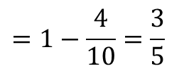
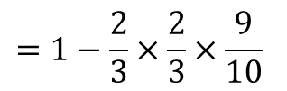
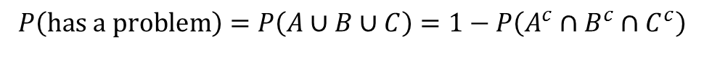
Problems with a device
There are three common ways for a system to experience problems, with independent probabilities over a year
A = overheats, P(A)=1/3
B = subcomponent malfunctions, P(B) = 1/3
C = damaged by operator, P(C) = 1/10
What is the probability that the system has one or more of these problems during the year?
$$P\left(has a problem\right)=P\left(A∪B∪C\right)=1−P\left(A^{c}∩B^{c}∩C^{c}\right)$$
$$=1−\frac{2}{3}×\frac{2}{3}×\frac{9}{10}$$
$$=1−\frac{4}{10}=\frac{3}{5}$$

Slide 25

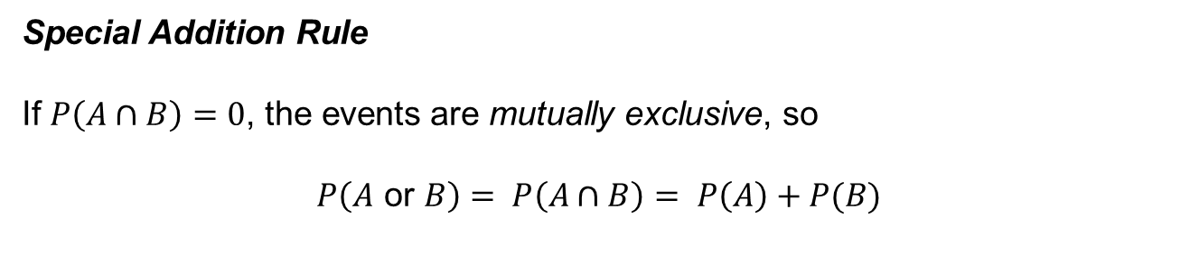
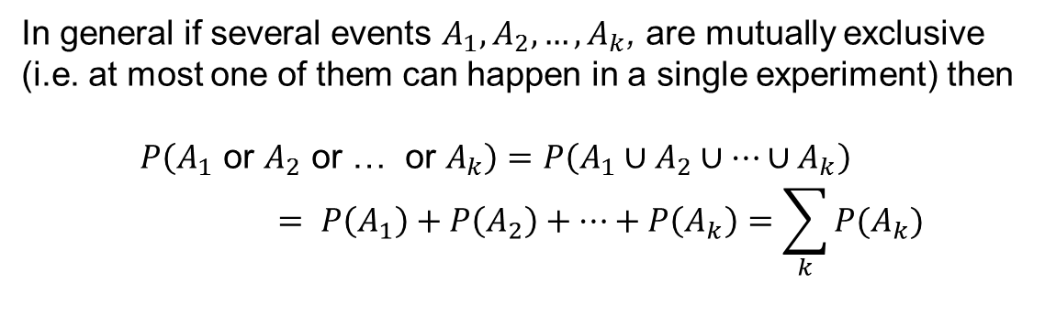
Special Addition Rule
If $P\left(A∩B\right)=0$, the events are mutually exclusive, so
$$P\left(A \text{or} B\right)= P\left(A∩B\right)= P\left(A\right)+P(B)$$
In general if several events $A_{1}, A_{2},…, A_{k}$, are mutually exclusive (i.e. at most one of them can happen in a single experiment) then
$$P\left(A_{1} \text{or} A_{2} \text{or}\text{ … }\text{or} A_{k}\right)=P\left(A_{1}∪A_{2}∪…∪A_{k}\right)= P\left(A_{1}\right)+P\left(A_{2}\right)+…+P\left(A_{k}\right)=\sum_{k}{P(A_{k})}$$
B
C
A
E.g. Throwing a fair dice,
P(getting 4,5 or 6)
= P(4)+P(5)+P(6) = 1/6+1/6+1/6=1/2

Slide 26
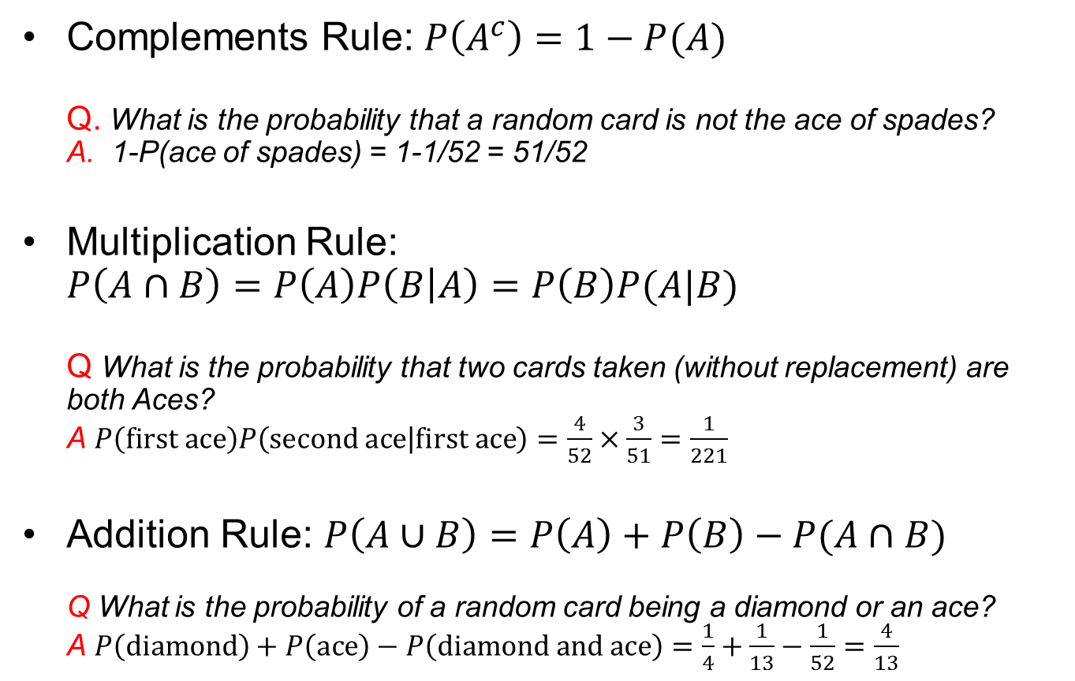
Rules of probability recap
Complements Rule: $P\left(A^{c}\right)=1−P(A)$
Q. What is the probability that a random card is not the ace of spades?
A. 1-P(ace of spades) = 1-1/52 = 51/52
Multiplication Rule: $P\left(A∩B\right)=P\left(A\right)P\left(B | A\right)=P\left(B\right)P(A|B)$
Q What is the probability that two cards taken (without replacement) are both Aces?
A $P\left(first ace\right)P\left(second ace | first ace\right)=\frac{4}{52}×\frac{3}{51}=\frac{1}{221}$
Addition Rule: $P\left(A∪B\right)=P\left(A\right)+P\left(B\right)−P(A∩B)$
Q What is the probability of a random card being a diamond or an ace?
A $P\left(diamond\right)+P\left(ace\right)−P\left(diamond and ace\right)=\frac{1}{4}+\frac{1}{13}−\frac{1}{52}=\frac{4}{13}$

Slide 27

Failing a drugs test
A drugs test for athletes is 99% reliable: applied to a drug taker it gives a positive result 99% of the time, given to a non-taker it gives a negative result 99% of the time. It is estimated that 1% of athletes take drugs.
A random athlete has failed the test. What is the probability the athlete takes drugs?
0.01
0.3
0.5
0.7
0.98
0.99
20
Countdown

Slide 28

Similar example: TV screens produced by a manufacturer have defects 10% of the time.
An automated mid-production test is found to be 80% reliable at detecting faults (if the TV has a fault, the test indicates this 80% of the time, if the TV is fault-free there is a false positive only 20% of the time).
If a TV fails the test, what is the probability that it has a defect?
Split question into two parts
1. What is the probability that a random TV fails the test?
2. Given that a random TV has failed the test, what is the probability it is because it has a defect?

Slide 29




Example: TV screens produced by a manufacturer have defects 10% of the time.
An automated mid-production test is found to be 80% reliable at detecting faults (if the TV has a fault, the test indicates this 80% of the time, if the TV is fault-free there is a false positive only 20% of the time).
What is the probability of a random TV failing the mid-production test?
Answer:
Let D=“TV has a defect”
Let F=“TV fails test”
The question tells us: $P\left(D\right)=0.$1 $P\left(F | D\right)=0.8$ $P\left(F | D^{c}\right)=0.2$
Two independent ways to fail the test:
TV has a defect and test shows this, -OR- TV is OK but get a false positive
$$P\left(F\right)=P\left(F∩D\right)+P(F∩D^{c})$$
$$=P\left(F | D\right)P\left(D\right)+P\left(F | D^{c}\right)P\left(D^{c}\right)$$
$$=0.8×0.1+0.2×\left(1−0.1\right)$$
$$=0.26$$

Slide 30
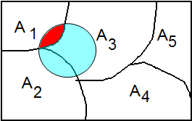
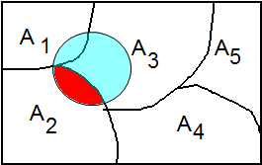
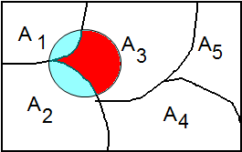




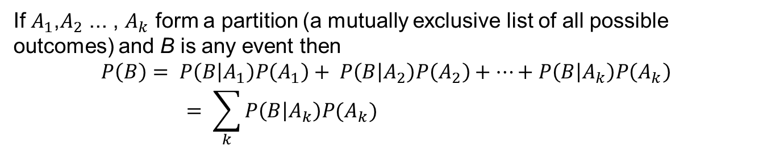

$$P\left(F\right)=P\left(F∩D\right)+P(F∩D^{c})$$
$$=P\left(F | D\right)P\left(D\right)+P\left(F | D^{c}\right)P\left(D^{c}\right)$$
Is an example of the
Total Probability Rule
If $A_{1}$,$A_{2}$ ... , $A_{k}$ form a partition (a mutually exclusive list of all possible outcomes) and B is any event then
$$P\left(B\right)= P\left(B | A_{1}\right)P\left(A_{1}\right)+ P\left(B | A_{2}\right)P\left(A_{2}\right)+…+P\left(B | A_{k}\right)P\left(A_{k}\right)= \sum_{k}{P\left(B | A_{k}\right)P(A_{k})}$$
B
=
+
+
$$P\left(A_{1}∩B\right)=P\left(B | A_{1}\right)P(A_{1})$$
$$P\left(A_{2}∩B\right)=P\left(B | A_{2}\right)P(A_{2})$$
$$P\left(A_{3}∩B\right)=P\left(B | A_{3}\right)P(A_{3})$$

Slide 31
Example: TV screens produced by a manufacturer have defects 10% of the time.
An automated mid-production test is found to be 80% reliable at detecting faults (if the TV has a fault, the test indicates this 80% of the time, if the TV is fault-free there is a false positive only 20% of the time).
If a TV fails the test, what is the probability that it has a defect?
Answer:
Let D=“TV has a defect”
Let F=“TV fails test”
We previously showed using the total probability rule that
$$P\left(F\right)=P\left(F | D\right)P\left(D\right)+P\left(F | D^{c}\right)P\left(D^{c}\right)=0.8×0.1+0.2×\left(1−0.1\right)=0.26$$
When we get a test fail, what fraction of the time is it because the TV has a defect?

Slide 32



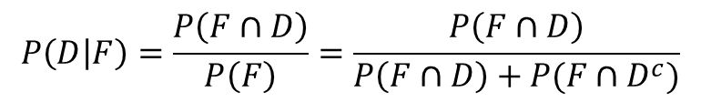



80% of TVs with defects fail the test
$$P\left(D | F\right)=\frac{P\left(F∩D\right)}{P\left(F\right)}=\frac{P\left(F∩D\right)}{P\left(F∩D\right)+P(F∩D^{c})}$$
$$D$$
All TVs
10% defects
$$F∩D$$
$$F∩D^{c}$$
$D^{c}$: TVs without defect
$$F∩D^{c}$$
20% of OK TVs give false positive
+
$F:$TVs that fail the test

Slide 33
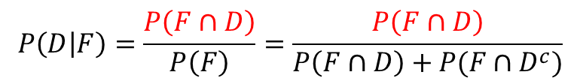
80% of TVs with defects fail the test
$$P\left(D | F\right)=\frac{P\left(F∩D\right)}{P\left(F\right)}=\frac{P\left(F∩D\right)}{P\left(F∩D\right)+P(F∩D^{c})}$$
$$D$$
All TVs
10% defects
$$F∩D$$
$$F∩D^{c}$$
$D^{c}$: TVs without defect
$$F∩D^{c}$$
20% of OK TVs give false positive
+
$F:$TVs that fail the test

Slide 34
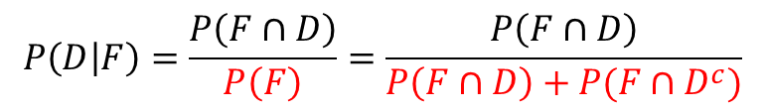
80% of TVs with defects fail the test
$$P\left(D | F\right)=\frac{P\left(F∩D\right)}{P\left(F\right)}=\frac{P\left(F∩D\right)}{P\left(F∩D\right)+P(F∩D^{c})}$$
$$D$$
All TVs
10% defects
$$F∩D$$
$$F∩D^{c}$$
$D^{c}$: TVs without defect
$$F∩D^{c}$$
20% of OK TVs give false positive
+
$F:$TVs that fail the test

Slide 35
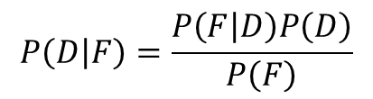

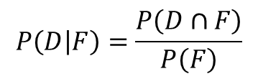

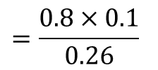
Example: TV screens produced by a manufacturer have defects 10% of the time.
An automated mid-production test is found to be 80% reliable at detecting faults (if the TV has a fault, the test indicates this 80% of the time, if the TV is fault-free there is a false positive only 20% of the time).
If a TV fails the test, what is the probability that it has a defect?
Answer:
Let D=“TV has a defect”
Let F=“TV fails test”
We previously showed using the total probability rule that
$$P\left(F\right)=P\left(F | D\right)P\left(D\right)+P\left(F | D^{c}\right)P\left(D^{c}\right)=0.8×0.1+0.2×\left(1−0.1\right)=0.26$$
When we get a test fail, what fraction of the time is it because the TV has a defect?
$$P\left(D | F\right)=\frac{P\left(D∩F\right)}{P\left(F\right)}$$
Know $P\left(F | D\right)=0.8, P\left(D\right)=0.1$:
$$P\left(D | F\right)=\frac{P\left(F | D\right)P\left(D\right)}{P\left(F\right)}$$
$$=\frac{0.8×0.1}{0.26}$$
$$≈0.3077$$

Slide 36
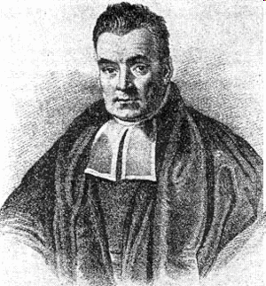

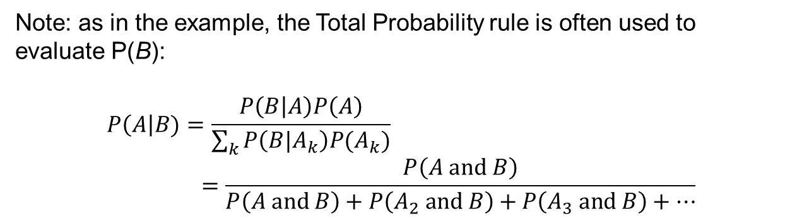




The Rev Thomas Bayes
(1702-1761)
Bayes’ Theorem
The multiplication rule gives
$P\left(A∩B\right)$
=
$$P\left(A | B\right)$$
$$P\left(B\right)$$
=
$$P\left(B | A\right)$$
$$P(A)$$
Bayes’ Theorem
Note: as in the example, the Total Probability rule is often used to evaluate P(B):
$$P\left(A\right|B)=\frac{P\left(B | A\right)P\left(A\right)}{\sum_{k}{P\left(B|A_{k}\right)P(A_{k})}}=\frac{P\left(A and B\right)}{P\left(A and B\right)+P\left(A_{2} and B\right)+P\left(A_{3} and B\right)+…}$$
If you have a model that tells you how likely B is given A, Bayes’ theorem allows you to calculate the probability of A if you observe B. This is the key to learning about your model from statistical data.

Slide 37



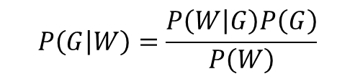
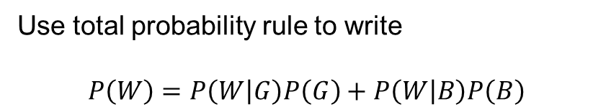

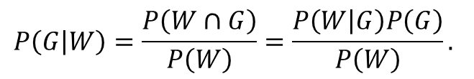
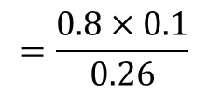

Example: Evidence in court
The cars in a city are 90% black and 10% grey.
A witness to a bank robbery briefly sees the escape car, and says it is grey. Testing the witness under similar conditions shows the witness correctly identifies the colour 80% of the time (in either direction).
What is the probability that the escape car was actually grey?
Answer:
Let G = car is grey, B=car is black, W = Witness says car is grey.
$$P\left(G | W\right)=\frac{P\left(W∩G\right)}{P\left(W\right)}=\frac{P\left(W | G\right)P\left(G\right)}{P\left(W\right)}.$$
Bayes’ Theorem
Use total probability rule to write
$$P\left(W\right)=P\left(W | G\right)P\left(G\right)+P\left(W | B\right)P\left(B\right)$$
$$= 0.8×0.1+0.2×0.9$$
$$=0.26$$
Hence:
$$P\left(G | W\right)=\frac{P\left(W | G\right)P\left(G\right)}{P\left(W\right)}$$
$$=\frac{0.8×0.1}{0.26}$$
$$≈0.31$$

Slide 38
Failing a drugs test
A drugs test for athletes is 99% reliable: applied to a drug taker it gives a positive result 99% of the time, given to a non-taker it gives a negative result 99% of the time. It is estimated that 1% of athletes take drugs.
Part 1. What fraction of randomly tested athletes fail the test?
1%
1.98%
0.99%
2%
0.01%
60
Countdown

Slide 39
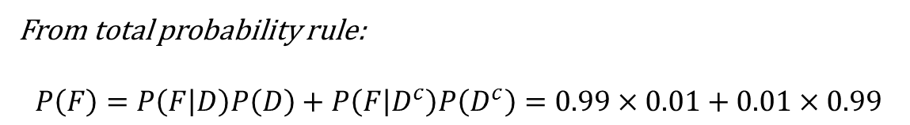
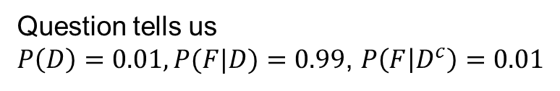
Failing a drugs test
A drugs test for athletes is 99% reliable: applied to a drug taker it gives a positive result 99% of the time, given to a non-taker it gives a negative result 99% of the time. It is estimated that 1% of athletes take drugs.
What fraction of randomly tested athletes fail the test?
Let F=“fails test”
Let D=“takes drugs”
Question tells us
$P\left(D\right)=0.01, P(F|D)=0.99$, $P\left(F | D^{c}\right)=0.01$
From total probability rule:
$$P\left(F\right)=P\left(F | D\right)P\left(D\right)+P\left(F | D^{c}\right)P\left(D^{c}\right)=0.99×0.01+0.01×0.99$$
=0.0198
i.e. 1.98% of randomly tested athletes fail

Slide 40
Failing a drugs test
A drugs test for athletes is 99% reliable: applied to a drug taker it gives a positive result 99% of the time, given to a non-taker it gives a negative result 99% of the time. It is estimated that 1% of athletes take drugs.
A random athlete has failed the test. What is the probability the athlete takes drugs?
0.01
0.3
0.5
0.7
0.99
60
Countdown

Slide 41
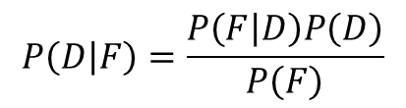
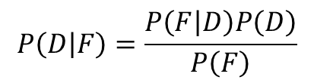
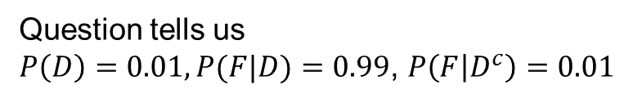
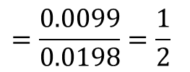
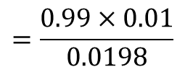
Failing a drugs test
A drugs test for athletes is 99% reliable: applied to a drug taker it gives a positive result 99% of the time, given to a non-taker it gives a negative result 99% of the time. It is estimated that 1% of athletes take drugs.
A random athlete is tested and gives a positive result. What is the probability the athlete takes drugs?
Let F=“fails test”
Let D=“takes drugs”
Question tells us
$P\left(D\right)=0.01, P(F|D)=0.99$, $P\left(F | D^{c}\right)=0.01$
$$P\left(D | F\right)=\frac{P\left(F | D\right)P\left(D\right)}{P\left(F\right)}$$
Bayes’ Theorem gives
We need $P\left(F\right)=P\left(F | D\right)P\left(D\right)+P\left(F | D^{c}\right)P\left(D^{c}\right)=0.99×0.01+0.01×0.99$
= 0.0198
$$P\left(D | F\right)=\frac{P\left(F | D\right)P\left(D\right)}{P\left(F\right)}$$
$$=\frac{0.99×0.01}{0.0198}$$
$$=\frac{0.0099}{0.0198}=\frac{1}{2}$$
Hence:

Slide 42
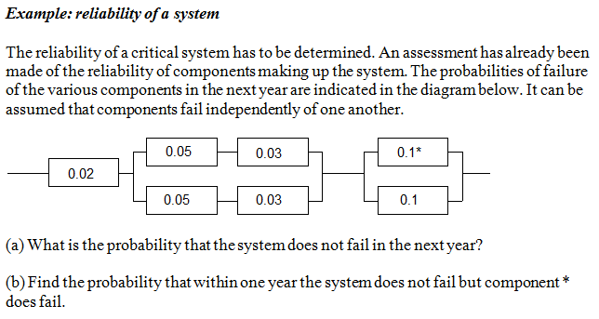
Reliability of a system
General approach: bottom-up analysis. Need to break down the system into subsystems just containing elements in series or just containing elements in parallel.
Find the reliability of each of these subsystems and then repeat the process at the next level up.

Slide 43
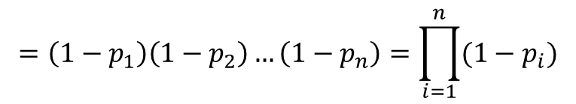
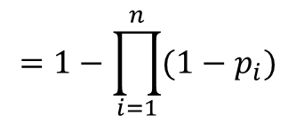
Series subsystem: in the diagram $p_{i}$= probability that element i fails, so $1−p_{i}$= probability that it does not fail.
The system only works if all n elements work. Failures of different elements are assumed to be independent (so the probability of Element 1 failing does alter after connection to the system).
$$P\left(system does not fail\right)=P(1 does not fail AND 2 does not fail AND…n does not fail)$$
$$=\left(1−p_{1}\right)\left(1−p_{2}\right)…\left(1−p_{n}\right)=\prod_{i=1}^{n}{(1−p_{i})}$$
Hence $P\left(system does fail\right)=1−P(system does not fail)$
$$=1−\prod_{i=1}^{n}{(1−p_{i})}$$

Slide 44


Parallel subsystem: the subsystem only fails if all the elements fail.
$$P\left(system fails\right)=P(1 fails AND 2 fails AND…n fails)$$
= $P\left(1 fails\right)P\left(2 fails\right)…P(n fails)$
[Special multiplication rule
assuming failures independent]
$$=p_{1}p_{2}…p_{n}=\prod_{i=1}^{n}{p_{i}}$$

Slide 45



Example:
Subsystem 3:
P(Subsystem 3 fails) = 0.1 x 0.1 = 0.01
Subsystem 1:
P(Subsystem 1 doesn't fail)
= $\left(1−0.05\right)\left(1−0.03\right)=0.9215$
Hence P(Subsystem 1 fails)= 0.0785
Subsystem 2: (two units of subsystem 1)
P(Subsystem 2 fails) =
0.0785 x 0.0785 = 0.006162
Answer:
P(System doesn't fail) =
(1 - 0.02)(1 - 0.006162)(1 - 0.01) = 0.964

Slide 46
Answer to (b)
Let B = event that the system does not fail
Let C = event that component * does fail
We need to find P(B and C).
Use $P\left(B∩C\right)=P(B|C)P\left(C\right)$. We know P(C) = 0.1.

Slide 47


P(B | C) = P(system does not fail given component * has failed)
If * failed replace
with
Final diagram is then
P(B | C) = (1 - 0.02)(1 – 0.006162)(1 - 0.1) = 0.8766
Hence since P(C) = 0.1
P(B and C) = P(B | C) P(C) = 0.8766 x 0.1 = 0.08766

Slide 48


Triple redundancy
What is probability that this system does not fail, given the failure probabilities of the components?
$$\frac{1}{3}$$
$$\frac{1}{3}$$
$$\frac{1}{2}$$
17/18
2/9
1/9
1/3
1/18
30
Countdown

Slide 49
Triple redundancy
What is probability that this system does not fail, given the failure probabilities of the components?
$$\frac{1}{3}$$
$$\frac{1}{3}$$
$$\frac{1}{2}$$
P(failing) = P(1 fails)P(2 fails)P(3 fails)$=\frac{1}{3}×\frac{1}{3}×\frac{1}{2}=\frac{1}{18}$
Hence: P(not failing) = 1 – P(failing) = $1−\frac{1}{18}=\frac{17}{18}$

