Slide 1
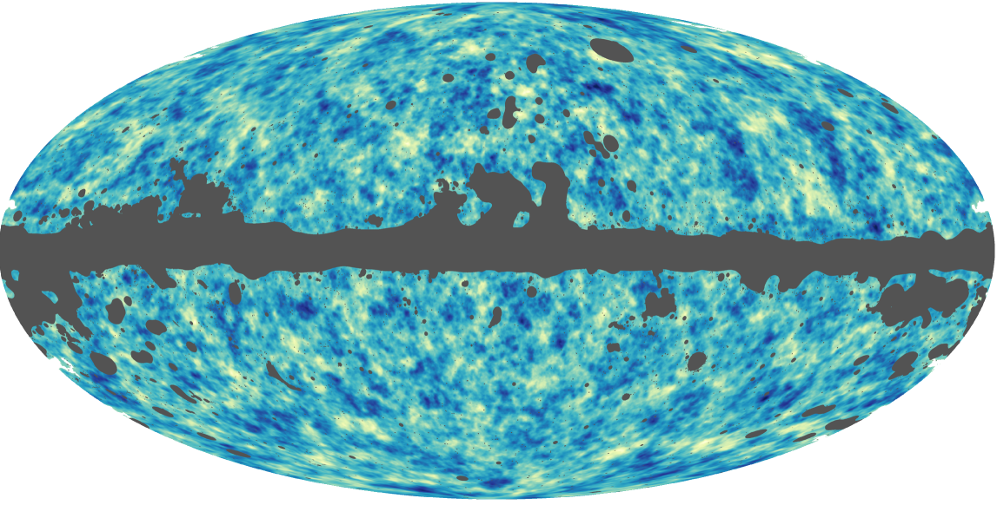


Effects and uses of CMB lensing
Antony Lewis
cosmologist.info

Slide 2
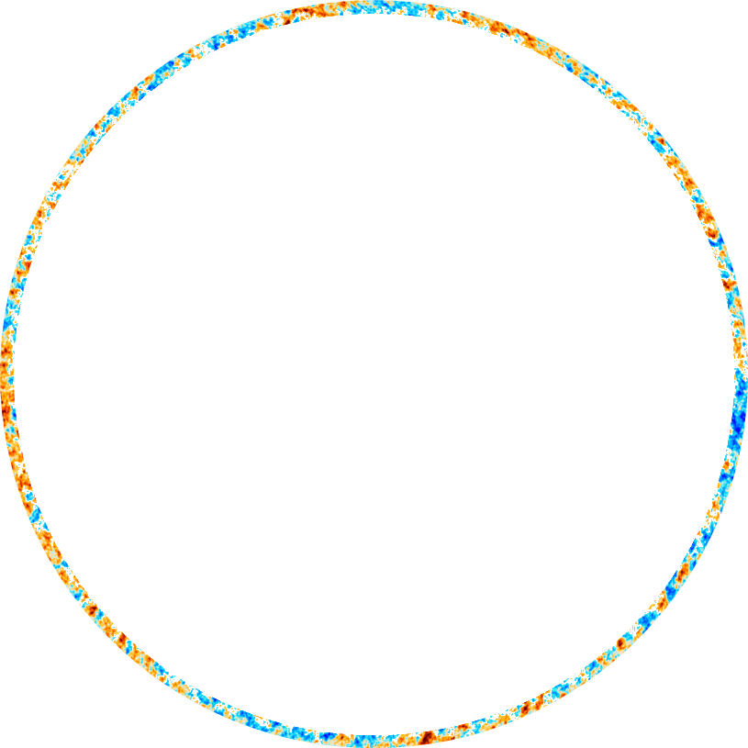
Linear CMB Anisotropies

Slide 3
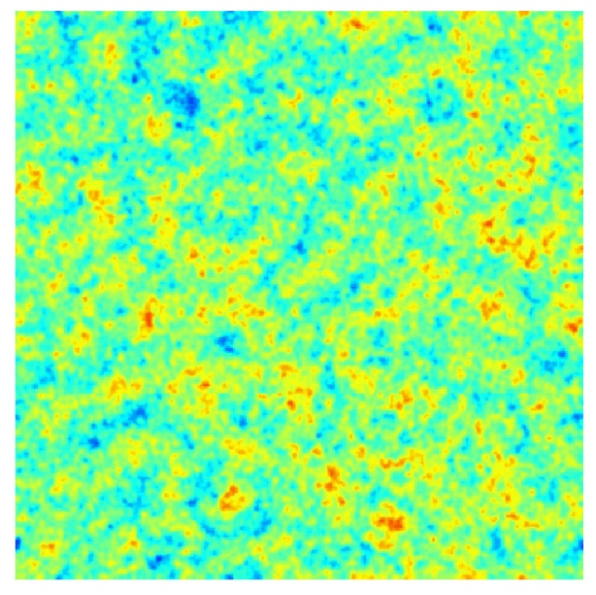
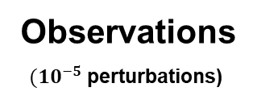
Observed CMB power spectrum
Planck 2018
arXiv:1807.06209
TE
TT
+
EE
Observations
$(10^{−5}$ perturbations)
Assume model, constrain parameters
Linear perturbation theory very accurate: given a model, can calculate to high precision

Slide 4
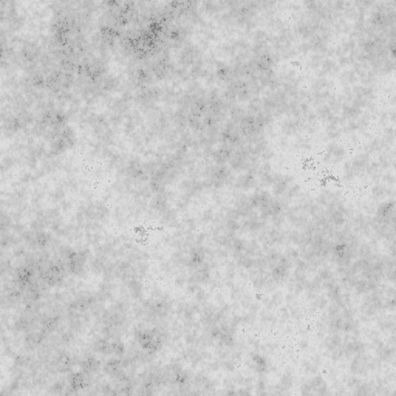
CMB Lensing: 1st order light propagation
Spatially varying gravitational potentials: high-$z$ kernel, mostly linear
(perturbations here not to scale)

Slide 5



Lens remapping approximation: deflection angle $α$
Deflection related to shear $γ_{i}$ , convergence $κ$, and rotation $ω$
$$κ$$
Convergence
$$γ$$
Shear
$$ω$$
Rotation
Rotation $ω=0$ from scalar perturbations in linear perturbation theory
$$ω=0⇒α=∇φ$$

Slide 6
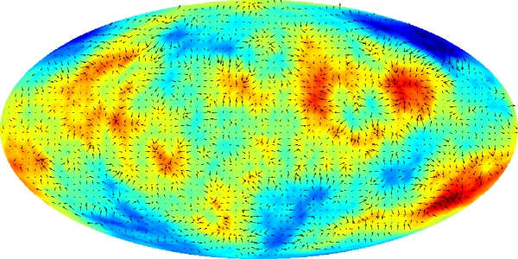




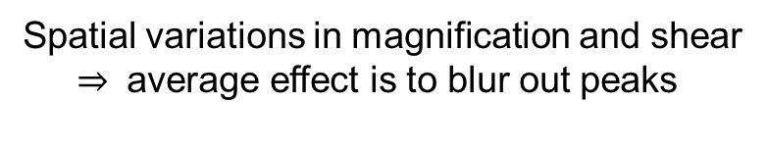
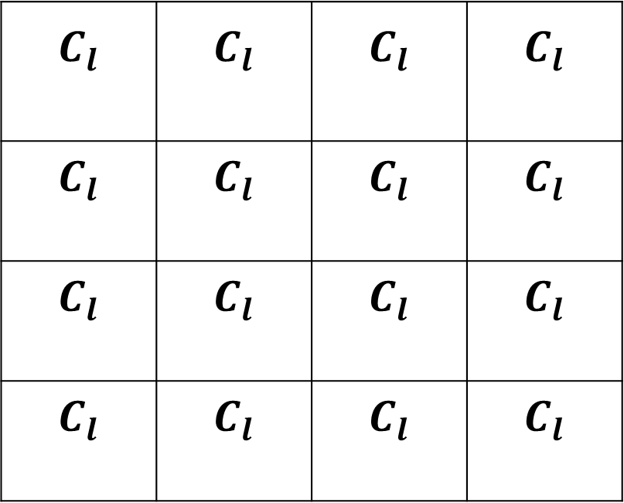
Lensing Magnification and Shear
$$C_{l}$$ | $$C_{l}$$ | $$C_{l}$$ | $$C_{l}$$
$$C_{l}$$ | $$C_{l}$$ | $$C_{l}$$ | $$C_{l}$$
$$C_{l}$$ | $$C_{l}$$ | $$C_{l}$$ | $$C_{l}$$
$$C_{l}$$ | $$C_{l}$$ | $$C_{l}$$ | $$C_{l}$$
Spatial variations in magnification and shear
$⇒$ average effect is to blur out peaks

Slide 7
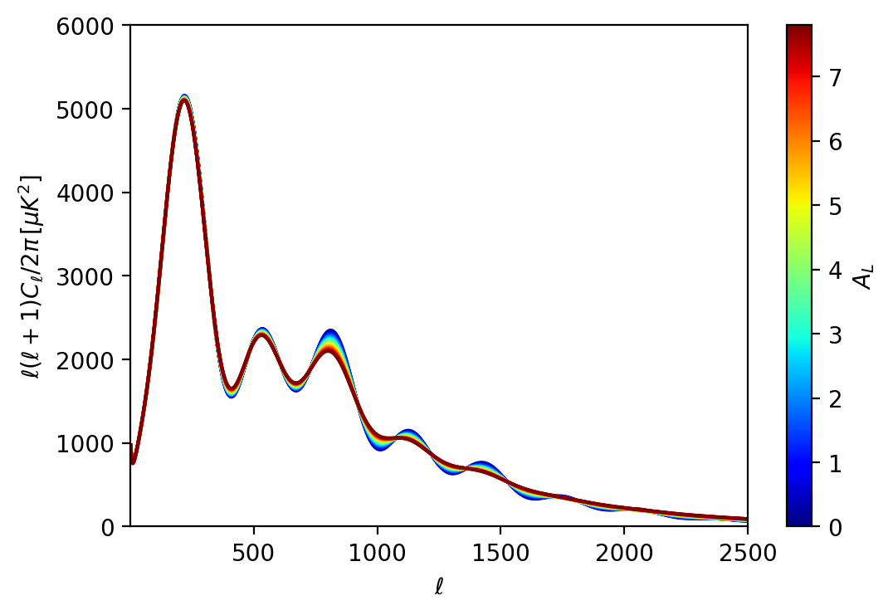
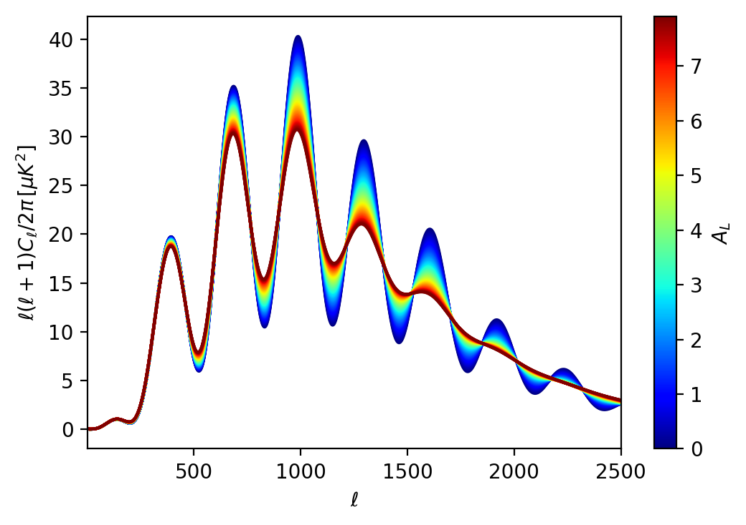
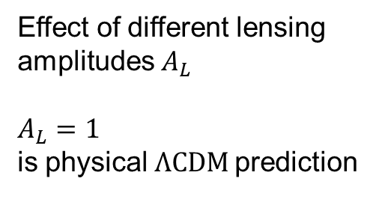
Lensing power smoothing
TT
Effect of different lensing
amplitudes $A_{L}$
$A_{L}=1$
is physical $ΛCDM$prediction
EE

Slide 8
Lensing reconstruction (concept)
$$C_{l}$$ | $$C_{l}$$ | $$C_{l}$$ | $$C_{l}$$
$$C_{l}$$ | $$C_{l}$$ | $$C_{l}$$ | $$C_{l}$$
$$C_{l}$$ | $$C_{l}$$ | $$C_{l}$$ | $$C_{l}$$
$$C_{l}$$ | $$C_{l}$$ | $$C_{l}$$ | $$C_{l}$$
Measure spatial variations in magnification and shear
Use assumed unlensed spectrum, and unlensed statistical isotropy

Slide 9
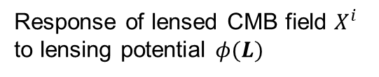


Lensing reconstruction (some maths)
Response of lensed CMB field $X^{i}$
to lensing potential $φ(L)$
$$⇒$$
Quadratic estimator
Reconstruction noise
$$=\frac{N{\left(L\right)}^{−1}}{2}$$
Maniyar et al. arXiv: 2101.12193

Slide 10
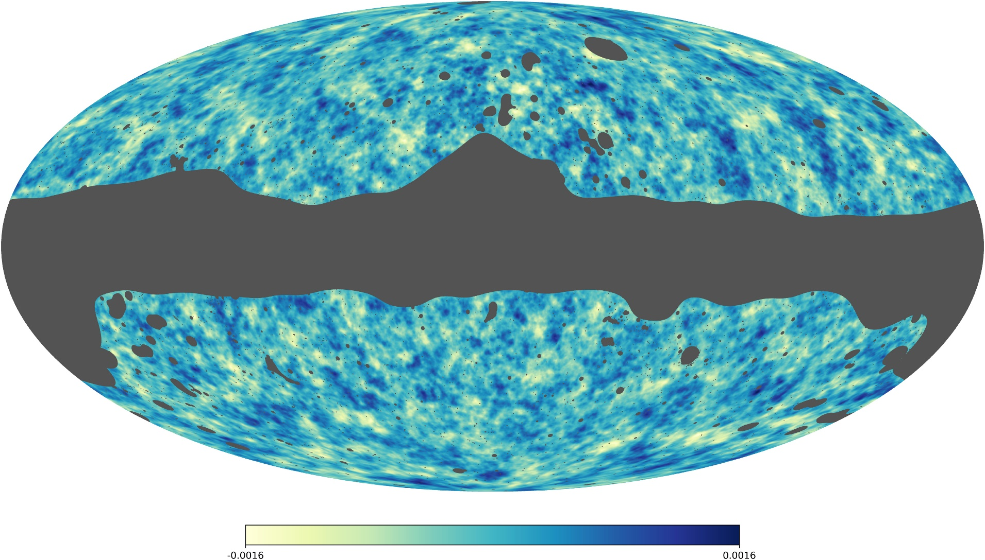
Map of the gradient-mode lensing
Planck Lensing 2018 arXiv:1807.06210

Slide 12

Lensing reconstruction $⇒$tightly constrains lensing smoothing on CMB spectra
(or delens)
Lensing well-measured
independently of theory
Early-$ΛCDM$constraints
Thanks: Pablo Lemos
$Ω_{b}h^{2}, Ω_{c}h^{2}, n_{s}, A_{s}e^{−2τ} , θ_{∗}$
constrained (almost) independently of late-time physics, e.g. dark energy/MG

Slide 13
PR4 (NPIPE) Planck reanalysis
NPIPE: 2007.04997 (Planck, Reijo Keskitalo et al.)
8% more data from repointing manoeuvres
Processing improvements
(slightly) lower noise and lower systematics
+ new sets of detector-split (A/B) maps for power cross-spectra rather than half-mission; more sims
Lensing smoothing
from CMB spectra
Rosenberg, Gratton, Efstathiou
arXiv: 2205.10869

Slide 14
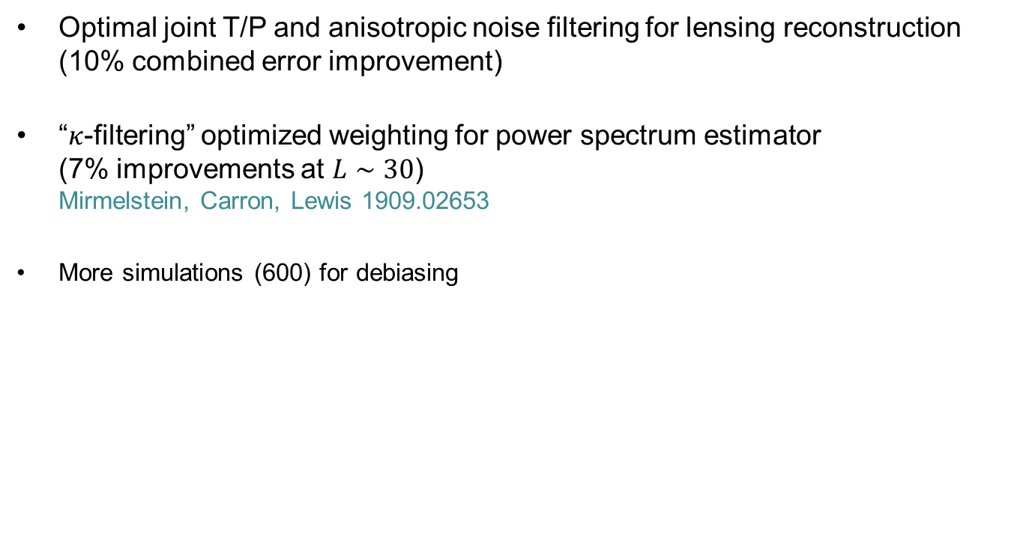
PR4 lensing reanalysis
Carron, Mirmelstein, Lewis 2022
Optimal joint T/P and anisotropic noise filtering for lensing reconstruction (10% combined error improvement)
“$κ$-filtering” optimized weighting for power spectrum estimator
(7% improvements at $L∼30$)
Mirmelstein, Carron, Lewis 1909.02653
More simulations (600) for debiasing
Quasi-local lensing
reconstruction noise map

Slide 15
Errors improved by 10-20%

Slide 16

Possible anomalies revisited
Lensing rotation (curl) – null test for Planck
Low Multipoles
$$L$$

Slide 17
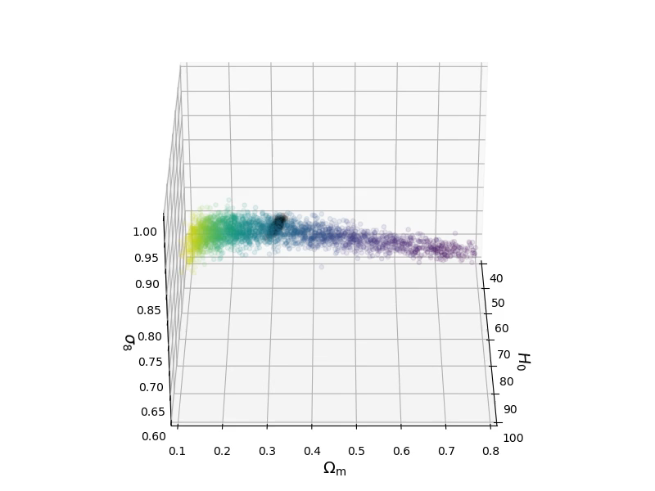
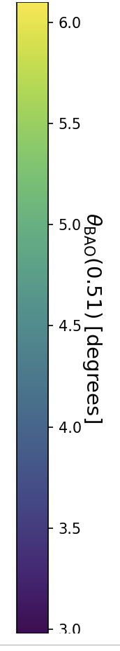


$ΛCDM$ (lensing priors)
lensing only
2018 TTTEEE+lowE
$$θ_{BAO}\left(0.51\right)≡r_{d}/D_{M}(z=0.51)$$

Slide 18

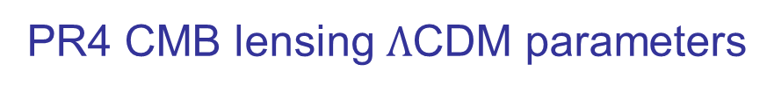
PR4 CMB lensing $Λ$CDM parameters
PR4 lensing
+ BOSS BAO (+$Ω_{b}h^{2}$ prior)
(“Lensing-only” priors: $Ω_{b}h^{2}=0.02233±0.00036,$ $n_{s}=0.96±0.02, 0.4<h<1$)

Slide 19
(Rosenberg, Gratton, Efstathiou 2022)
$σ_{8}Ω_{m}^{0.25}=0.599±0.16$ (c.f. PR3: $σ_{8}Ω_{m}^{0.25}=0.589±0.$20)
CMB lensing + BAO inverse distance ladder (with $Ω_{b}h^{2}$ prior from abundance measurements)
$σ_{8} =0.814±0.016$, $H_{0}={68.1}_{−1.1}^{+1.0} km s^{−1}{Mpc}^{−1}, Ω_{m}={0.313}_{−0.0186}^{+0.014}$
Best joint constraint:

Slide 20
Similar pipeline with PR4 data gives new $τ_{NL}$ constraint $τ_{NL}$< 1700 (95%)
arXiv: 2205.14408

Slide 21
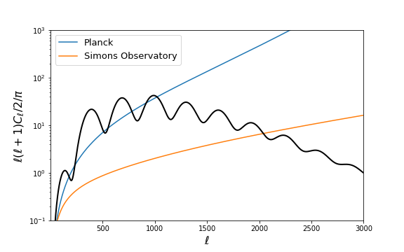
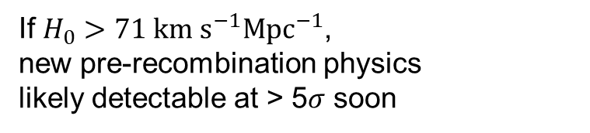
High resolution/sensitivity polarization:
precision small-scale EE, TE, TT power spectrum
EE polarization noise
+ ActPol, SPTpol (now)
+ CMB-S4 (beyond)
e.g. Poulin et al. early dark energy model
If $H_{0}>71 km s^{−1}{Mpc}^{−1}$,
new pre-recombination physics
likely detectable at > 5$σ$ soon

Slide 22
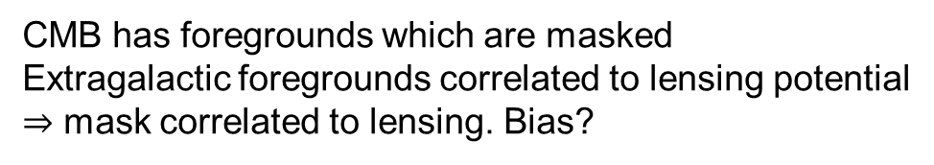
Effect of CMB lensing on the masked CMB
Fabbian, Carron, Lewis, Lembo: arXiv 2011.08841
CMB has foregrounds which are masked
Extragalactic foregrounds correlated to lensing potential
$⇒$ mask correlated to lensing. Bias?

Slide 23
Scale-dependent demagnification

Slide 24
Limiting case: foreground $∝κ,$ peak threshold mask

Slide 25
Fortunately much smaller for Poisson point sources
Can also check empirically that bias should be negligible for Planck

Slide 26
Mask bias on lensing reconstruction
Lembo, Fabbian, Carron, Lewis: 2109.13911
Bias small as long as you use optimal filtering ($∼$ optimal PS mask inpainting)

Slide 27



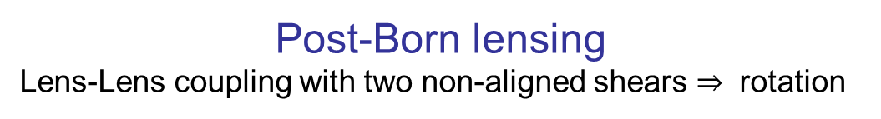
Post-Born lensing
Lens-Lens coupling with two non-aligned shears $⇒$ rotation
+
=
$$ω$$
+ $κ+ γ$
Q: Can we also detect the rotation??
Work with Mathew Robertson
(warning: all super preliminary!)
Pratten & Lewis: arXiv:1605.05662

Slide 28
Making a rotation template from LSS tracers
‘lens-lens’ like quadratic
combination of LSS tracers
Normalization equivalent to cross-correlation $r^{2}$ between estimator and truth:
Parity-odd rotation-LSS-LSS bispectrum
e.g. $a^{i}=δ\left(z_{i}\right);$ no shot noise and many slices $⇒$perfect $ω$ template

Slide 29
Flat sky approximation: post-Born rotation-tracer bispectrum

Slide 30
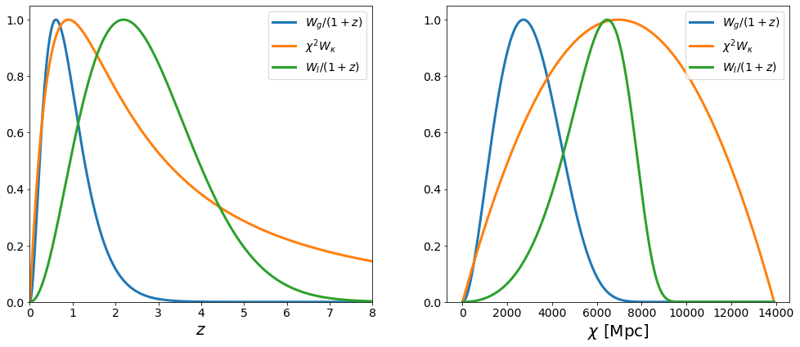

Possible LSS tracers
Lensing reconstruction $κ$
Cosmic Infrared Background (CIB, $I$)
Galaxy surveys, e.g. (LSST, $g)$
Etc..

Slide 31
Preliminary!
Fisher forecasts for detection sigma
Separate estimators
Optimally combined
c.f. ideal limit
Can also split galaxies into multiple tomographic bins; only modest gains.
Credit: Mathew Robertson

Slide 32
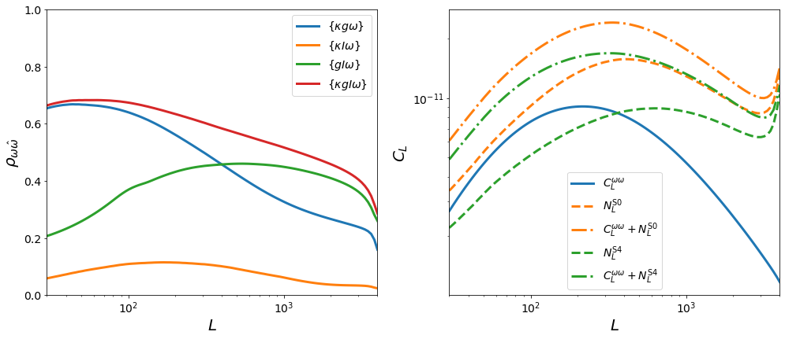
SO-LSS template correlation
SO/S4 template noise
Credit: Mathew Robertson

Slide 33
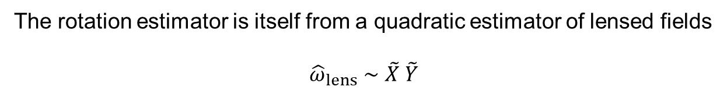
Complications
The rotation estimator is itself from a quadratic estimator of lensed fields
$${\hat{ω}}_{lens}∼\tilde{X} \tilde{Y}$$
Lensed fields have leading lens-dependent terms:
Gaussian bias:
where:
Preliminary calculation suggests important but not dominant

Slide 34

Complications
If $κ$ is also used as a tracer, many more possible bias contractions
Probably best estimated and tested on simulations
+ other biases
Work ongoing… but rotation ‘likely‘ detectable at high significance

Slide 35
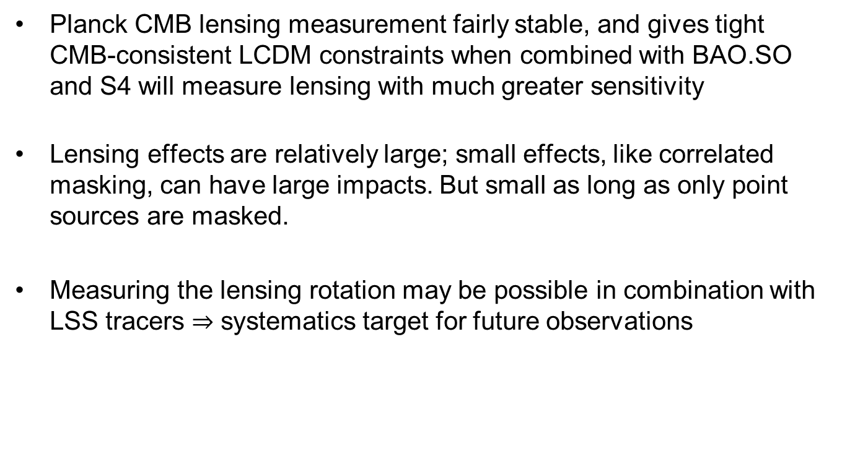
Conclusions
Planck CMB lensing measurement fairly stable, and gives tight CMB-consistent LCDM constraints when combined with BAO.SO and S4 will measure lensing with much greater sensitivity
Lensing effects are relatively large; small effects, like correlated masking, can have large impacts. But small as long as only point sources are masked.
Measuring the lensing rotation may be possible in combination with LSS tracers $⇒$ systematics target for future observations

